Slide 1
Avalara Sales Tax Interface
Carol Santee
Vice President of R&D

Slide 2
National Sales Tax Issue
Collecting sales tax for other state was only an issue for big corporation
physical presence rule
Ecommerce breaks this rule (Amazon)
Distribution center at Las Vegas. Sell to California customers without sales tax.
Unfair for brick & mortar stores.
2018 decision - S. Dakota vs. Wayfair
You need to collect sales tax for other states regardless of physical presence.
This is too complicated due to all the taxing jurisdictions - hence opportunity for Avalara

Slide 3
The Big Unknown
What if I only sell to resellers?
How do you prove the resellers status?
Do you collect digital copy of the resellers license?
Other states can still audit you.
Will they pick on you for your proofing process of resellers status?
We do not know if you need to worry national sales tax reporting issue. This is something you should watch out.

Slide 4
Avalara Sales Tax Integration
Elliott previously supported Vertex for national sales tax collection. Elliott V8.6 favors Avalara over Vertex. Existing Vertex users should plan to migrate to Avalara.
Avalara solution is cloud based.
Integration allows you to track tax liabilities and validate shipping addresses with rooftop accuracy across more than 13,000 U.S. tax jurisdictions.
Product taxability supported at the item, product category, and user defined code level.
Tax exemptions are supported at the customer, ship-to and customer type levels.

Slide 5
Elliott System Requirements
Relational Database Support
Report Desk
PowerSearch
AvaTax Online Account from Avalara
Avalara Sales Tax Interface License from Netcellent
Running Version 8.6

Slide 6
Elliott System Requirements
Avalara only works with V8.6. Avalara related programs cannot be run under V8.5.
Applications with a user interface will provide the user with an error message informing them the application must be run under V8.6.

Slide 7
Elliott System Requirements
Printing and posting applications will print an error message on the report output.
Applications not related to Avalara can still be run under V8.5 or V8.6.

Slide 8
Elliott System Requirements
Conversion is required to use the Avalara interface.
Database conversion to use alpha document number. You can still use numeric values.
System will assign new tax codes in customer, ship-to, and order tables. This is a one-way conversion.

Slide 9
Elliott System Requirements
Conversion of your live company at month or quarter end
Taxes are normally reported to states on a quarterly or monthly basis
This allows for a clean cut-over
Post all existing invoices to Accounts Receivable
All existing invoice that have taxes calculated using the old Elliott method must be posted before the conversion

Slide 10
Elliott System Requirements
Consider setting up a sandbox testing environment
Integration takes a lot of setup and training before you start using it
Create a copy of your database for testing
Create an Avalara sandbox account with the same features as your production environment

Slide 11
Avalara Design Principles
Elliott uses attributes to store additional data
_AVATAXSNAPSHOT - Snapshot of order from initial communication with Avalara from either Address validation or tax calculation
_AVATAXFINAL - Final tax calculation order info
_USECODE - Tax exemption reason
_GOODSERVICES - Avalara tax code
_TAXBREAKDOWN00 - Tax breakdown for each jurisdiction at the order and line item level
_CALCAVALARA - Stores address validation info

Slide 12
_AVATAXSNAPSHOT Attribute
The _AVATAXSNAPSHOT attribute is attached to orders to record the ship-to address and the order, miscellaneous charges, and freights amounts when taxes are calculated for the order. For example, if a preauthorization is performed during order entry, tax are calculated before the payment screen is shown. If an item is added to the order or the quantity shipped is changed before the pick ticket is printed, taxes will need to be recalculated for the order because the order amount has changed.

Slide 13
_AVATAXFINAL Attribute
The _AVATAXSNAPSHOT attribute is attached to the order to record the ship-to address and the order, miscellaneous charges, and freights amounts on the order when taxes are calculated for the invoice. Once the invoice is posted to Accounts Receivable, this attribute is attached to the invoice in history.

Slide 14
Avalara Design Principles
Simple User Interface
Use and tax codes are stored in attributes so the user doesn’t notice a user interface difference.
Use codes indicate why a customer/ship-to is non-taxable. The code can be setup at the customer type and inherited or overridden at the customer and ship-to.
Tax codes indicate types of items. The code can be set up at the product category and user defined codes and inherited or overridden at the item level.

Slide 15
_USECODE Attributes
The _USECODE attribute is attached to Ship-To and Customer records to indicate the reason why a customer is non-taxable. They can be inherited from the customer type as well. For example, if all of your non-taxable customer are grouped by the customer type DISTR, you would attach the attribute to the customer type and it would apply to all customers with that customer type.

Slide 16
_USECODE Attributes
The use codes are provided by Avalara. They can be downloaded from the Avalara Utility option under System Utilities. You are able to search for the appropriate use code using a PowerSearch from the attribute maintenance screen.

Slide 17
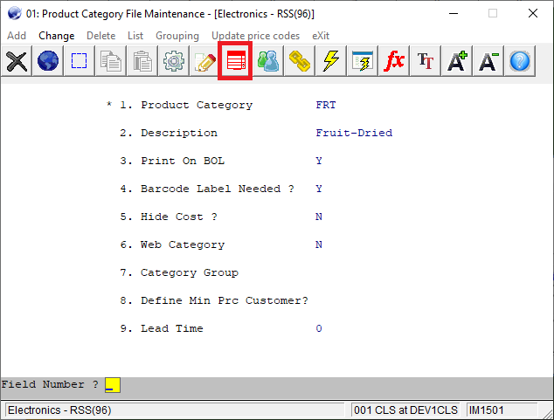
_GOODSERVICES Attributes
The _GOODSERVICES attribute is attached to a product category, user defined code, or an item. An item will inherit a tax code from its product category or user defined code. A default tax code is also defined in Global Setup. This code specifies what type of an item this is and this code is used by Avalara to determine the taxability of the item.

Slide 18
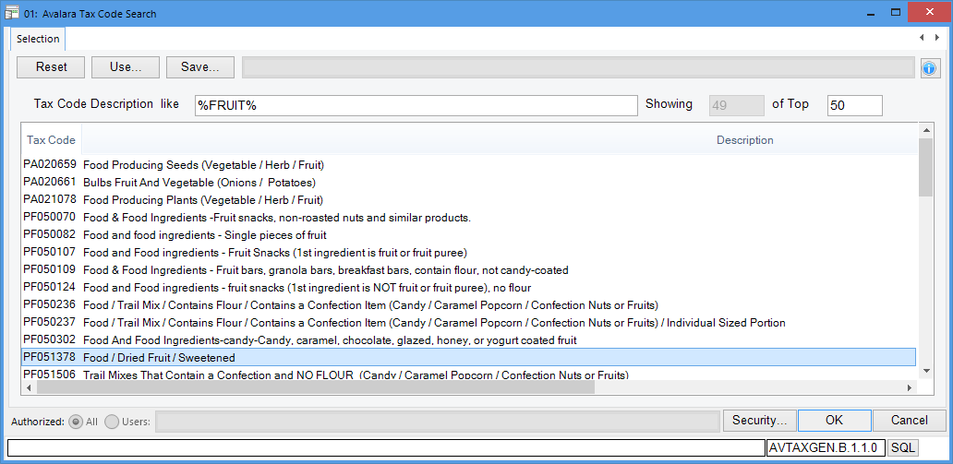
_GOODSERVICES Attributes
The taxes codes are provided by Avalara. They should be downloaded on a regular basis from the Avalara Interface option under System Utilities. You are able to search for the appropriate tax code by description using a PowerSearch from the attribute maintenance screen.

Slide 19
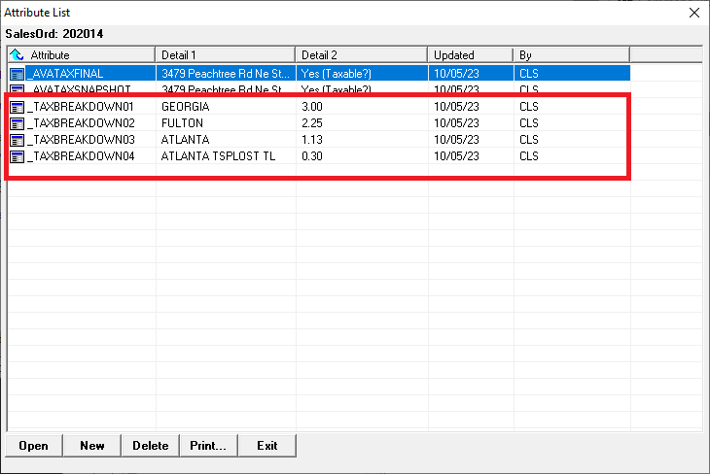
_TAXBREAKDOWN Attributes
When taxes are calculated the amounts for each taxing jurisdiction are stored in the _TAXBREAKDOWN attributes. These amounts are saved at the order header and the order line item levels.

Slide 20
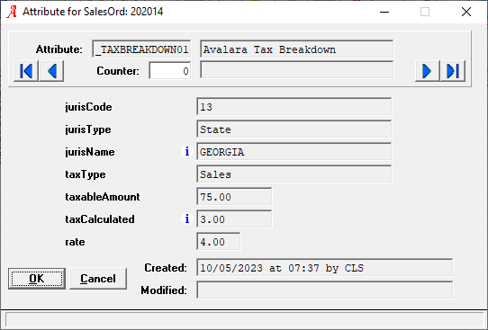
_TAXBREAKDOWN Attributes
Here’s an example of the _TAXBREAKDOWN01 attribute showing the state tax amounts calculated for the order for the state of Georgia.

Slide 21
_CALCAVALARA Attribute
The _CALCAVARA is created for customer, ship-to and drop ship order addresses. Elliott Zip Checked indicates whether the zip code is on file in the Elliott zip codes table. Avalara Addr Checked indicates if the address has been validated by Avalara.

Slide 22
Avalara Design Principles
Avalara taxes are only calculated in COP
A/R Sales and Cr/Dr Memo Processing will force tax amounts 1, 2, and 3 to be zero.
Avalara tax calculations require line item detail not available in Accounts Receivable.

Slide 23
Avalara Design Principles
A message is shown explaining that A/R does not support taxes.

Slide 24
In the Case of an Internet Outage
Elliott needs to continue to operate if an internet connection is unavailable. Tax rates by zip code should be downloaded on a monthly basis to be used to estimate taxes.

Slide 25
In the Case of an Internet Outage
Elliott uses a separate step commit to Avalara so posting Invoices does not commit the transaction. This is to avoid a crash during invoice posting. A tax queue captures the transactions that need to be committed.

Slide 26
In the Case of an Internet Outage
If there is no internet connection available, the entire process can run using the estimated tax rates. The reconciliation report computes the difference between the estimated and actual amounts when an internet connection can be re-established and the document committed to Avalara.

Slide 27
Avalara Design Principles
Applications with a user interface, such as Order Entry and Sales Desk, will calculate taxes using estimated tax percentages since the order may still be subject to change.

Slide 28
Avalara Design Principles
Address Validation
At the time of order creation, it is important that the order ship-to address is validated. This can be done during entry if address validation is enabled for drop ship orders.
If address validation is enabled, it is available in Customer File Maintenance, Ship-To File Maintenance, Order Entry, Sales Desk, Recurring Order Entry, etc.
If address validation is not enabled, the address will not be validated until Avalara is called to calculate taxes. A bad address can cause a tax calculation error.

Slide 29
Address Validation
If address validation is enabled, address validation is available in Customer File Maintenance, Ship-To File Maintenance, Order Entry, Sales Desk, Recurring Order Entry, etc.

Slide 30
Address Validation
If you accept the proposed address change, the change is applied to the record you are editing. in this example, note the tax codes for the customer. They are the customer’s state plus a “1” for the state tax code, plus “2” for the county/district tax, and plus “3” for the city tax.

Slide 31
Elliott Tax Code Changes
During the conversion tax codes 1, 2 and 3 will be replaced in the Customer, Ship-To and Order Header files. For example the following tax codes will be created a customer or order with a state of California:
CA1 - California
CA2 - CA county and district tax. This does not refer to a specific county.
CA3 - CA city tax. It does not refer to a specific city.

Slide 32
Elliott Tax Code Changes
CA2 and CA3 area place holders and do not represent any specific taxing jurisdiction. The tax percent on file is not used. The initial estimated taxes for an order are based upon rates that are downloaded from Avalara on a monthly basis.

Slide 33
Elliott Tax Code Changes
Updating Avalara tax rates will also update the tax type in the state file. This information is updated based on the information provided in the Admin section of the Avalara portal. These flags will affect how Elliott estimates taxes since the sales tax rate and the use tax rate can be different.

Slide 34
Avalara Design Principles
When Avalara Is Called to Calculate Taxes
Taxes will be calculated from the billing screen if entering a payment amount. This is done so an accurate tax amount is available when pre-authorizing or charging credit cards.
Otherwise, taxes will be calculated when the pick ticket is printed since this action implies that the order is going to be shipped.
Typically, additional costs like freight and miscellaneous charges are added to the order after the picking ticket is printed. Also, items may be backed order and the order total amount adjusted. These amounts can also affect the final tax amount.
The final tax calculation occurs when invoices are printed.
Orders will be placed on hold if any issue is encountered calculating taxes.
Held orders should be released through the Credit Check and Release application.

Slide 35
Avalara - Best Practice
Consider setting up a sandbox testing environment
Integration takes a lot of setup and training before you start using it
Create a copy of your database for testing
Create an Avalara sandbox account with the same features as your production environment

Slide 36
Questions & Answers

