Slide 1
EDI Processing & Shopify
Mark DeShazo
Support Manager

Slide 2
Elliott SPS Services (ESS)
Netcellent has partnered with SPS Commerce to create an EDI solution.
Netcellent created ESS to map SPS standardized XML files to and from Elliott text and CSV files.
Netcellent makes sure the data on the Elliott end is correct and SPS makes sure the data on the EDI end is correct.

Slide 3
Why the change to SPS?
Problem:
The future of our legacy software tools (ECS & Delta) is uncertain.
The legacy EDI solution requires a high level of maintenance.
Solution:
SPS is an EDI industry leader.
Changes to EDI specifications and communication can be maintained by SPS.
Notes:
We began using ECS and Delta in 2001 when it was owned by Softshare in Santa Barbara. The company was sold several years ago and has changed hands several times.

Slide 4
Division of Expertise
Netcellent
ERP (Elliott)
ESS (Elliott SPS Services)
Mapping (XML <-> Text Documents)
Communication (SFTP, FTP, Email)
SPS
EDI
Communication (AS2, SFTP, Mail Box)
Fulfillment Web Portal (Web Form)
Mapping (EDI & other formats <-> XML)
Handle EDI changes by trading partners

Slide 5
What changes are required?
Sales Order Import and Sales Order Export are still used in the same manner.
You can still receive email notifications.
Extra data can be stored in Attributes instead of or in addition to Notes.

Slide 6
What are the benefits of ESS?
Unassigned EDI data is stored in Attributes that can be returned in the outbound documents.
You are not required to maintain an EDI server and the software.
Transactions are more visible through the SPS Fulfillment Monitor.
Exceptions can be processed through the Fulfilment portal.

Slide 7
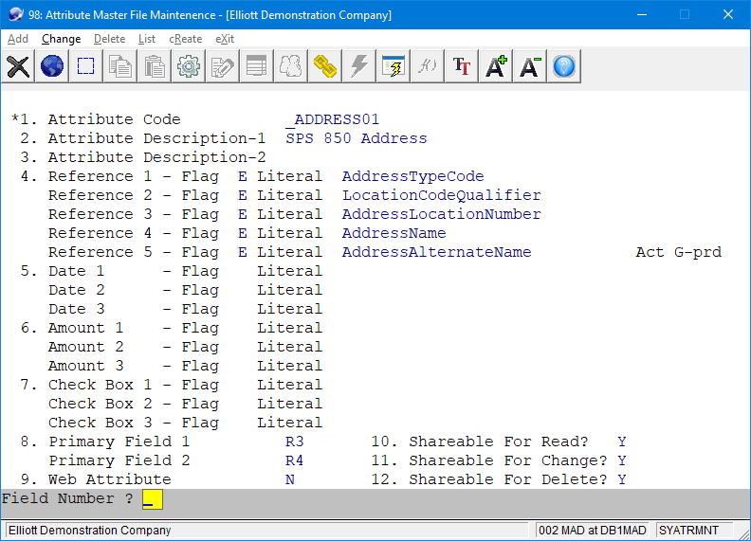
Attributes
Notes:
SPS Attributes begin with an underscore (_).

Slide 8
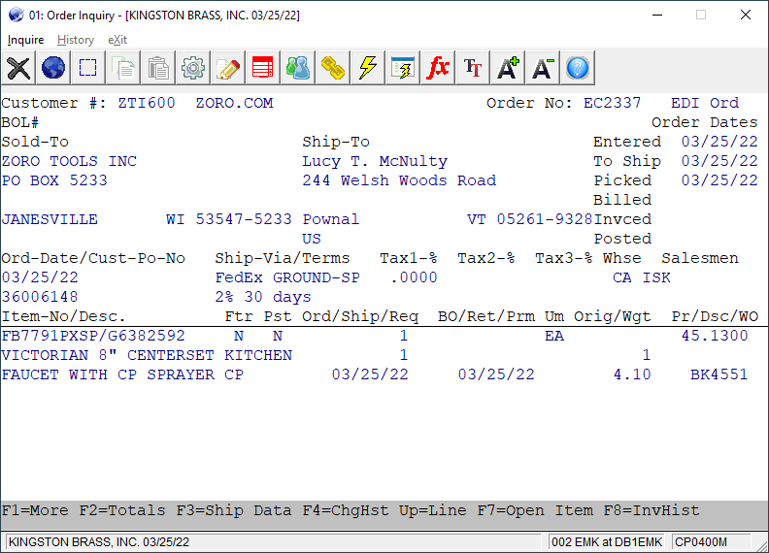
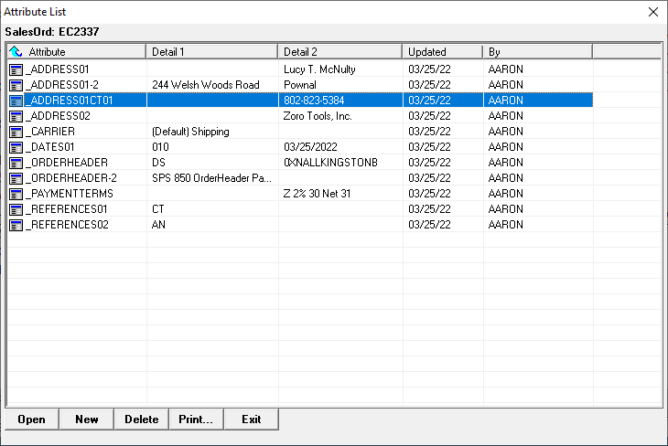
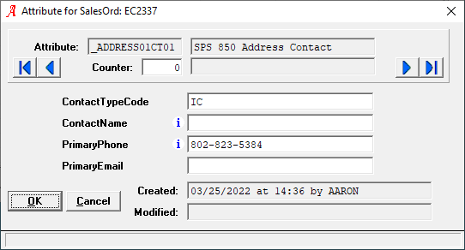
EDI Attribute sample
Notes:
The Elliott order header doesn’t have a contact phone number, so it is saved in an Attribute. All imported EDI data not stored in the Elliott order header or line items are stored in Attributes and Notes so they are available to the outbound documents.

Slide 9
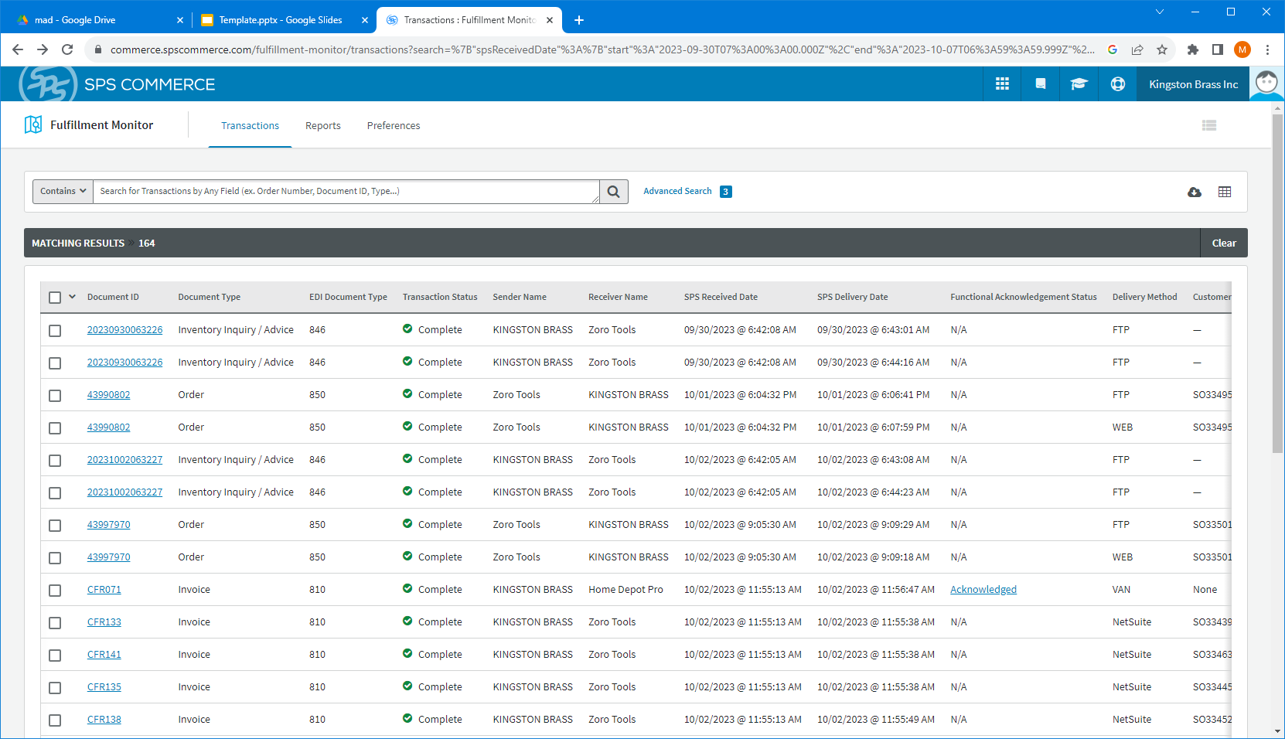
SPS Fulfillment Monitor
Notes:
Fulfillment Monitor allows you to see all the EDI traffic and the status. The Fulfillment portal is rarely used in this configuration, but when Integration has problem and you have a deadline you can manually process EDI transactions. This was not possible with our previous legacy solution.

Slide 10
Other benefits
Low entry level price.
SPS offers an entry-level solution through the Fulfillment portal.
Integration with ESS is a step up in price, but a step up in automation.
More support available through SPS.
More visibility and control over the transactions with Fulfillment Monitor.

Slide 11
How does it work?
SPS directly communicates with the trading partner or their VAN.
Incoming data is translated and provided to our system via SFTP in an XML format.
We use the XML to create an import file and place the file via FTP in the import folder.
Outbound is just the reverse.

Slide 12
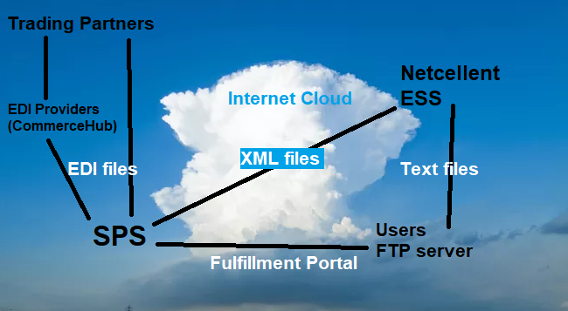
Data flow in the cloud

Slide 13
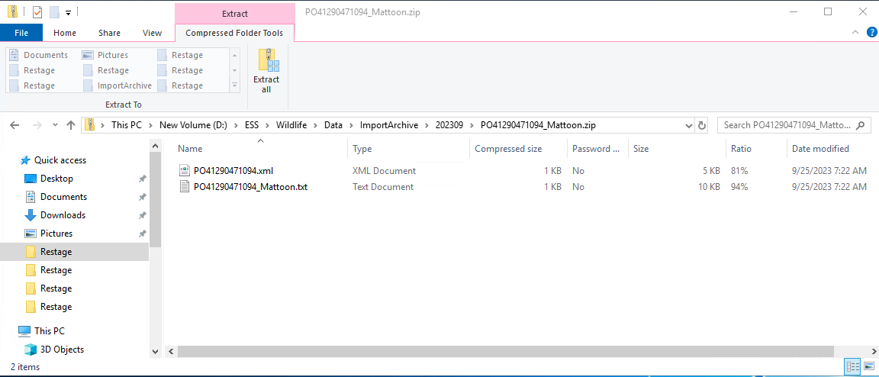
Received orders
The XML file and import file are archived on our server for future reference.

Slide 14
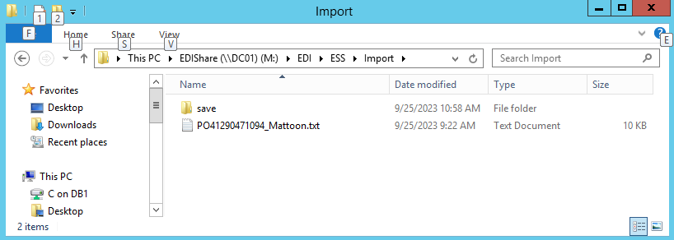
Import files are transferred to the customer’s server
The import file is named for the document type and trading partner.
The FTP runs every 15 minutes.

Slide 15
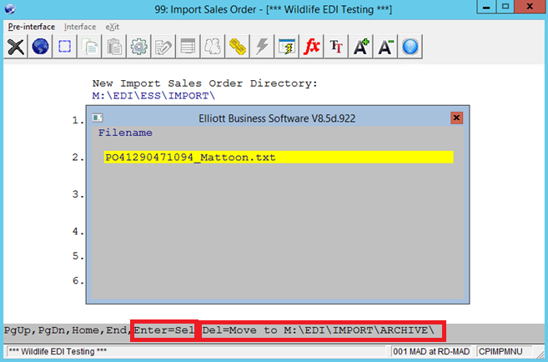
Sales Order Import
The file can be imported or archived.
Notes:
Question: While it is convenient to use the Delete key to move import files to the archive folder, what other benefits you can think of?

Slide 16
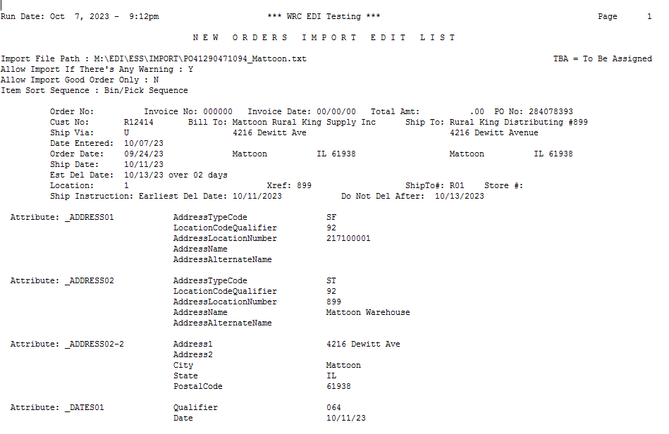
SO Import with Attribute data

Slide 17
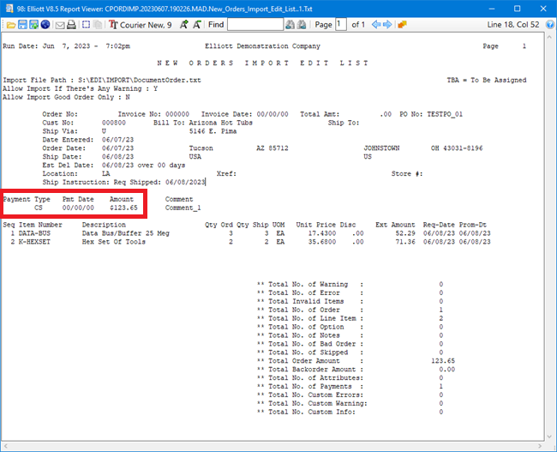
Payment data can now be imported to support eCommerce

Slide 18
Build EDI data in Elliott
Shipment Verification builds ship data that is used to create advanced ship notices and UCC labels.
Ship Data Update allows the tracking number to be entered when other methods are unavailable.
The VICS Bill Of Lading can be used for truck shipments and to generate UCC labels.

Slide 19
Export EDI data
The EDI Profile can be configured to generate order acknowledgements (855) during order import.
Order Ship Data Export can be used to create advanced ship notices (856).
Order Invoice Export can be used to create EDI invoices (810).
Export Processor can be used to create an inventory feed (846).

Slide 20
eCommerce
eStore will be discontinued, but Web Services will continue be supported for custom websites.
Other solutions are easier to use and more affordable:
Through your trading partner’s website
Amazon - Seller Central
Shopify

Slide 21
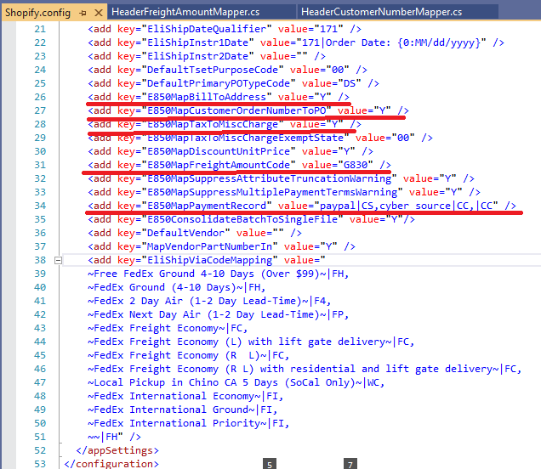
Many fields and flags were added to ESS to support Shopify
Notes:
Mapping for a new trading partner can be difficult. Since Shopify is an eCommerce site, they send data we normally do not process, like payments, the freight amount, and sales tax. The shipping method is also more complex.

Slide 22
Shopify advantages
It is easy to build content.
There are several tools available.
SPS has interface with Shopify to order through ESS and import SO into Elliott.
Tracking numbers can be uploaded into Shopify via CSV.
You have control over the look of your website.

Slide 23
