Slide 1
Elliott 8.6 Other Features (1)
Edward M. Kwang
President

Slide 2
Document Notes
Purpose: For employees or supervisors to document procedures for each task
What happens if only one person knows how to do a certain thing?
Location of NOTE.BTR
<ElliottRoot>\Note.btr – Doc Notes
<ElliottRoot>\Data\Note.btr – Regular Notes
Doc Notes are shared with all companies

Slide 3
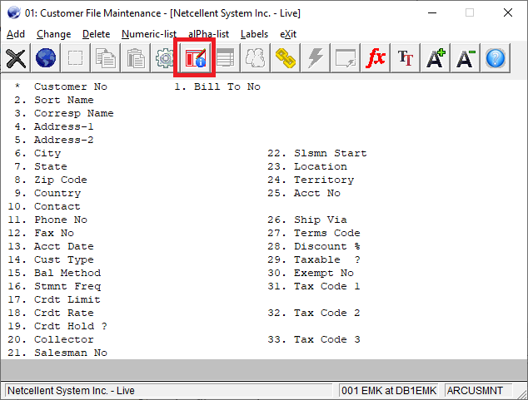
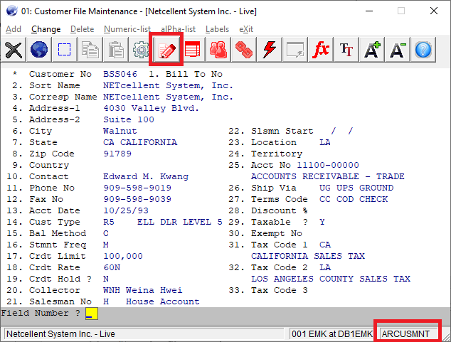
Document vs Regular Notes Icon
Notes:
The icon color – Red means it is hot. There are document notes defined.

Slide 4
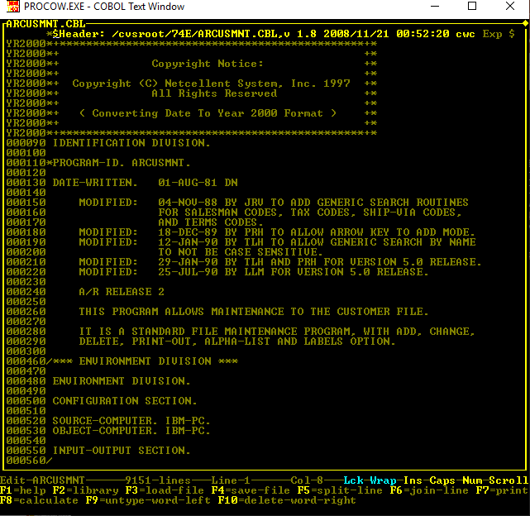
Task Name - ARCUSMNT

Slide 5
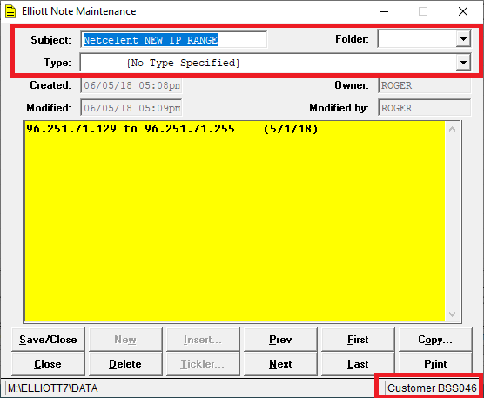
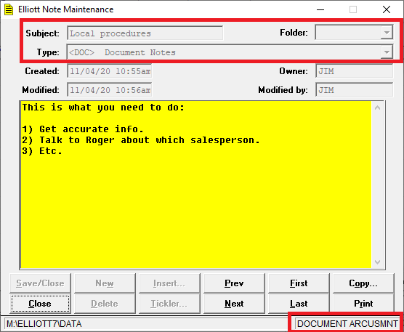
Document vs Regular Notes

Slide 6
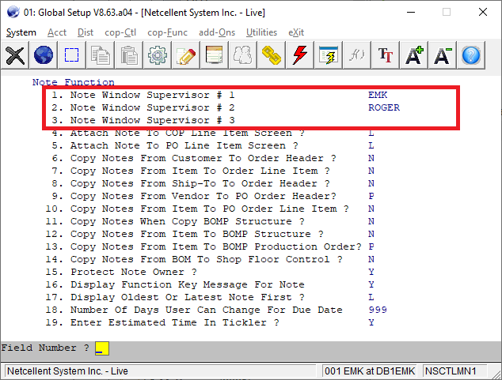
Note Security in Global Setup

Slide 7
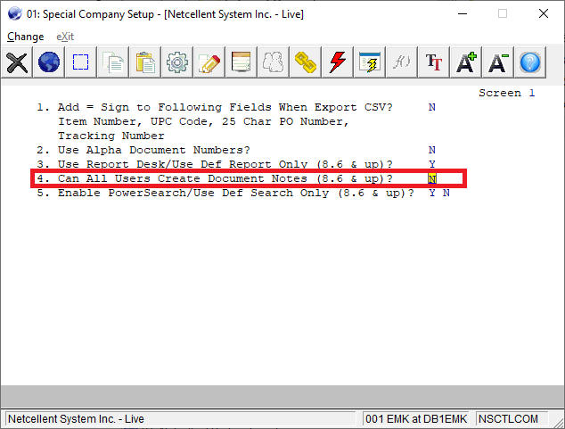
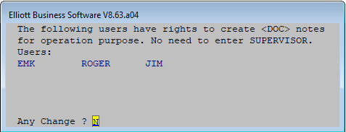
User Who Can Create Doc Notes Global Setup -> System -> Company Specialized Control
Notes:
Elliott user SUPERVISOR always has the right. In addition user EMK, ROGER and JIM has the right to define document note.

Slide 8
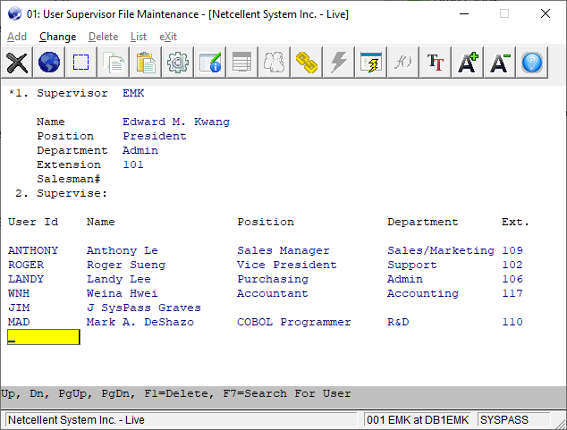
Supervisory Relationship Allow to Delete or Modify Someone Else’s Notes

Slide 9
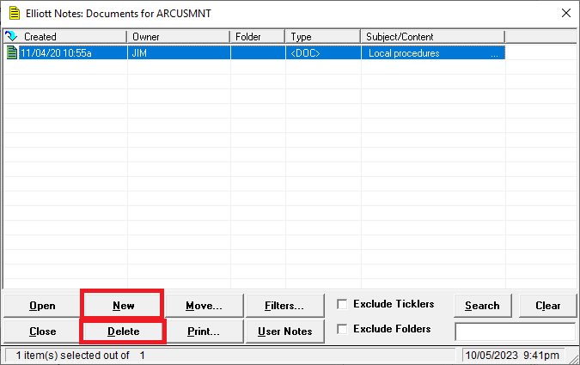
Has Right to Create & Delete Doc Notes

Slide 10
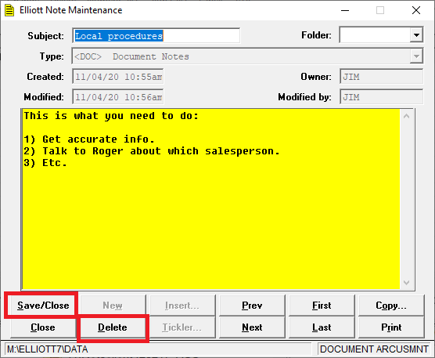
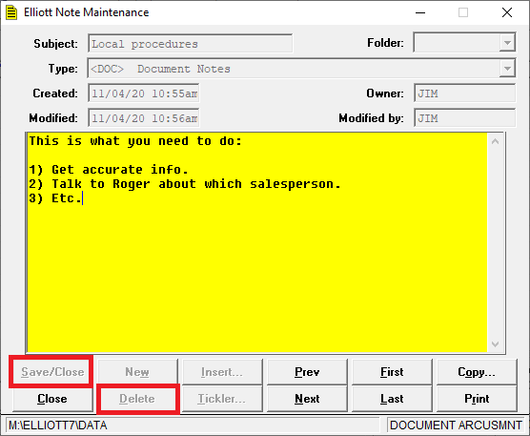
Has Right vs No Right to Modify Someone Else’s Doc Note

Slide 11
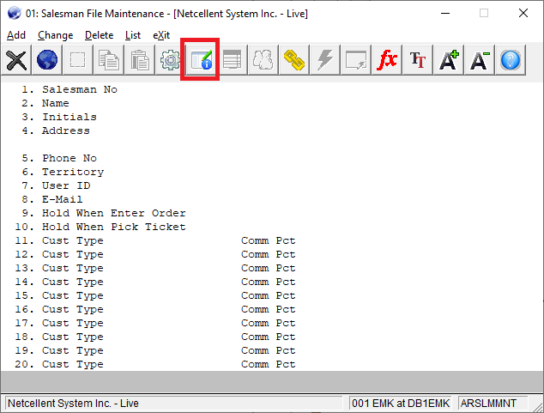
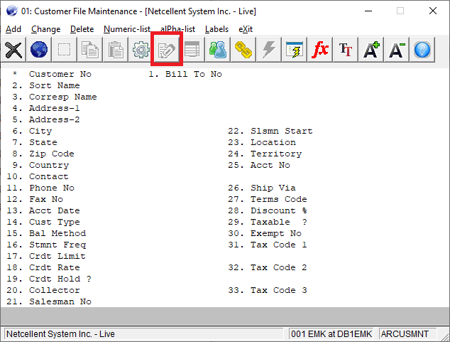
Doc Notes Icon 8.6 vs 8.5

Slide 12
Document Notes Summary
Document Notes is an extension of the existing Elliott Note function.
When no master record is identified:
In Elliott 8.5 – the note button is disabled
In Elliott 8.6 – you can bring up doc note
You can define a list of users who have the right to create document notes
Or you can let all users create doc notes
To modify or delete other’s doc notes subject to Supervisory relationship

Slide 13
Demo of Document Notes
You will learn
How to write sample document notes.
What if you need better editing? Copy & Paste Feature

Slide 14
A/R Statement – Report Desk
A/R Statement
PDF PostOffice
Report Desk (a specialized version)
Both of them are not user modifiable
Can be customized by Netcellent
The Report Desk format is more attractive because of using different fonts

Slide 15
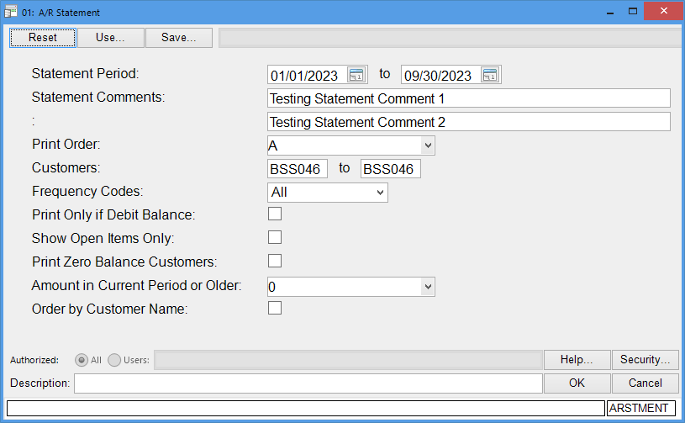

Slide 16
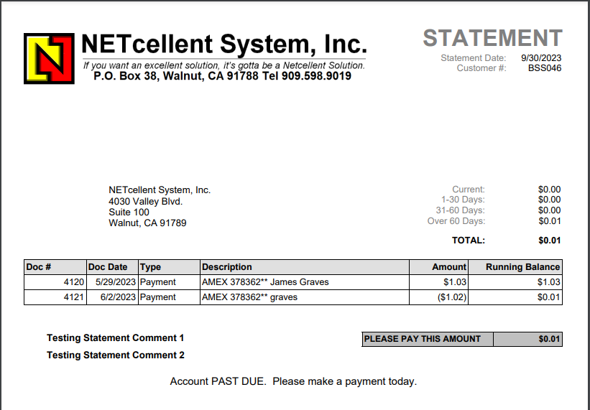
Notes:
The PGN file is for Report Desk
The BMP file is for Elliott Laser Form Designer
The 01 folder imply company 01. If the COMPADDR.PNG exist in there, then Statement will use it. Otherwise, it use the one in the Logo folder.

Slide 17
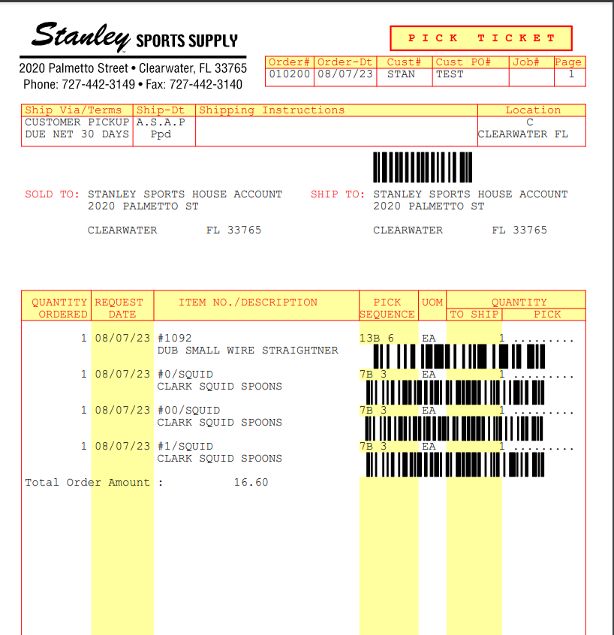
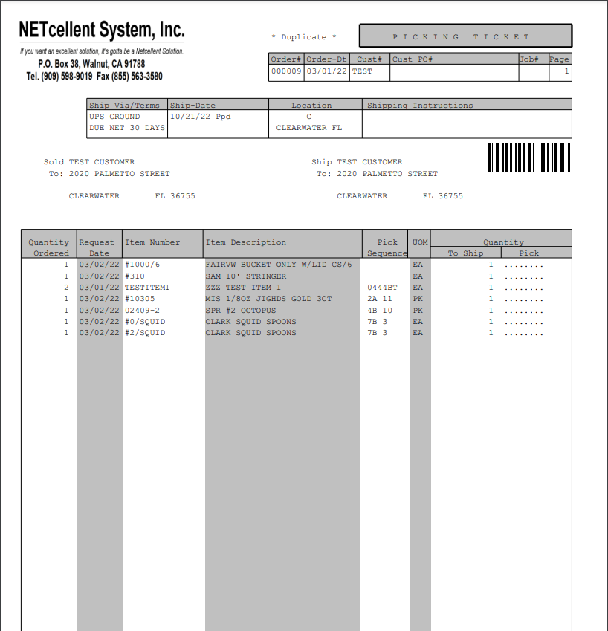
Fixed vs. User Definable Pick Ticket
3 lines minimum vs 1 line
Fixed format vs user definable

Slide 18
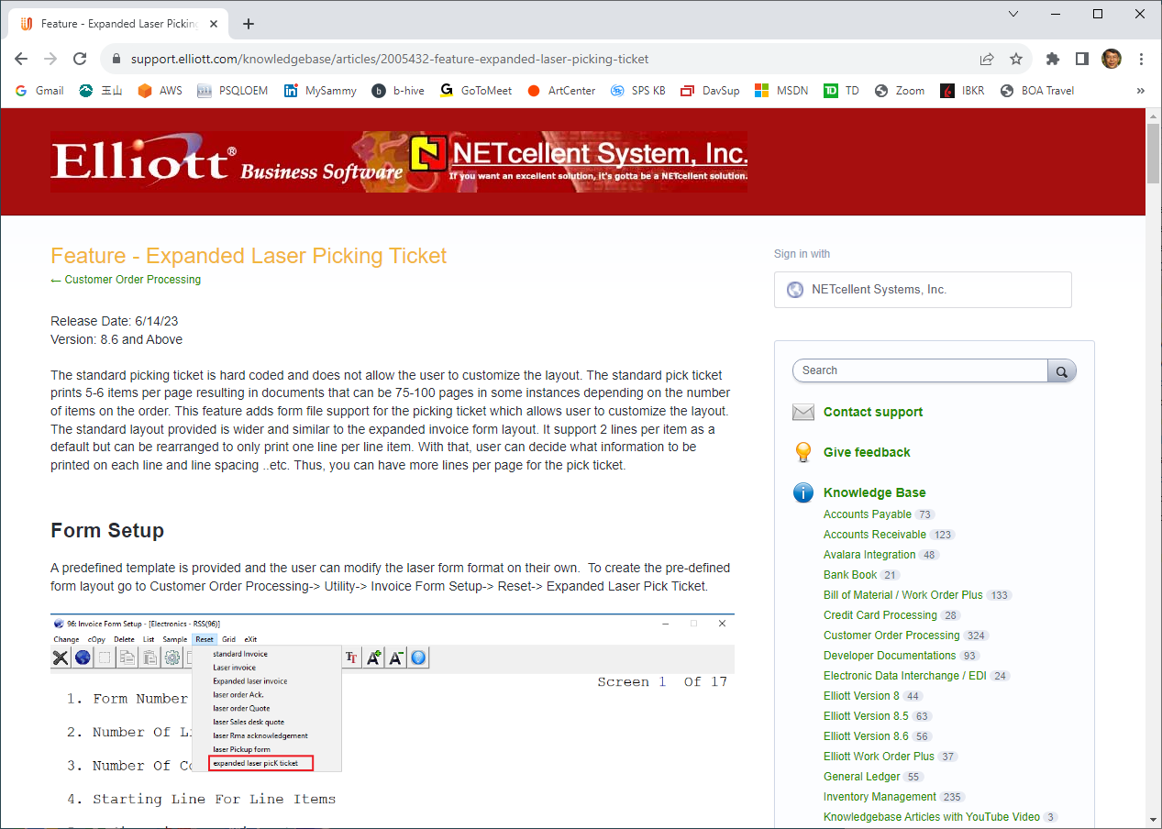
KB – Expanded Laser Pick Ticket

Slide 19
Attribute Enhancement
Free Form Date Entry Field
8.5 – Calendar Date Selector Only
8.6 – Calendar Selector or Free Form

Slide 20
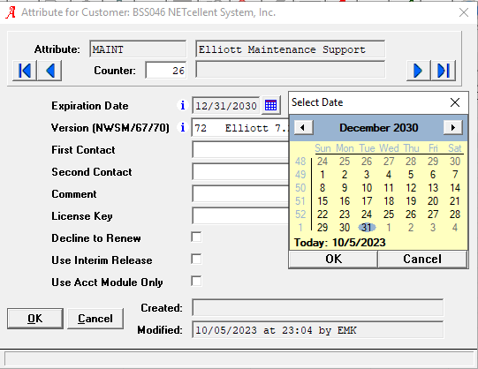
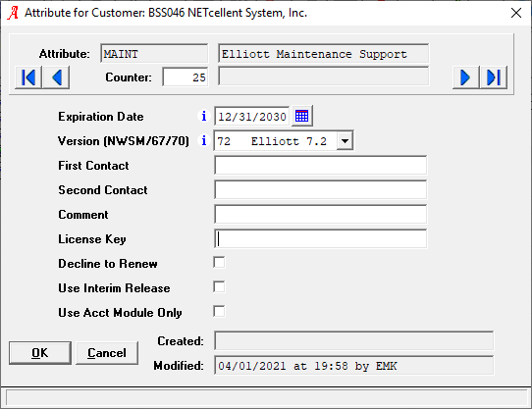
8.5 vs 8.6 Attribute Date Field
8.5 Date field is grey out & must use date selector
8.6 date field is free form with date selector

Slide 21
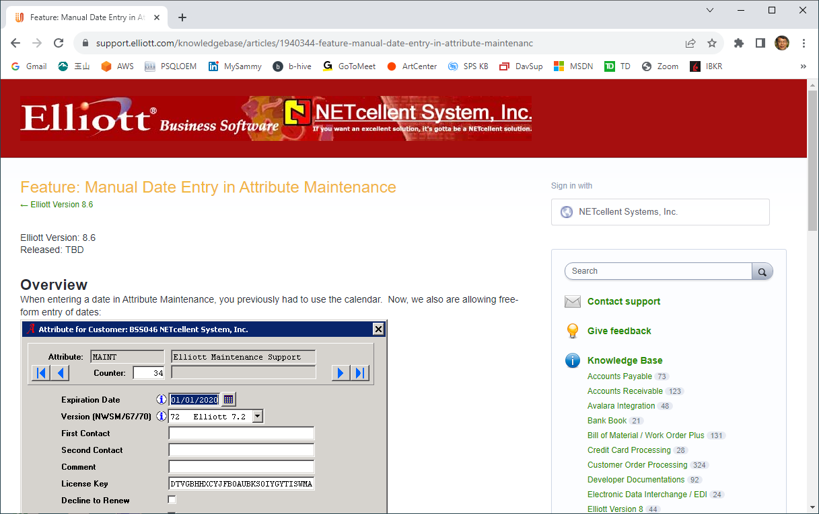
KB on 8.6 Date Free-Form Entry

Slide 22
Supports Various Conventions
A 6-digit date in the form of MMDDYY. When leaving the field, it will be reformatted to MM/DD/YYYY
An 8-digit date in the form of MMDDYYYY. When leaving the field, it will be reformatted to MM/DD/YYYY
A date entered as M/D/Y, where the month and day can be 1 or 2 digits and the year can be 1 to 4 digits.
A date entered as M.D.Y, where the month and day can be 1 or 2 digits and the year can be 1 to 4 digits.
Examples:
010120 would be converted to 01/01/2020.
01012020 would likewise be converted to 01/01/2020.
1120 would cause an error -- it would not convert to 01/01/2020.
112020 would convert to 11/20/2020 -- it would not convert to 1/12/2020.
1/1/20 would convert to 01/01/2020.
1.1.20 would convert to 01/01/2020.
1 1 20 would convert to 01/01/2020.

Slide 23
Invoice Printing Defer Processing
This can be a significant feature for users who print invoices by batch.
The biggest issue is to support PDF PostOffice through defer.
What if there’s no email address to send?
Print a hard copy to the printer for mailing
Defer does not support printing to a printer.
ToBePrinted Folder
Notes:
Anybody know why defer processing cannot support printing to a physical printer?

Slide 24
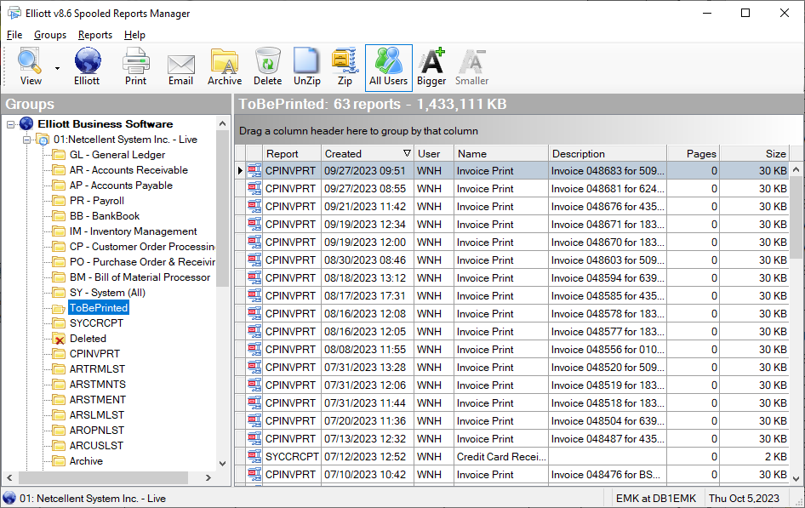
ToBePrinted Folder

Slide 25
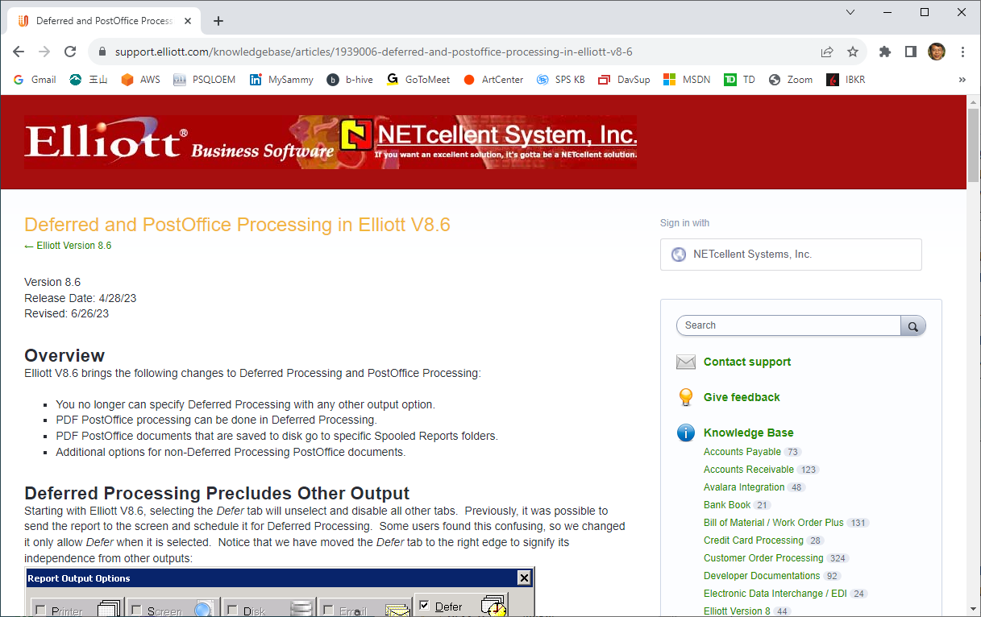
KB on Defer & PDF PostOffice

Slide 26
Date Cutoff: 2030 -> 2050
In Elliott 8.5
12/31/30 is the last date -> 12/31/2030
1/1/31 will be converted to 1/1/1931
This was due to the Payroll module having a birthday field.
This designed was in 1999.
In Elliott 8.6, the cutoff is changed to 50
12/31/50 is the last date -> 12/31/2050
1/1/51 is the first date -> 1/1/1951
Payroll module birthday supports entering 8-digit dates

Slide 27
Words of Caution
In general, you can run 8.5 & 8.6 side-by-side.
But if you enter a date between 1/1/2031 – 12/31/2050
Do not use both 8.5 and 8.6 side by side
8.5 will get confused
Only use 8.6

