Slide 1
Elliott 8.6 Other Features (2)
Edward M. Kwang
President

Slide 2
Email Servers Setup in 8.5
There’s a default setup in EL850.CFG
Does not work well for Exchange on-line or Outlook 365 – no relay by default
This can work if you host your own email server (e.g. Exchange Server)
Configure your mail server to allow relay.
Easy to setup in Elliott
You can override default server by each Windows user login (user profile)
You should use this method with Exchange on-line or Outlook 365.
Notes:
If you know the answer, raise your hand. The question is why Outlook 365 do not allow relay by default?

Slide 3
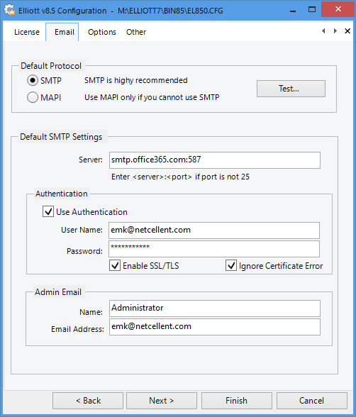
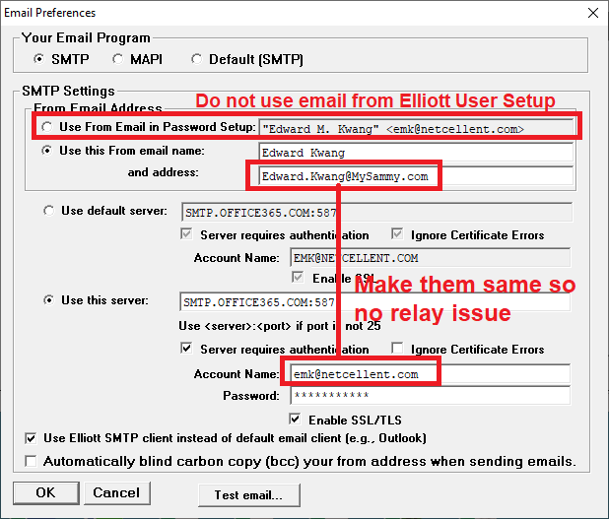
8.5 Email Setup for Outlook 365
Notes:
It works. But there are room for improvements

Slide 4
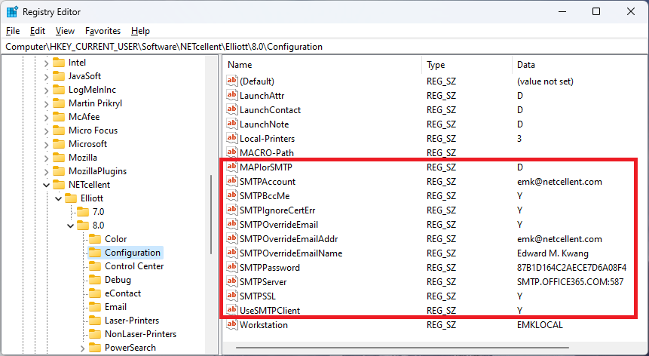
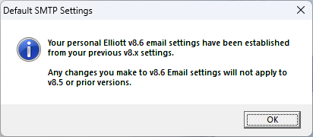
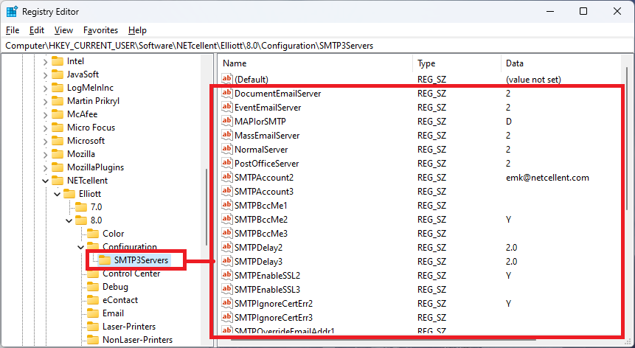
Run 8.6 1st Time on a Workstation

Slide 5
8.6 Allows up 3 to Email Servers
8.5 & 8.6 Use Different Registry Settings
Scenario
Send Important emails through Outlook 365
Outlook 365 has good reputation
My email won’t go to the junk folder
But you can’t send more than 30 emails in 1 minute
We need to throttle it by 2 seconds delay
Send mass email through Sendgrid.com
Sending mass email without delay

Slide 6
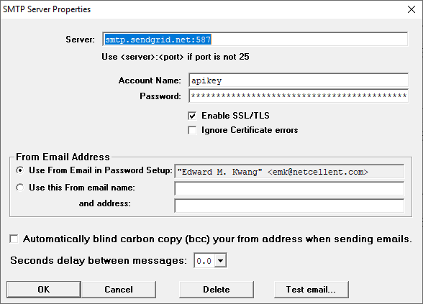
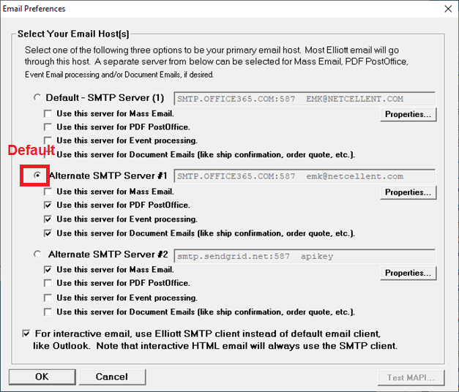
Email Servers Setup in 8.6
Notes:
Anybody here using Sendgrid or similar email solution?
What’s your experience?
We find it less reliable, sometimes the email will go to junk mail folder (Gmail will do that, but not Outlook 365) -> but this is unpredictable.
Sometime you may experience the email you send out with Sendgrid get blocked, that’s because the Email server you use is on an IP address. Other people share that server are sending out spam. As a result, that IP address is black list, as a result, your email server is on the same IP, and you get black list too. -> The solution with sendgrid is you can allocate your own IP address, but it is a lot more expensive. May not make sense if you don’t send out that many emails.
Like many things in life, it is a trade off. So for which email servers to use, it is also a trade off. You can’t ask for reliability and convenient mass email at the same time. If you don’t have that many mass email to send, I will just go with Outlook 365 and throttle it with 2 seconds delay.

Slide 7
DDF Files & Elliott 8.6
DDF = Database Definition Files
The schema for accessing PSQL database
Contains definition of Tables, Columns, Indexes…etc.
In <ElliottRoot>\Bin86\DDF40 Folder & Subfolders
Elliott will cache DDF into memory upon start up
PSQL will open DDF for relational engine

Slide 8
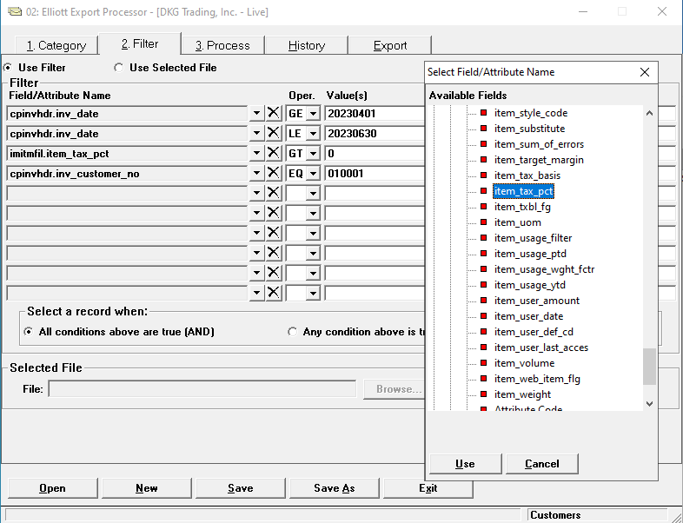
DDF Used by Elliott (Transactional Engine)

Slide 9
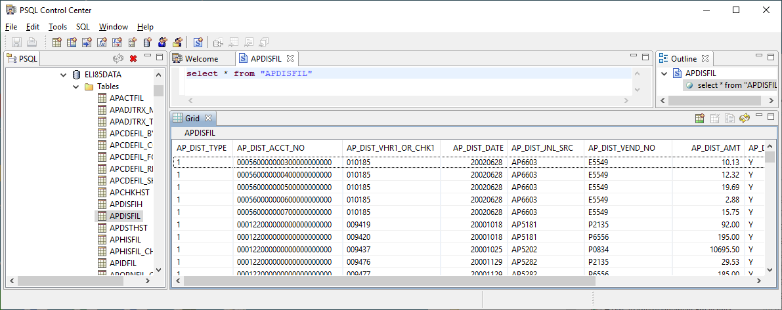
DDF Used by PSQL Relational Engine

Slide 10
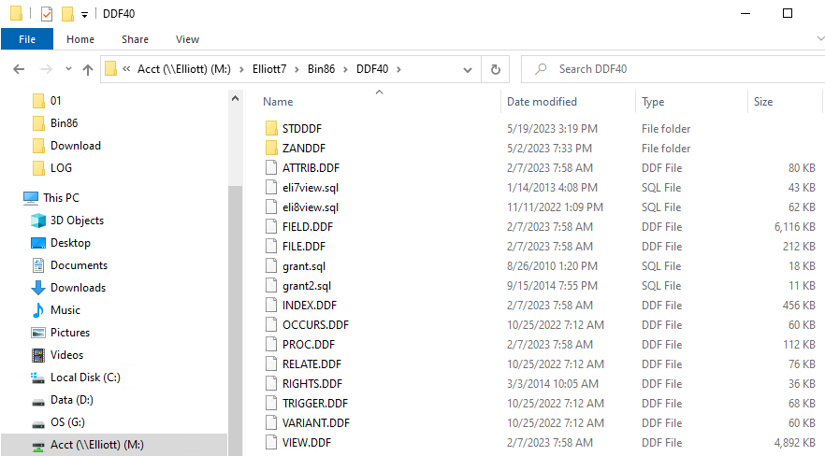
Example of DDF Files
<ElliottRoot>\Bin86\DDF40
STDDDF & possible custom DDF subfolders

Slide 11
Elliott 8.5/8.6 Installation & DDF
New Installation
Both 8.5 and 8.6 will install DDF Files
Update Installation
8.6 installation updates DDF by default
Updating DDF files is very important for 8.6 because the using of relational engine
8.5 installation does not update DDF by default
Notes:
While It’s not as important to keep 8.5 DDF updated, but it is still desirable.
If you know the answer, raise your hand first. Anybody know why we don’t update DDF with 8.5 installation,

Slide 12
DDF Files Update Strategy
<ElliottRoot>Bin86\DDF40\
*.DDF:
Used by Elliott Transaction Engine by default
Elliott startup will cache this DDF
Update will override DDF here
STDDDF\*.DDF
Used by PSQL Relational Engine
Update will not override DDF here
Login SUPERVISOR will attempt to update
<CUSTOM>\*.DDF – Custom DDF folders
Manually Update DDF Here

Slide 13
When Login to SUPERVISOR
Will attempt to update DDF
Copy ….\DDF40\*.DDF to DDF40\STDDDF
It may fail if PSQL is actively using the DDF files
Elliott users are using Report Desk or PowerSearch

Slide 14
DDF Update Assumptions
We assume the person who installs Elliott 8.6 can login as Elliott SUPERVISOR.
SUPERVISOR has NTFS right to update <ElliottRoot>\Bin86\DDF40\STDDDF
SUPERVISOR will pick a time to login and update DDF when no one is using Elliott relational database activities.

Slide 15
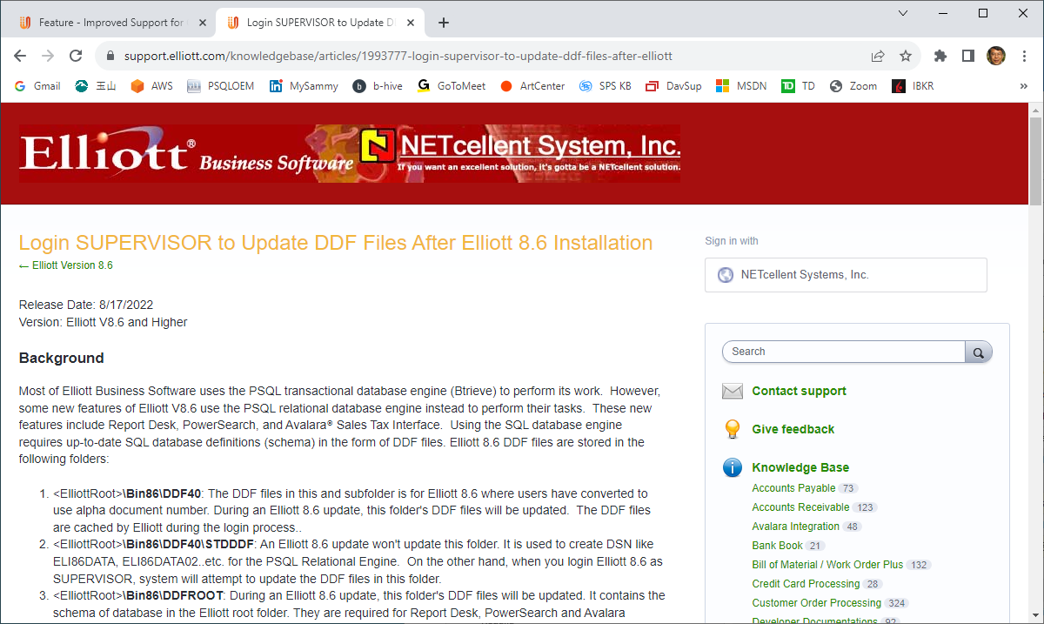
What if DDF Update Fails?

Slide 16
If SUPERVISOR Cannot Update DDF
Use PSQL Monitor to find out which user or machine is opening the DDF files. Exit the user or machine.
Wait till evening when all Elliott Users are out.
If it still fails – Stop & Start PSQL Engine

Slide 17
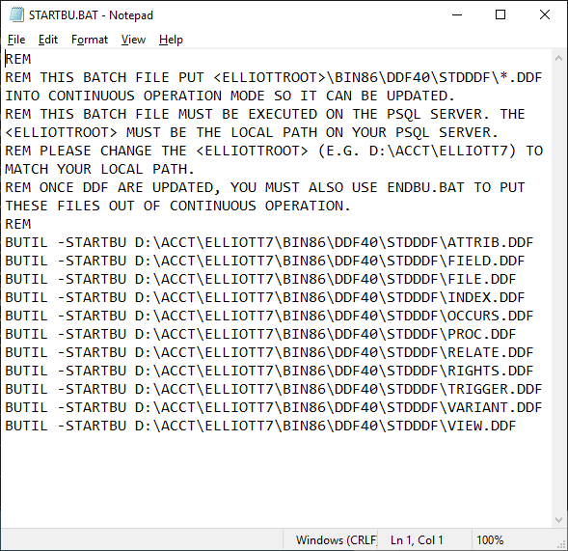
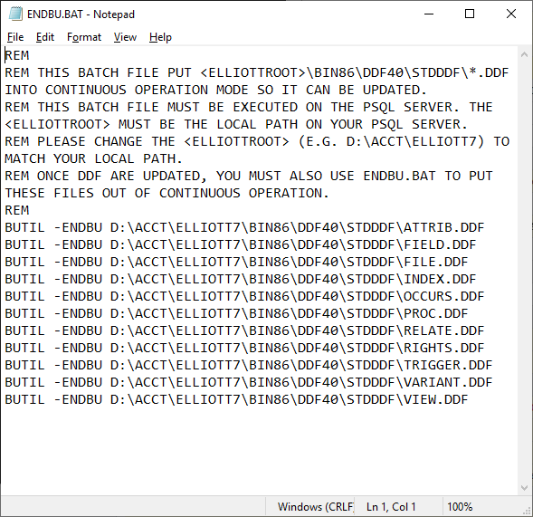
Do I have to stop PSQL engine?
Use BUTIL –STARBU & -ENDBU in BAT File
Use Local path (e.g. D:\ACCT\Elliott, not M:\Elliott)
DDF Files Date/Time become System Date

Slide 18
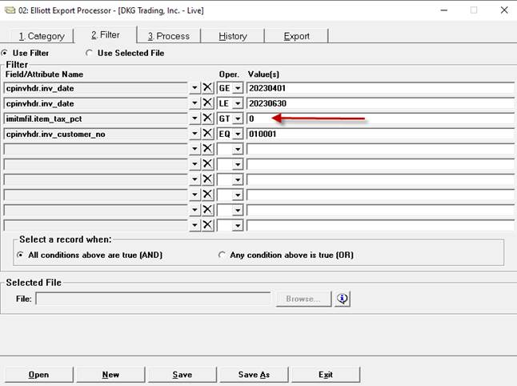
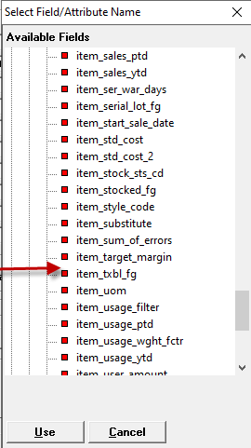
DDF in <ElliottRoot>\Bin86\DDF40

Slide 19
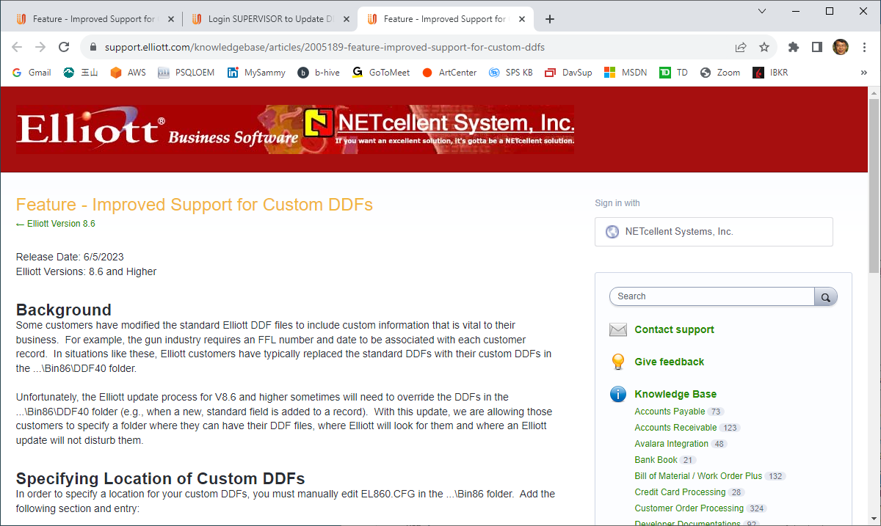
Support of Custom DDF in Elliott

Slide 20
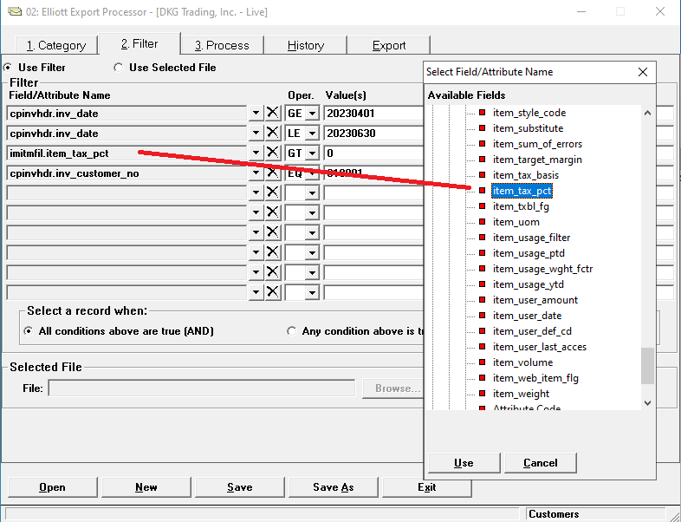
Update Bin86\EL860.CFG

Slide 21
Installing 8.5 or 8.6 during The Day
If you run Elliott from Network
No
If you run Elliott from Local Folder
This is the suggested method
You can install Elliott 8.5 during the day
Can you install Elliott 8.6 during the day?
It depends
May Need to update SY*.BTR in root folder
Similar to the DDF update issue
Could use BUTIL –STARBU & ENDBU

Slide 22
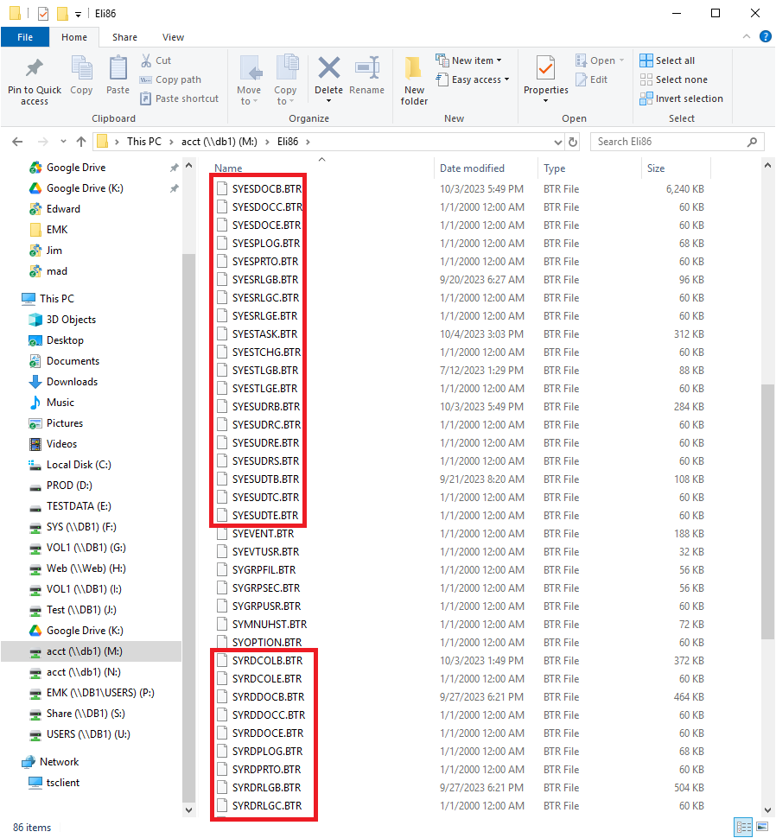
Elliott RD & PS Files in Root Folder
Notes:
Two group of files
RD = Report Desk
ES = Elliott Search (this was the name we use before we settle down on the name PowerSearch)
Look at the file that may end we B E and C.
B=Base (deliver by Netcellent), E = Enahancement (deliver by Netcellent’s Developer, including Netcellent), C=Customized
We deliver B, E and C the first time.
We do not update E & C with future update.
We do update B with future update if there are more report desk and power searches added by Netcellent.

Slide 23
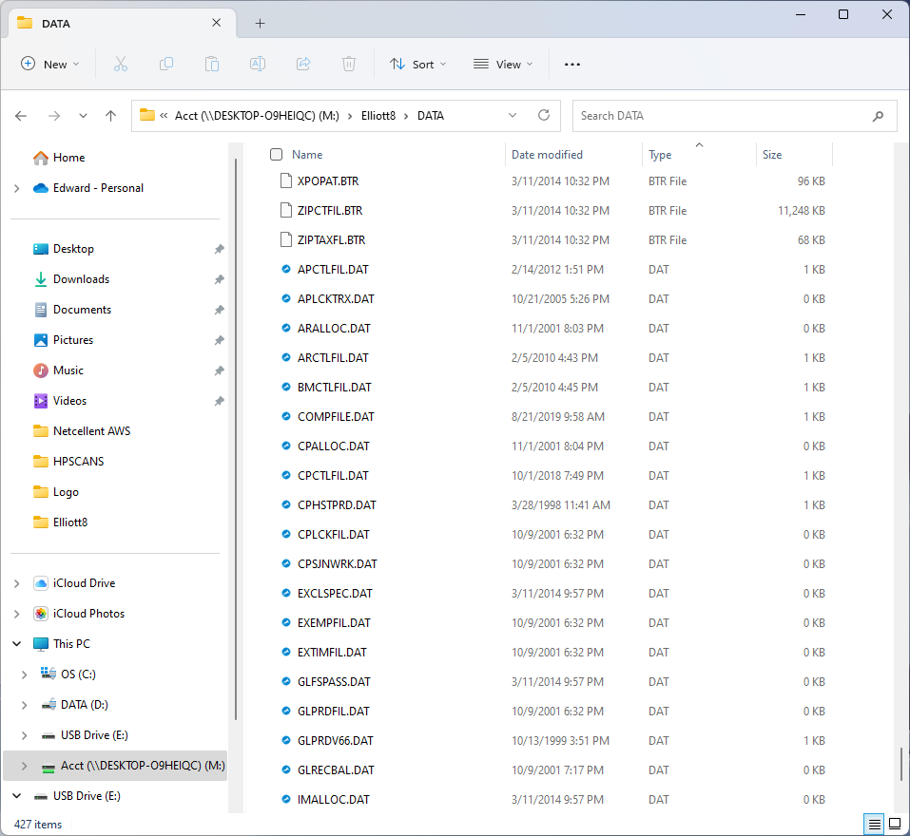
DAT Files in DATA Folder
Notes:
DAT files stores setup information. Sometime it is also used for locking control.
For example
APCTLFIL
ARCTLFIL
BMCTLFIL
COMPFIlE.DAT
CPCTLFIL.DAT
GLPRD*.DAT

Slide 24
BTR vs DAT Files
BTR files are handled by PSQL Engine
No need for user’s NTFS right (PSQL setup)
Vast majority of Elliott Data files are BTR
DAT files are handled by OS
Elliott access DAT files like TXT files thru OS
User’s NTFS right to DAT files are required
You could follow Elliott NTFS guideline to protect DATA from ransomware.
Except we can’t protect DAT files

Slide 25
Ransomware Attack Is Real !
5/7/23 – San Bernardino County Police Department pay $1.1M to ransomware.
May 2021, Colonial Pipeline which operates the largest fuel pipeline in the United States, fell victim to ransomware attack and was forced to pay 75 Bitcoins ($4.4M at the time).
One of my customers was attacked and did not pay. Take several days to recover from backup.
Notes:
Ransomware works by encrypt your data. If you want your data be decrypted, you need to make a request to them first. Then they will do some marketing research on you and size your business, before making the demand on how many bitcoins are need to pay.
For whatever reason, a lot these attackers are located in East Europe.
Just the one I know, there are 4 or 5 customers was attacked by ransomware.
The attack usually come as an attachment through the emails. If you open the attachment, and the attachment contains the attack codes, then you become the victim of the ransomware.

Slide 26
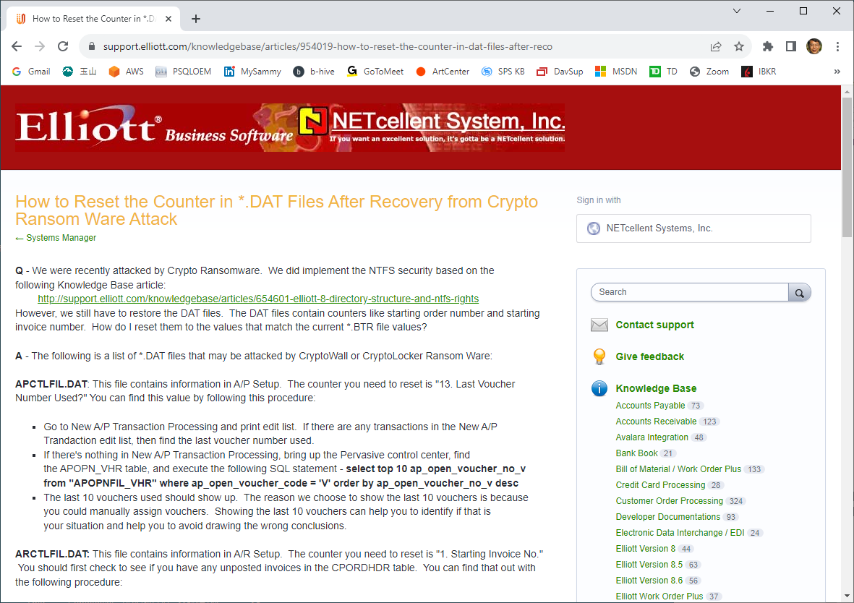
Ransomware Attack Is Real !
Notes:
Several days downtime.
Attack usually come through emails.
Because DAT files usually are setup data and does not change so you can restore from your backup.
The only exception is the counter like next invoice number, order#, voucher#...etc. So this KB article show how you can figure that out.

Slide 27
Duplicate Invoice Number Issue
Scenario
30 Packing Workstations
Invoices are print at packing workstation
Based on invoice log file, 3 orders were processed at exactly the same time.
Why does it happen?
OS caching delay
Solution is to convert DAT to BTR Files

Slide 28
8.6 Can Optionally Eliminate DAT Files

Slide 29
What Are You Waiting For?
Once you convert DAT to BTR files
You need to upgrade to 8.6 web services
You can no longer run Elliott 8.5 or previous version side by side
Wait till you feel comfortable with 8.6
Benefits
Protection against ransomware
Eliminate duplicate invoice number issue

