Slide 1
Financial Statements Thru CSV
Roger Sueng
Vice President

Slide 2
Benefit to Spreadsheet (Excel)
Expandable – it can be expanded to 65 columns.
Format compatible – CSV to Excel.
Collect more information – Can fit Actual, Comparative, Budget, Variance and Ratio.
Flexibility – User friendly for design report.

Slide 3
How to design Custom Specification (1)?
Assign a new Specification number
Text format as a default (13 columns)
CSV format can be extended to 65 columns.
Basic parameter
Financial Entity / Profit Center
Variance Percentage
Showing Fiscal Year / Current Period

Slide 4
How to design Custom Specification (2)?
Data Source Type
P = Present Year
B = Budget
C = Comparative (last year)
V = Variance
Period (from / to)
Header of column
Format of amount

Slide 5
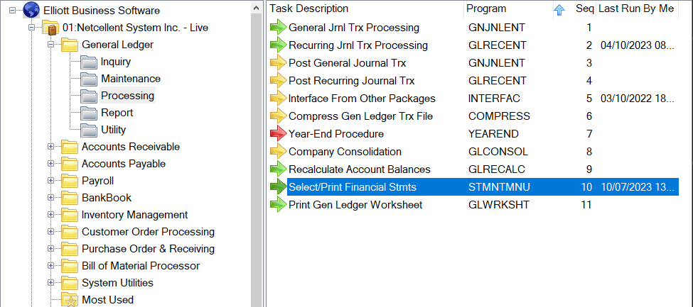
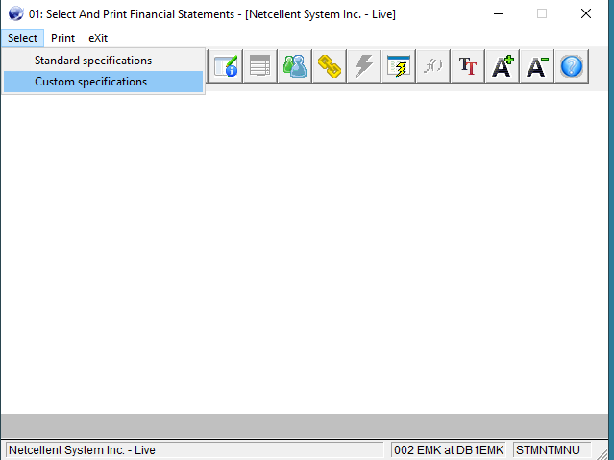
Create Custom Financial Statements

Slide 6
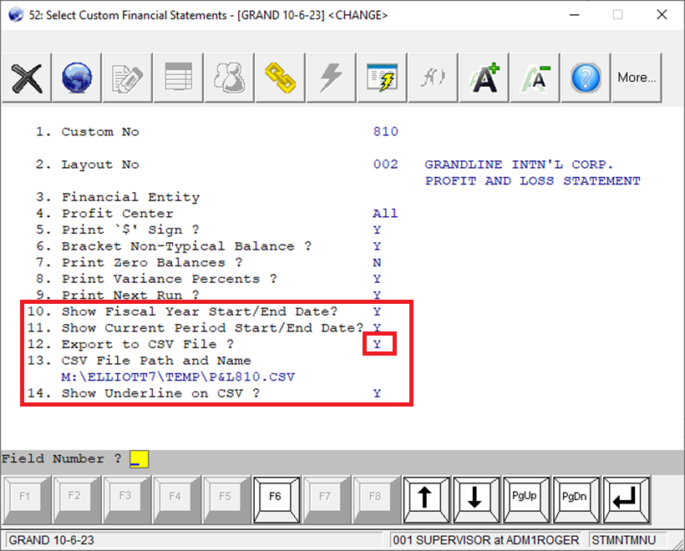
Create Custom Financial Statement

Slide 7
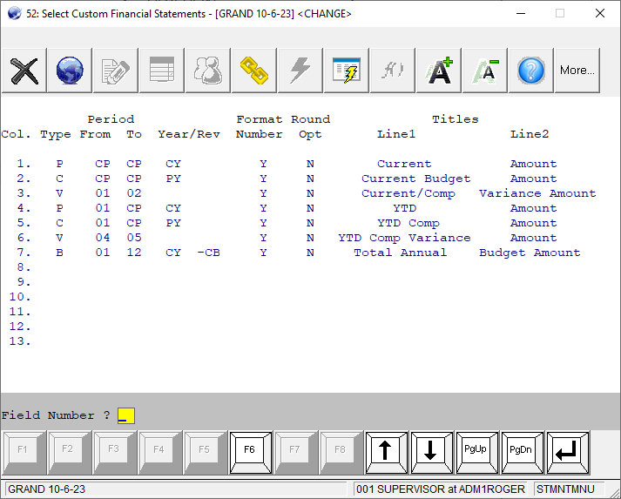
Detail Column – Text Format

Slide 8
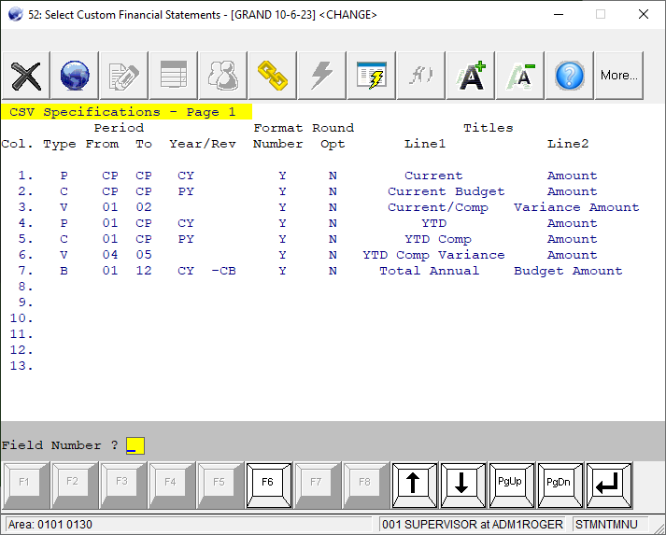
Detail Column – CSV Format

Slide 9
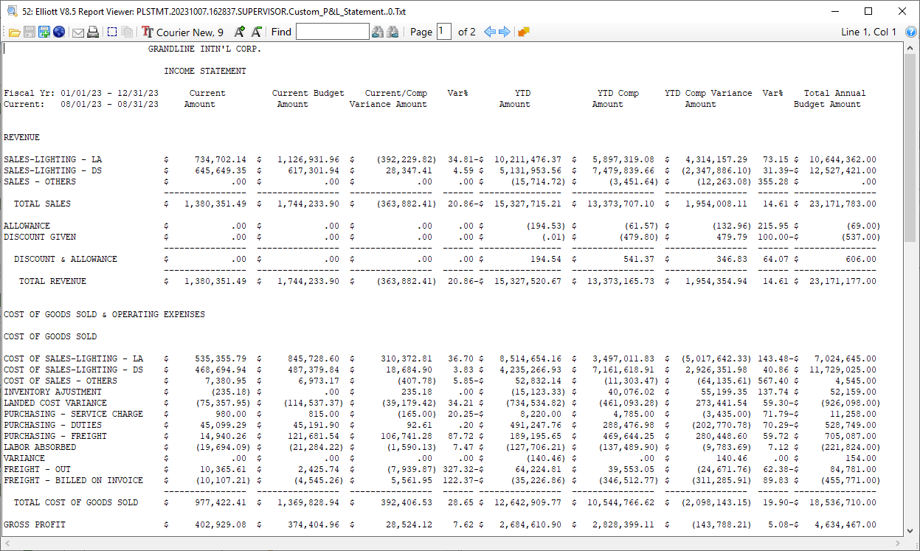
View Text Financial Statement

Slide 10
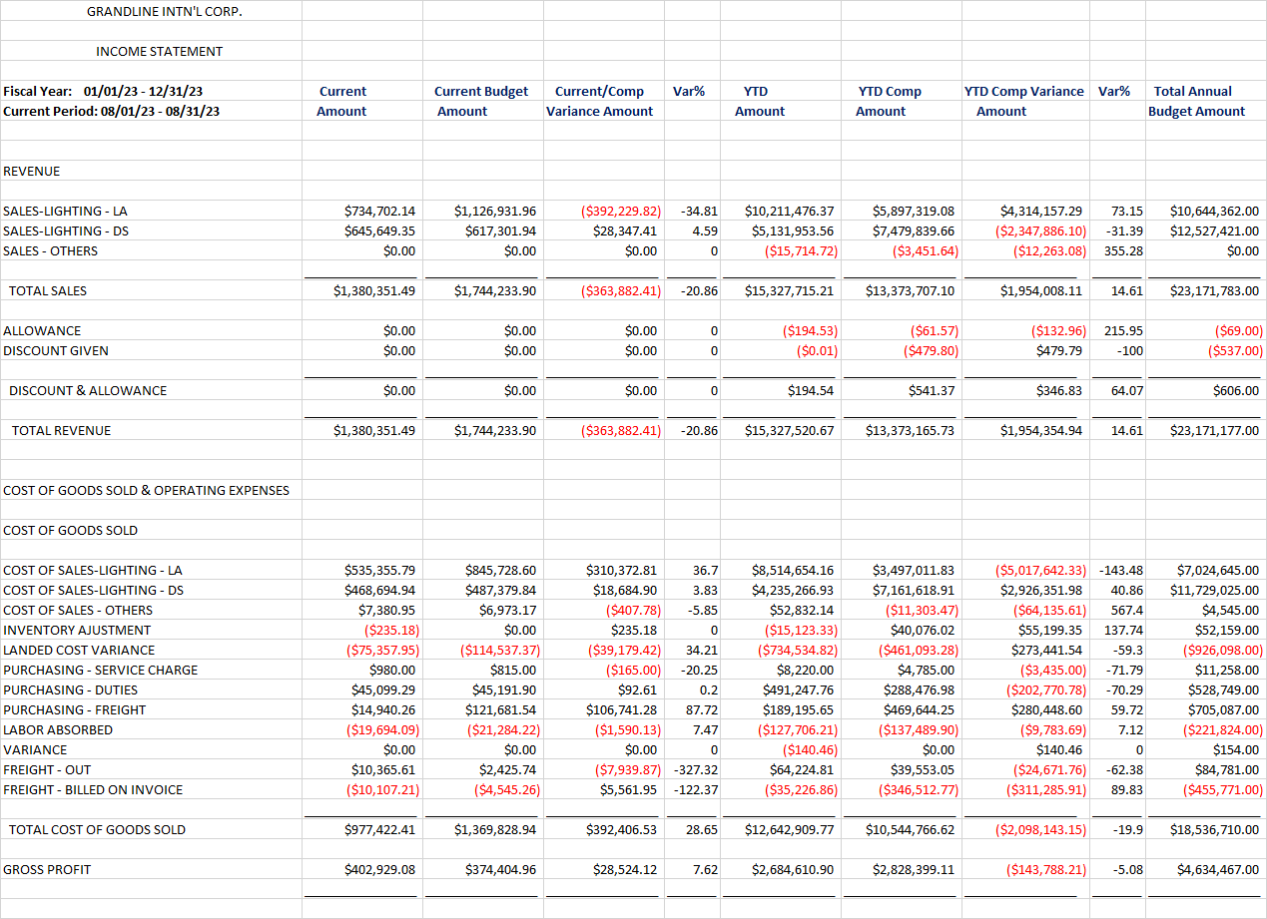
View Financial Statement in Excel

Slide 11
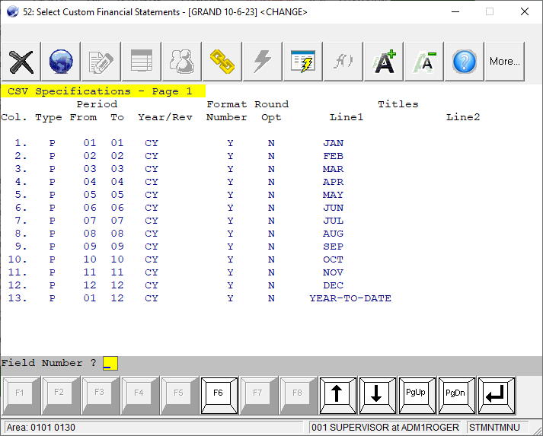
Define 12 Months P&L Statement

Slide 12
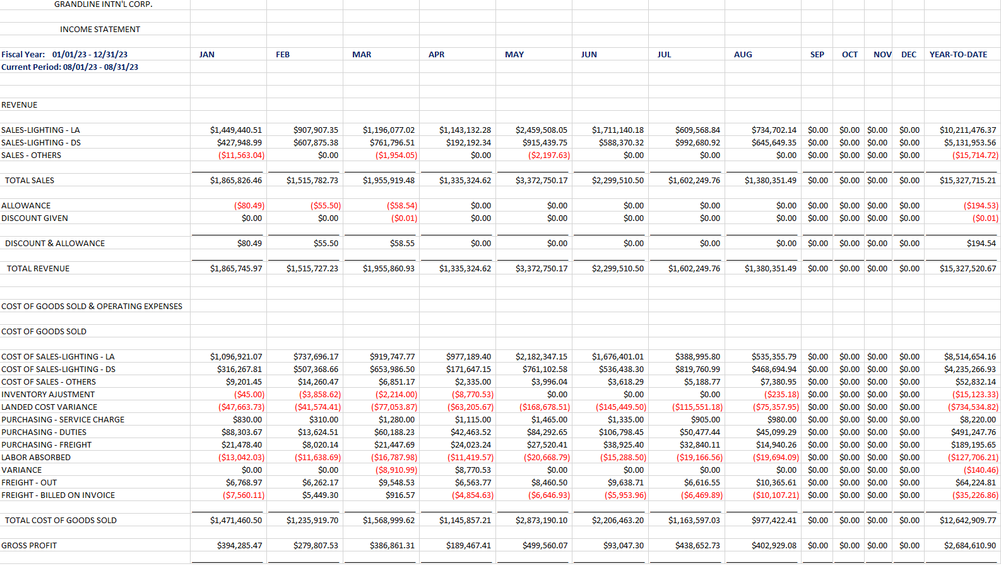
View 12 Months P&L in Excel

Slide 13
Demo
Create a new custom specification
Header parameters
Detail columns – Text format
Detail columns – CSV format
Modify columns – Delete, Insert etc.
Important at Accounting Period setting (Fiscal Year and Current Period)

Slide 14
New features in GL
Calculating and adding LYNI (Last Year Net Income) at Balance Sheet
Total Credit <> Total Debit
LYNI will fix the out of balance issue.
Interfacing outside general journal transaction through CSV file import utility.

Slide 15
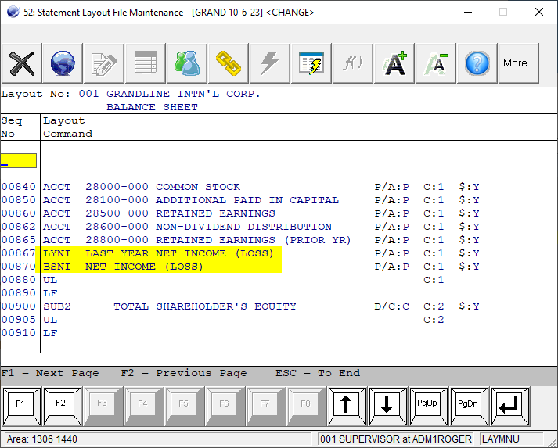
Demo

