Slide 1
HTML Acknowledgement Email
Edward Kwang
President

Slide 2
Examples of HTML Emails
Credit Card Receipts (New)
Order Acknowledgement (also PDF)
Quote Acknowledgement (also PDF)
Sales Desk Desk Quote Ack (also PDF)
Shipment Acknowledgement (also text)
Notes:
Clarify the two Quote Acknowledgements

Slide 3
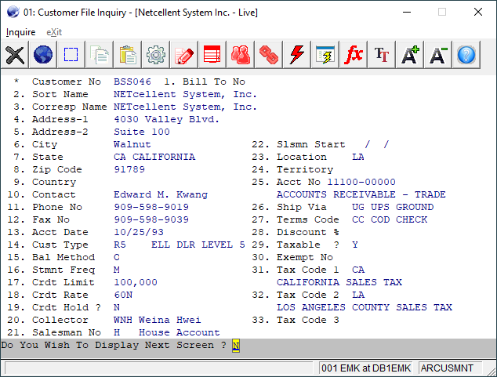
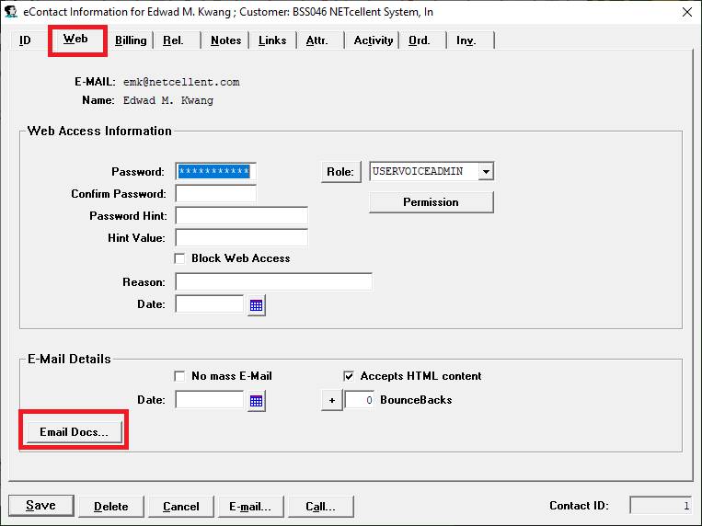
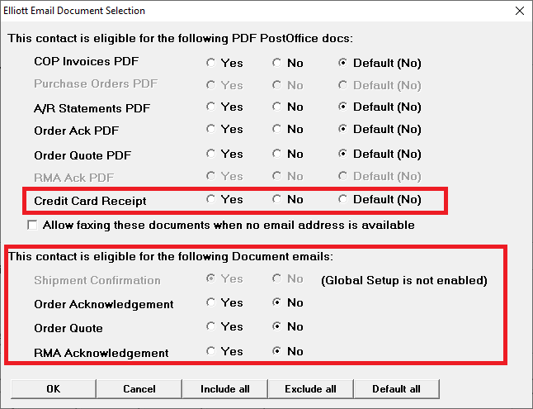
Who Receives The Email?

Slide 4
Recipients Based on eContacts
Sources of eContacts Same as PDF PostOffice
Orders – Default “Yes”
Customer – Default “No”
Ship-To – Default “No”
Salesman – Default “No”

Slide 5
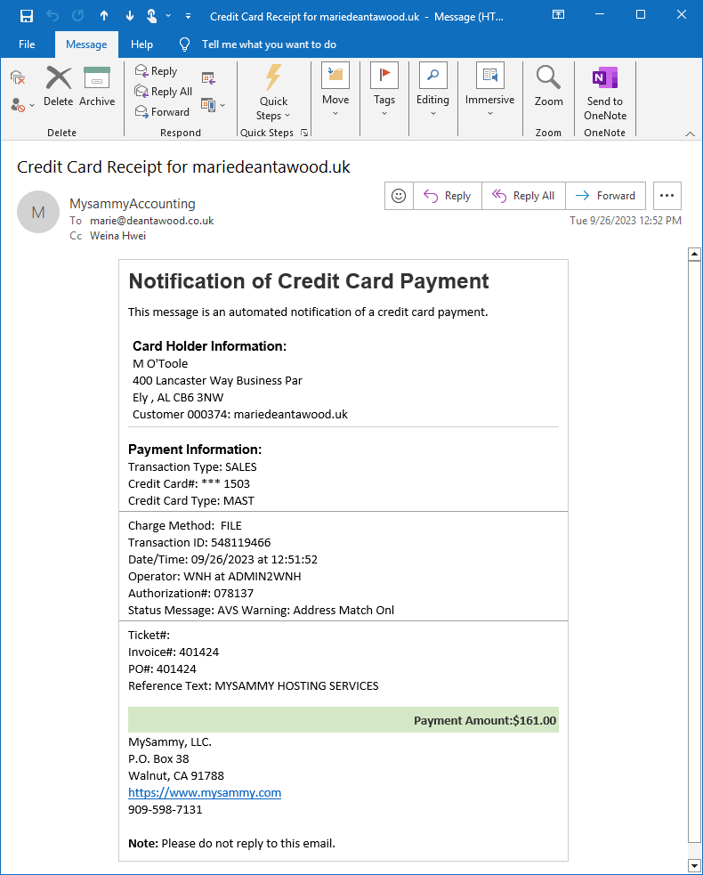
Interactive Credit Card Receipt

Slide 6
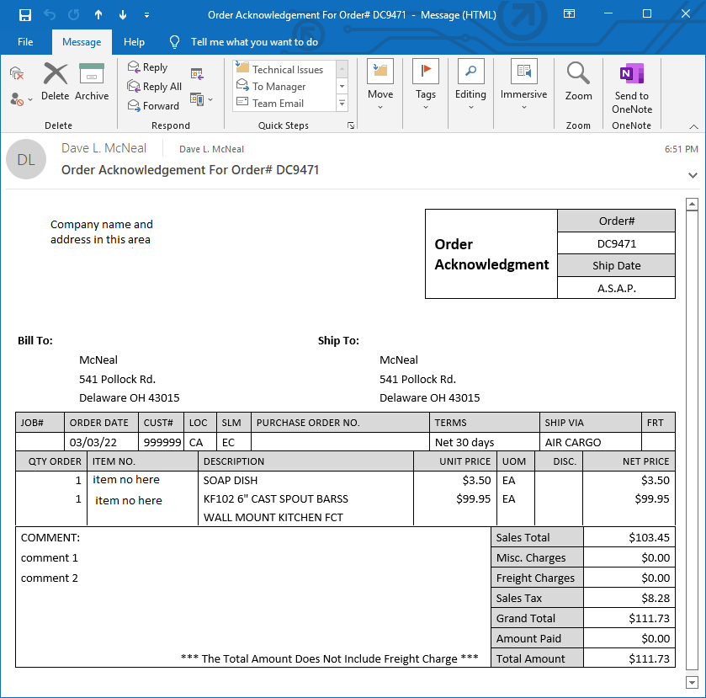
Order Acknowledgement

Slide 7
Sending Order Ack. Options
Interactive or Batch
Format:
HTML (V8.6 Only)
PDF (Laser Form Format)
Text

Slide 8
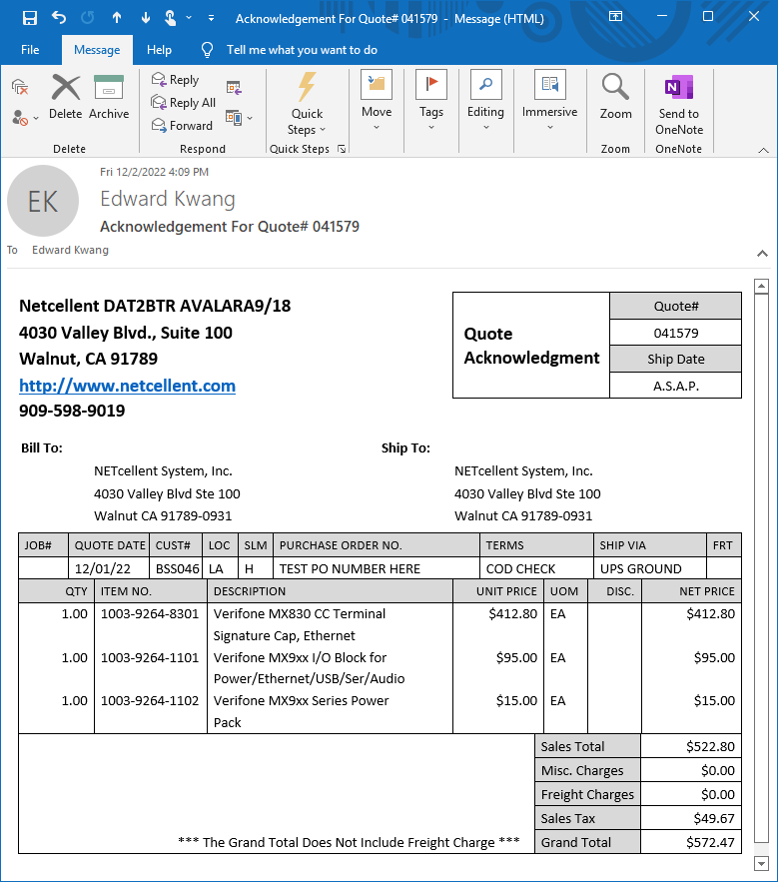
Quote Acknowledgement

Slide 9
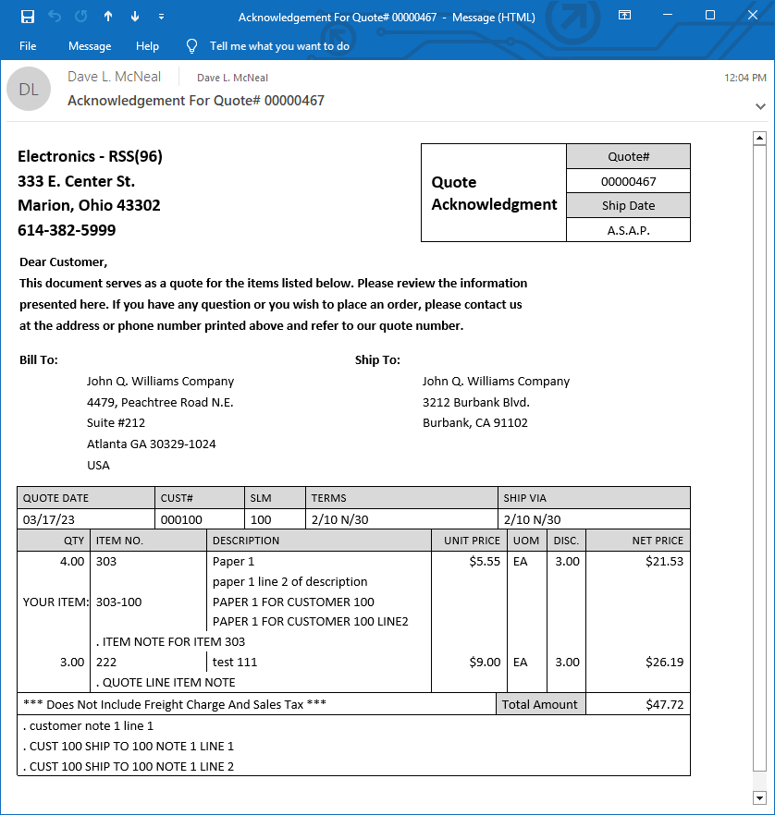
SD Quote Acknowledgement

Slide 10
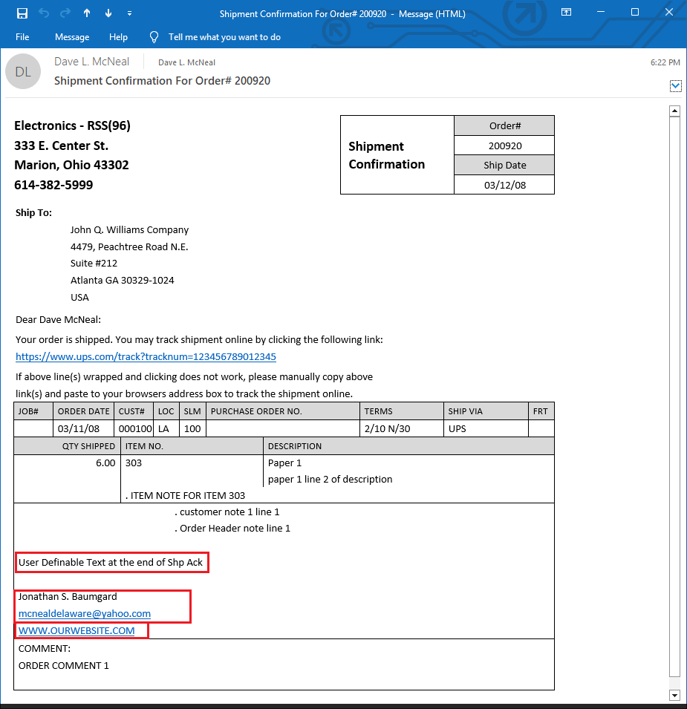
Shipment Acknowledgement

Slide 11
Shipment Ack. Options
Batch Only (Ideal for Defer Processing)
Source of Data
Orders (Before Posting)
Invoice History (After Posting)
Format
HTML (V8.6 only)
Text (Since V7)

Slide 12
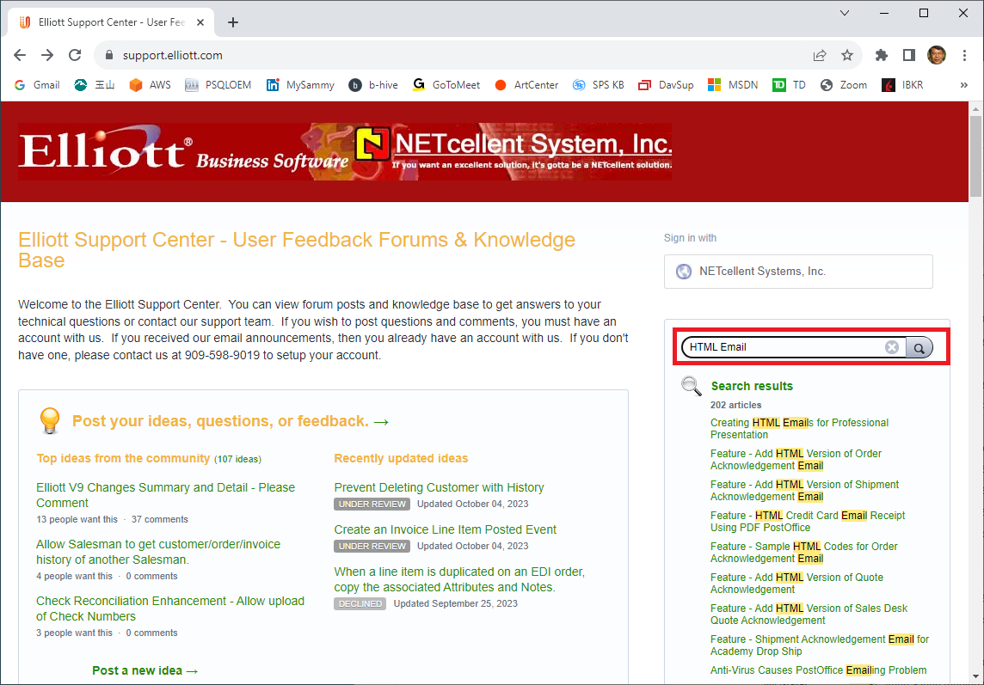
Setup of HTML Emails

Slide 13
Demo

Slide 14
HTML Emails vs PDF PostOffice
HTML Emails (Elliott 8.6)
Credit Card Receipts Are User Definable
The Rest are Hard Coded
PDF PostOffice (Elliott 8.2)
Layouts Are User Definable
What Are the Benefits of Using HTML Emails over PDF PostOffice?
Order Acknowledgement
Quote Acknowledgement

Slide 15
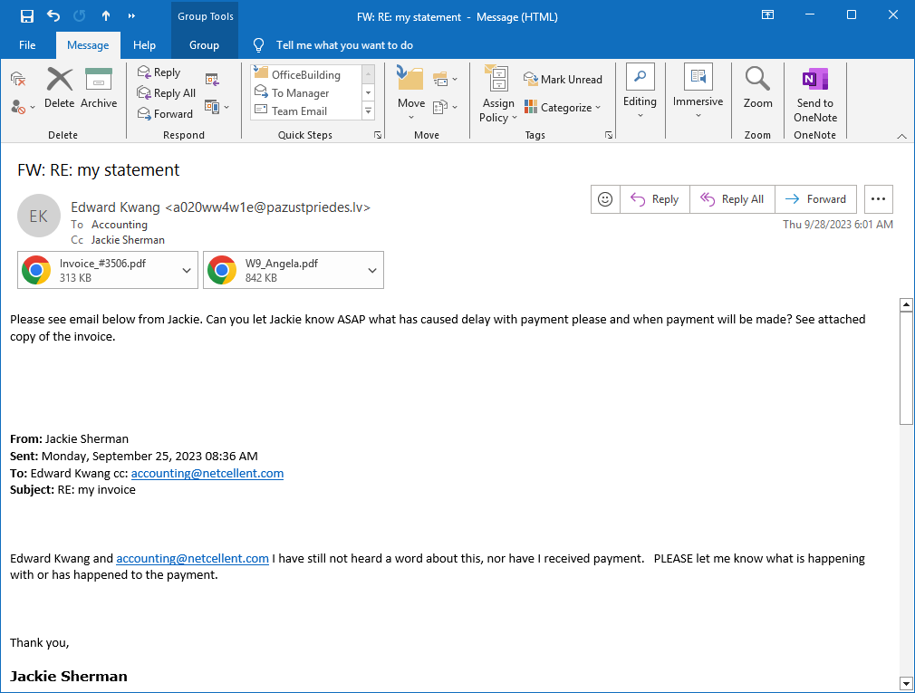
Example of an Email Attack
Notes:
People may be afraid of open PDF files with email attachment
PDF may not go through email server

