Slide 1
Inventory Report Writer
Edward M. Kwang
President

Slide 2
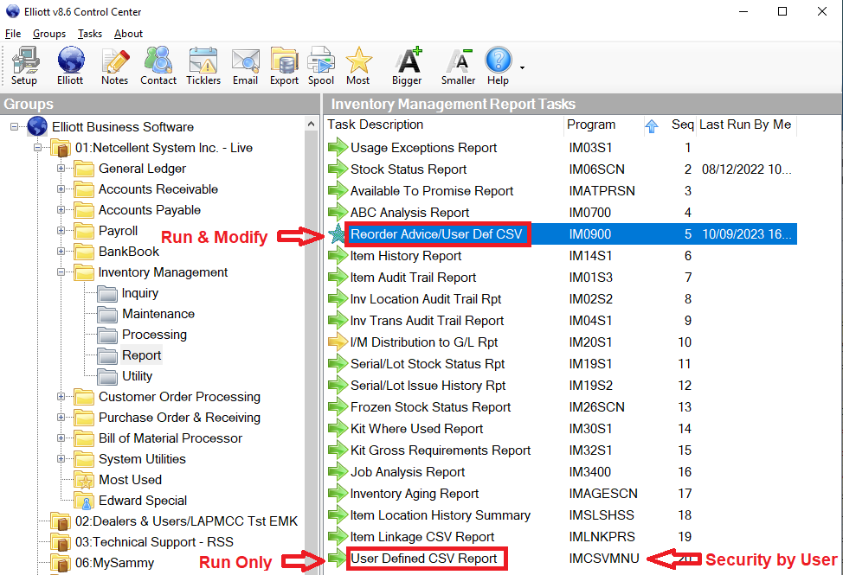
How to Access?

Slide 3
I/M -> Reorder Advice / User Def CSV
User Def CSV = Inventory Report Writer
Dedicated to retrieve inventory related data, hence the name “Inventory Report Writer”
Originally developed to export item and location history.
It was later expanded to handle:
ATP (Available to Promise)
Item Attribute
Item Link Info
Item Qty Sold by Customer or Type

Slide 4
Compare to Report Desk, Crystal or Excel Query
Report Desk, Crystal or Excel Query are great tools for Elliott data that can be retrieved by using a SQL statement.
Example 1: Item list is easy.
Example 2: Stock status report with multiple locations is somewhat challenging because IMITMFIL & IMINVLOC tables are not designed as relational.
Issue to be resolved with Elliott V9
Inventory Report Writer can access Elliott’s non-relational data.

Slide 5
Demo – Stock Status Report
Learn the following
Search for column ID
What’s the first character you can think of?
How to use formula & its limitation?
How to add a new column?
With or without location column
Notes:
How to adjust the column size for autofit
Ask Sheryl, how does she run a stock status report with Crystal Report?

Slide 6
Demo – Add Sales History
Learn the following
How to copy from an existing design?
How to add sales history for each period?
Why the column name should be short?
How to add sales history for a certain customer or customer type?

Slide 7
EDI 846 Inventory Advice
Purpose: when working with e-retailers, the document advises your inventory availability. You may send updated quantities to them several times a day.
Users can send necessary data through
Export Processor – Automated through Windows Scheduler (Partial Solution)
User Defined CSV – Automated through Deferred Processing

Slide 8
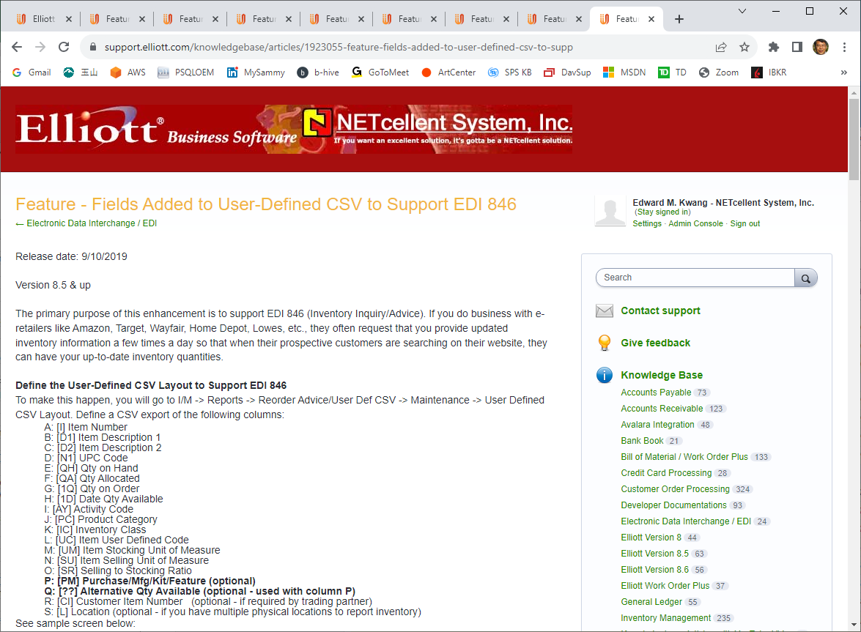
User Defined CSV for EDI 846

Slide 9
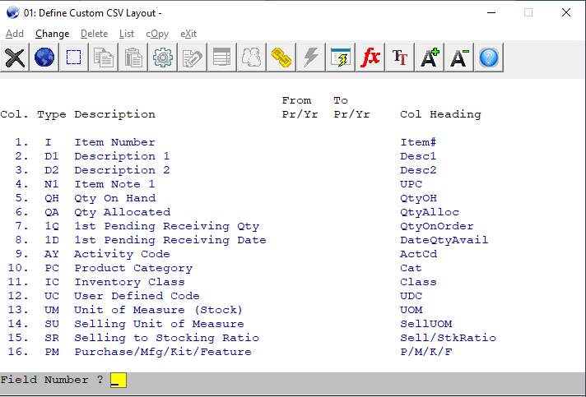
Sample 1 EDI 846 Layout

Slide 10
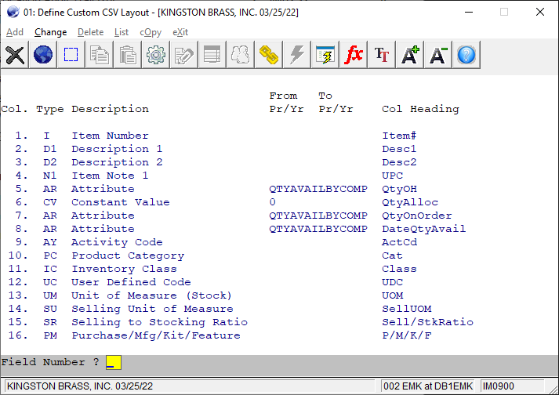
Sample 2 EDI 846 Layout

Slide 11
Custom ESS Setting for 846
By UDC, when Qty < Min, send zero.
If no customer item # setup, don’t send
Sending which quantity depends on:
P = Purchase Item
MP = Manufacturing but mostly purchase
M or MM = Manufacutring
K = Kit Item

Slide 12
Demo – EDI 846 Inventory Advice
Learn the following
How to use constant
Why use 1Q (First Qty) to Replace QO (Qty on Order)
1D – Next Schedule Receiving Date
Where is this from?

Slide 13
Demo – Item Batch
Learn the following:
An Item Batch is a list of items that can be used as the selection instead of the normal filter parameters.
To use it, create a TXT file with each row containing the item number.
Create a item batch point to this TXT file.
In User CSV Report, Item Number Field, Press F4 to enter batch ID.

Slide 14
Two Types of Business
Purchase or Manufacture to Stock
Forecasting is important.
Commonly uses sales history to forecast.
Purchase or Manufacture to Order
Will require lead time
Purchasing
Production
Customer can still adjust their orders.
Planners need to adjust PO or WO according to customer’s latest demand.
Getting it wrong can be devastating.

Slide 15
What is ATP?
ATP = Available to Promise
A database of future activities including:
Replenishments (PO, WO parents)
Requirements (SO, WO components)
Add current Qty OH, project future balance
Negative means shortage, & planner should
Create PO for components
Create WO for parents
ATP is a real time MRP (Material Requirement Planning)

Slide 16
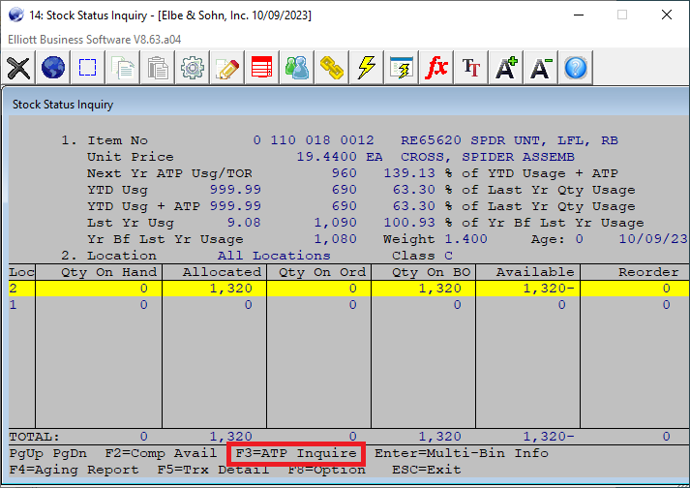
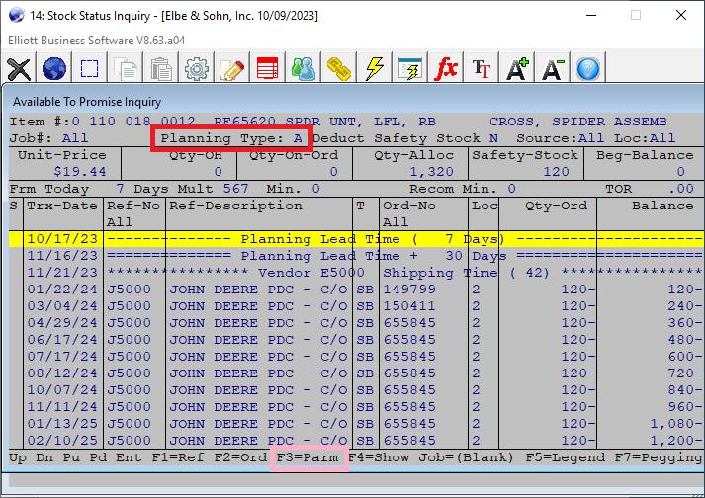
Example of ATP - Parent Item

Slide 17
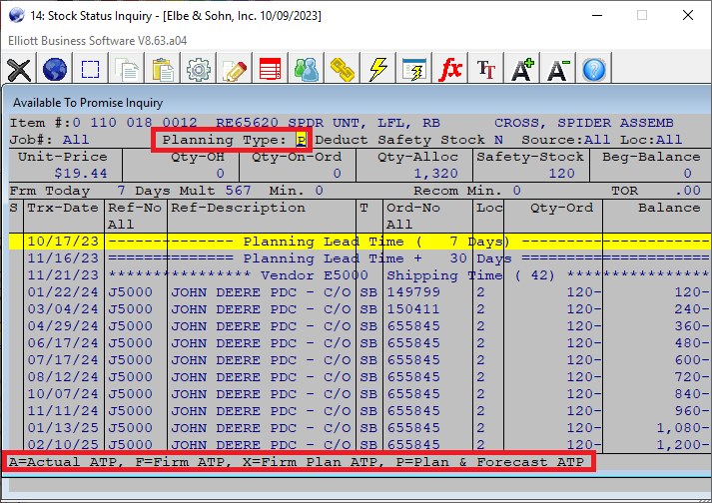
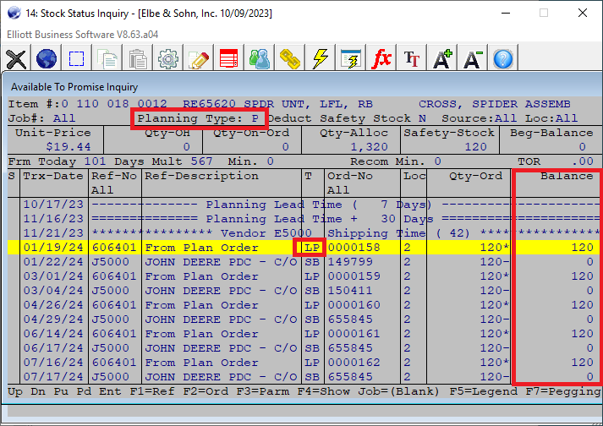
Parent ATP to Show Plan Trx

Slide 18
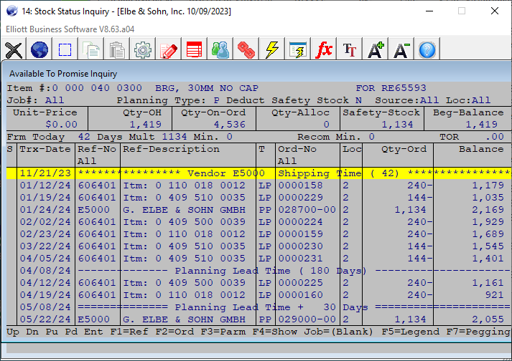
Component ATP & Planning Zones
Before or After Vendor Shipping Lead Time
Before or After Planning Lead Time
Before or After Planning Lead Time + 30 Days

Slide 19
Demo – Add ATP Data
Create daily, weekly or monthly buckets so planner can look for those items that become negative in any bucket.
As it gets closer, you want to see daily buckets
Then weekly, and in the future, monthly.
Advantage of managing MRP in Excel
See multiple items planning in one screen
Easier for planners to get an overall picture

Slide 20
Demo – Add Links Data
Links are critical for certain industries
For customers focused in eCommerce:
Spec
Drawing
Pictures
User guide
The above are setup as auto links.
Managers need to see if required links are created for the item in a report (CSV)

Slide 21
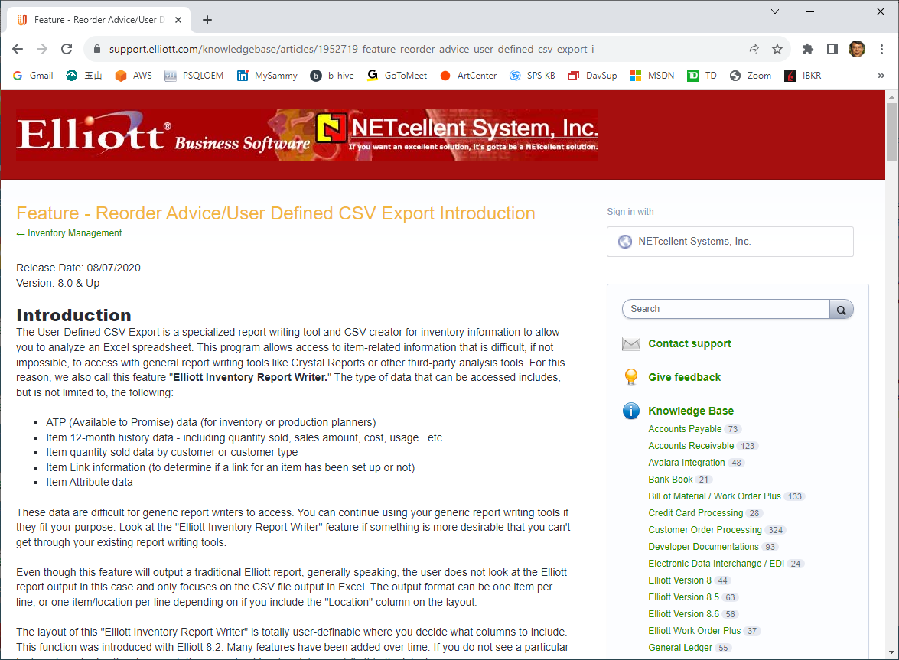
Where Do I Go from Here?

