Slide 1
New Credit Card Feature & HTML Receipts
Jim Graves
Developer

Slide 2
Quick Survey
How many of you accept credit cards for payments?
How many of you currently use our Elliott Credit Card interface?
How many are sending our new HTML receipt by email?

Slide 3
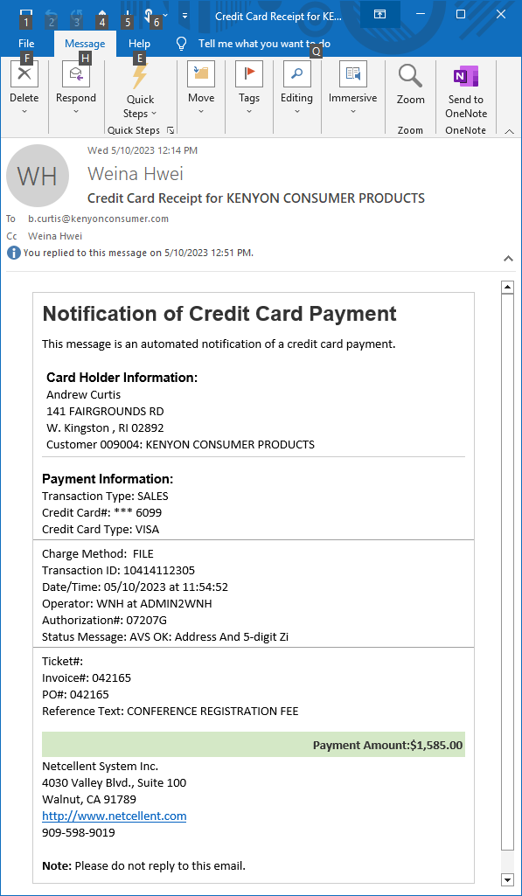
Here It Is!

Slide 4
Why Did We Develop This?
To provide a more professional appearance
To make it easier to email receipts
Set up using eContacts
To minimize the chance of being blocked by your customers’ email services
HTML content is considered safer than an attachment like PDF
Our HTML design does not rely on external image links. So there’s no blocking.
To eliminate the customers’ hesitance to click on an attached receipt

Slide 5
There Is a Lot to Consider
How is Elliott PostOffice involved?
How are email recipients selected?
Why are email enforcements suggested?
How can I customize the HTML receipt?
What if I mess up the provided HTML?
How do I reprint an HTML credit card receipt?

Slide 6
Elliott PostOffice Basics
PostOffice enables Elliott processes to:
Send individual email documents (Invoices, Statements, etc.) …
To pre-specified eContacts…
Instead of printing documents, stuffing them into envelopes and mailing them through the Post Office.
Let’s talk about what is involved to send HTML credit card receipts.

Slide 7
HTML or PDF Attachment
Our out-of-the-box HTML receipt provides a professional appearance.
HTML is more trusted because PDF attachments can contain viruses that can attack your computer.

Slide 8
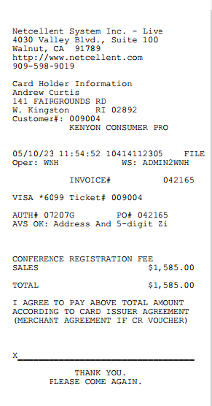

Slide 9
How To Use HTML Receipt
Set options in Global Settings
Specify eligible eContacts
Customers, ShipTo, Salesman, Order
Copy Customer, ShipTo and/or Salesman to the Order
Set any enforcements
Customize the HTML content

Slide 10
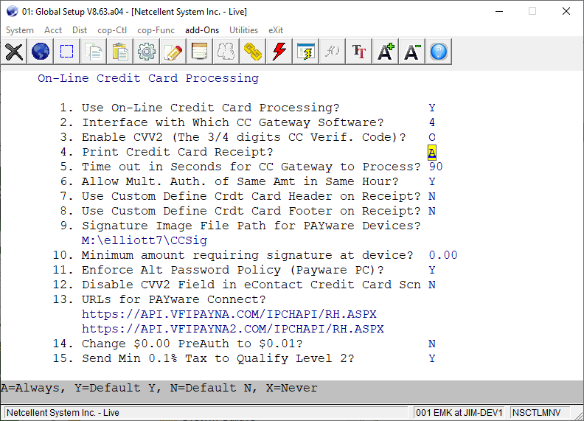
Set Global Settings Options

Slide 11
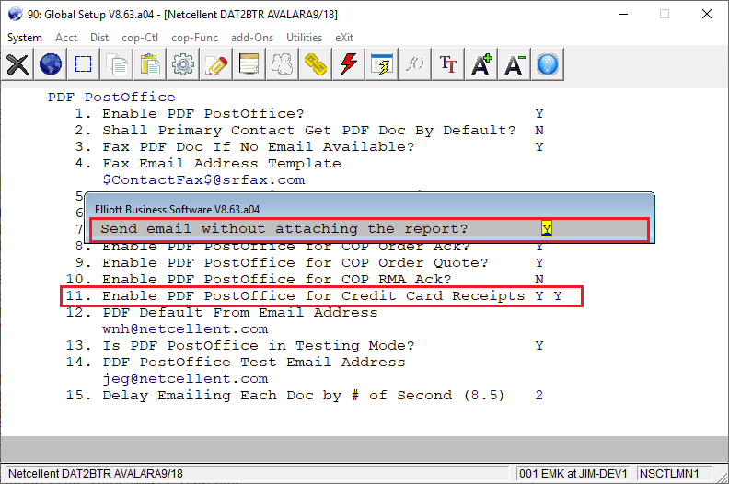
Elliott PostOffice Settings

Slide 12
Recipients Based on eContacts
The following eContacts will receive all documents by default:
Orders
The following eContacts will not receive documents by default – they must specifically request them:
Customer
Ship-To
Salesman

Slide 13
Specify Eligible eContacts
Typically start with the Customer
Bring up the Customer’s eContacts
Add or Edit an eContact
Go to the Web tab
Click on Accept HTML content
Push Email Docs… button
Check Yes for Credit Card Receipt

Slide 14
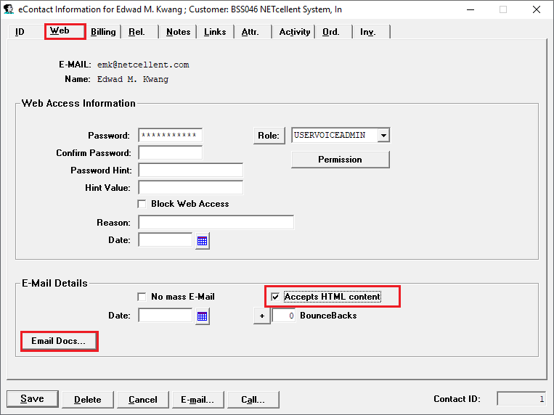
Specify Eligible eContacts

Slide 15
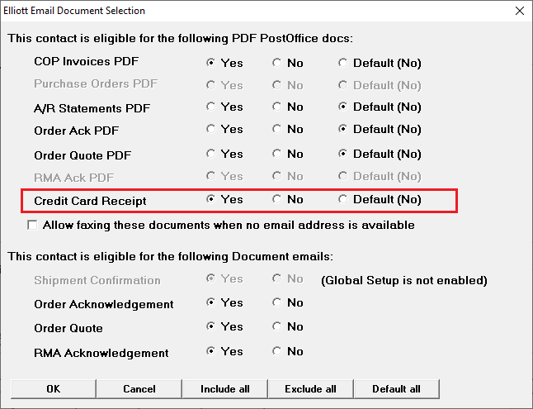
Specify Credit Card Receipt

Slide 16
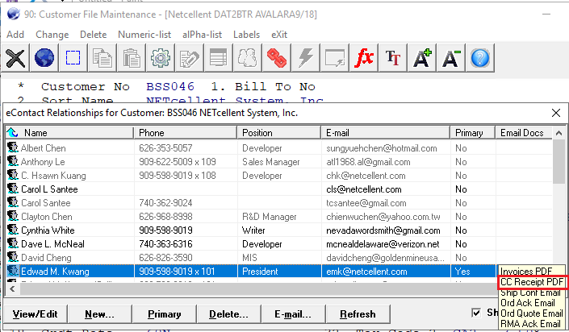
Notice eContact Gets CC Receipt

Slide 17
Enforcing Destinations
SUPERVISOR or designated Supervisor users can create enforcements for PostOffice documents.
This ensures that all others must use all the settings the Supervisor has set.
The Supervisor can enforce Email settings (to make sure the email is always sent the same way) and Disk settings (to enforce auditing).

Slide 18
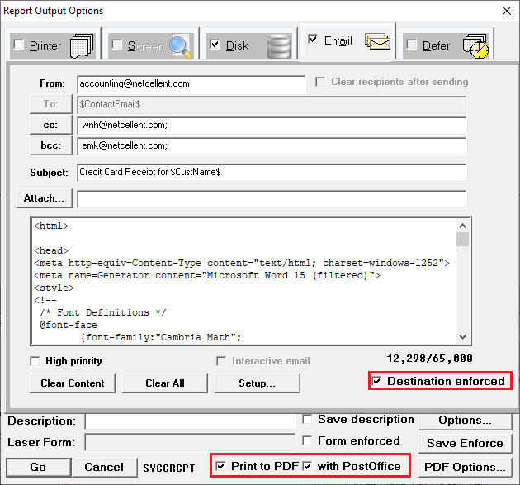
Enforcing Destinations

Slide 19
Modifying HTML Content
Must log in as SUPERVISOR
It is very detailed work and requires much knowledge of HTML.
Can export the “text” to an HTML editor, change it, and then copy it back.
You can insert variables, like the Card Holder name, by right-clicking.

Slide 20
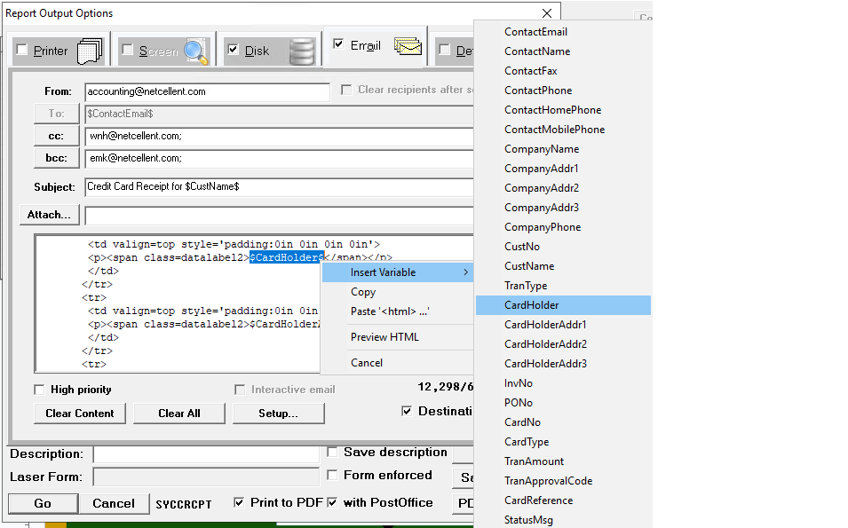
Modifying the HTML Content

Slide 21
Restoring the Default HTML
If you need to restore the default HTML:
Click the Clear Content button.
This erases the Body of the email.
Check the with PostOffice box.
If it was already checked and it gets unchecked, check it again.
This will restore the default HTML.

Slide 22
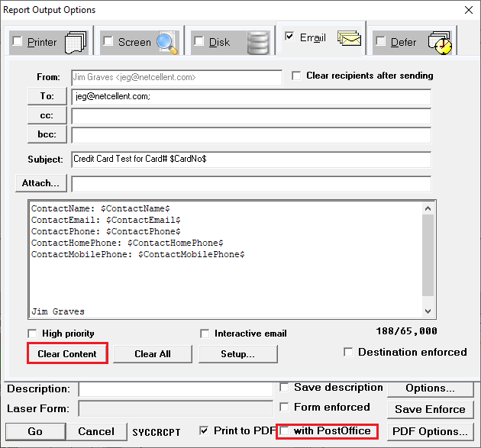
Restoring the Default HTML

Slide 23
Reprinting a Credit Card Receipt
Go to A/R / Processing / Credit Card Trx Handle
Select Change and enter the Trx ID if you know it…
Otherwise, select Add.
Enter the Customer number and press F8.
Select a transaction and press Print Receipt…

Slide 24
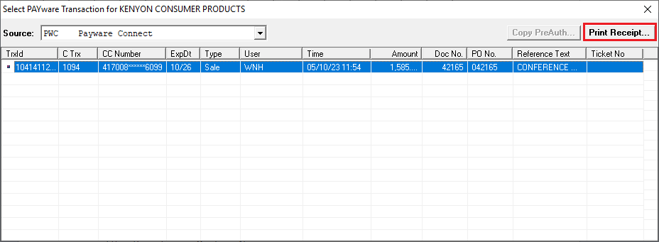
Reprinting a Receipt

Slide 25
Help Articles
That was a lot of content in a short time.
For more detailed information, search for these topics on Support.Elliott.Com:
HTML credit card receipt
PostOffice
Enforcements

