Slide 1
New Features in 8.5 & 8.6
Edward M. Kwang
President

Slide 2
New Features Since Oct. 2018
New Features since Last Conference
All these features can be found on https://support.Elliott.com
Weekly newsletter from Cynthia White
Provides links of new Elliott KB articles
Extremely useful
How many of you are not aware of this news letter?

Slide 3
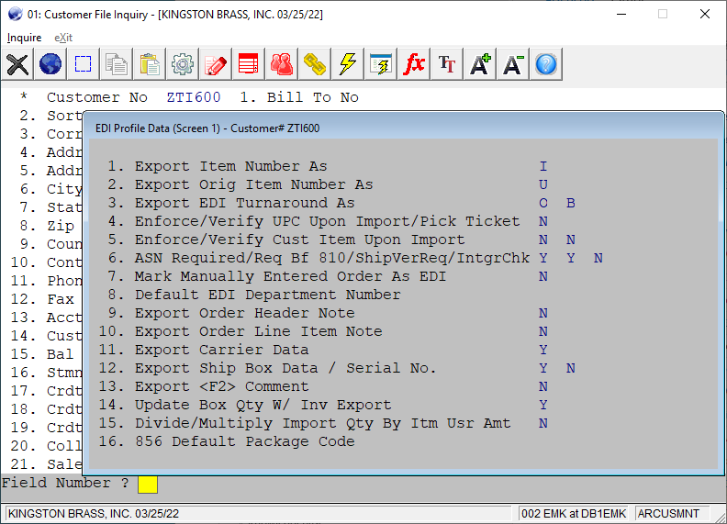
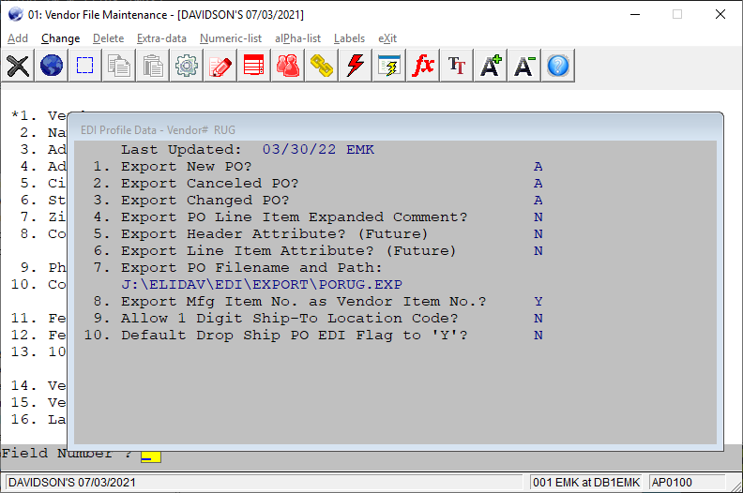
Support Vendor EDI Operations
Vendor EDI Profile
Customer EDI Profile

Slide 4
Find out Who Did Not Logout at Night
For those users who do not logout at night time, the backup may not work well
Find out who those users are.
Send them an email to remind them.
System Utilities -> Password Setup -> List -> Active users Report

Slide 5
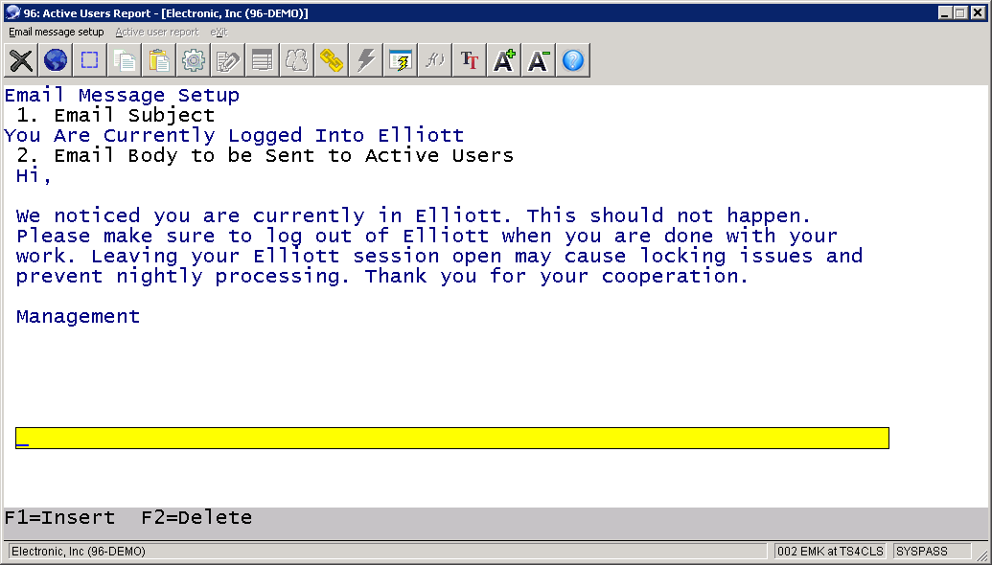
Setup the Email Content

Slide 6
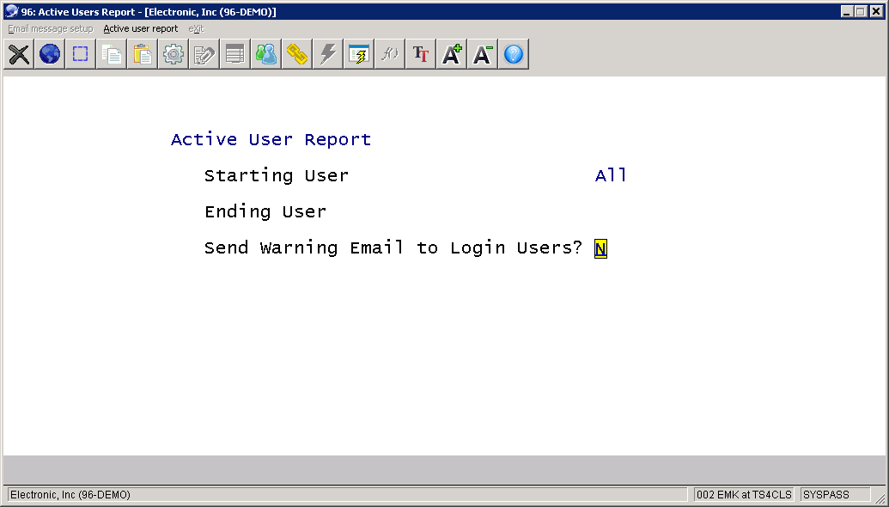
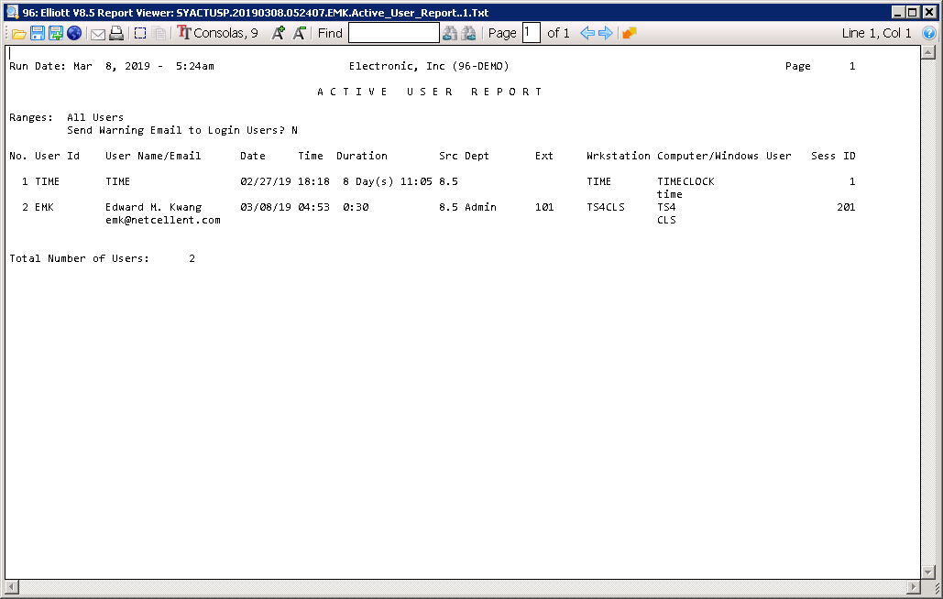
Run (Defer) The Report

Slide 7
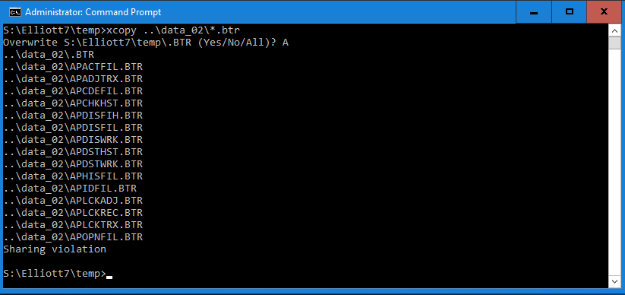
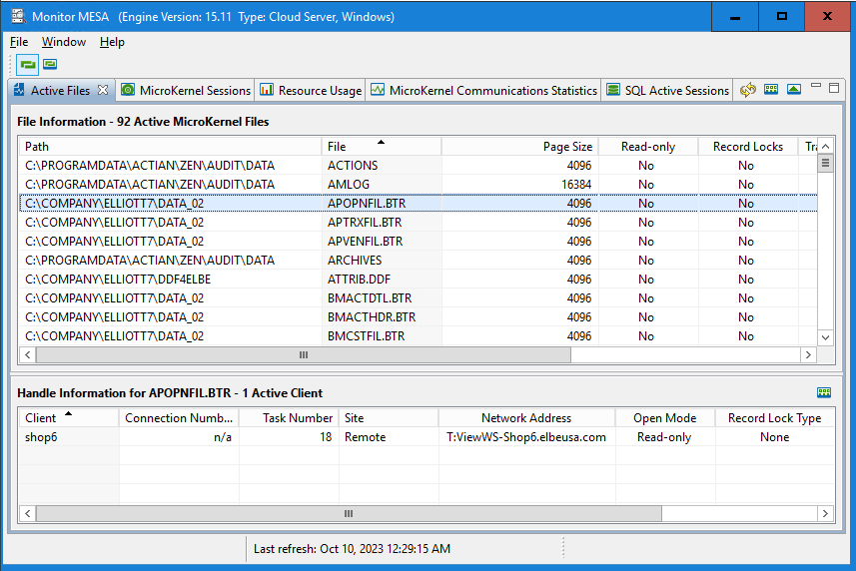
Sharing Violation When Copying
Notes:
Why is this important?

Slide 8
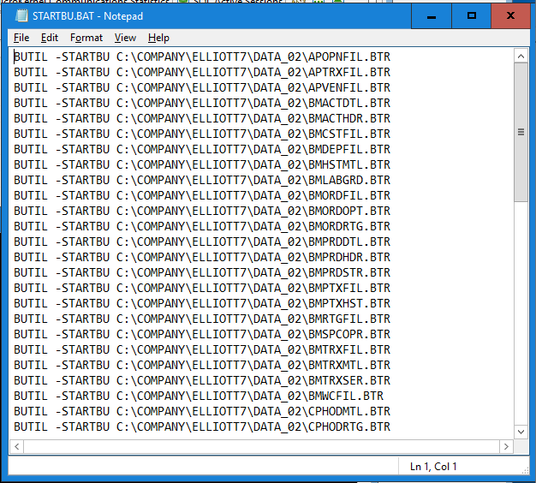
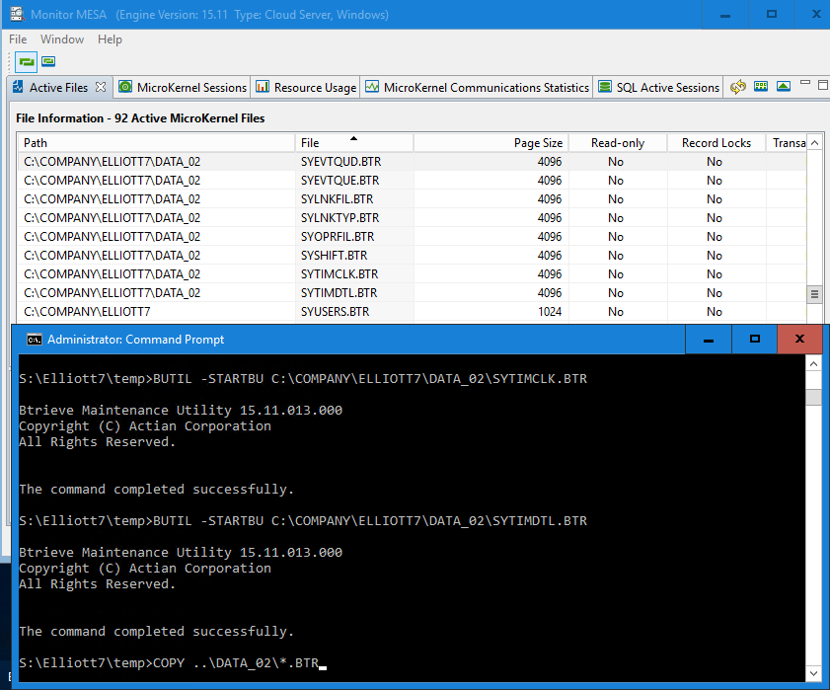
Use BUTIL –STARBU -ENDBU

Slide 9
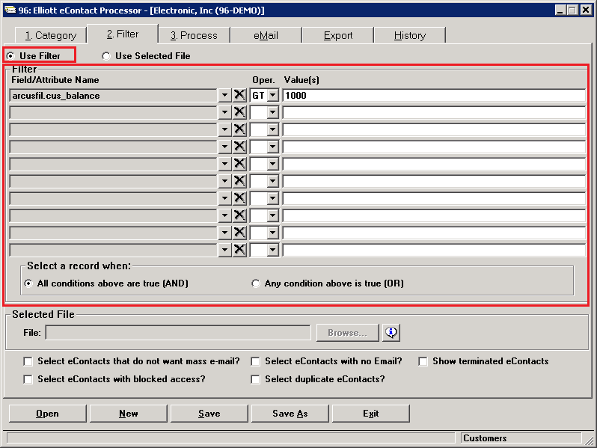
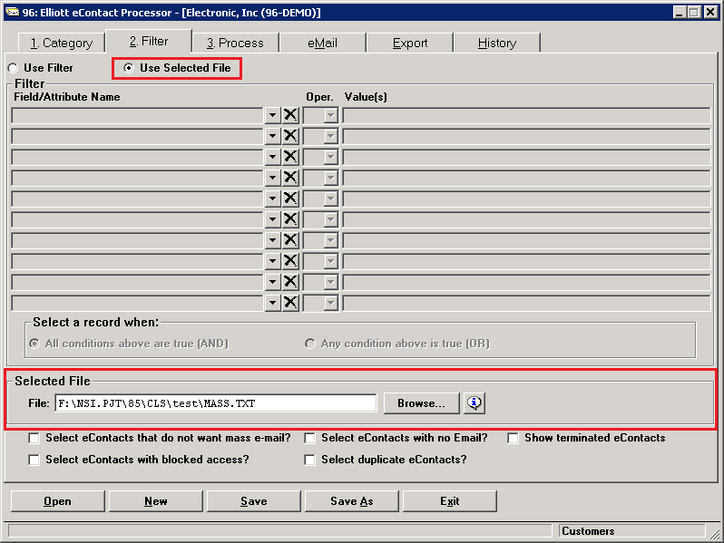
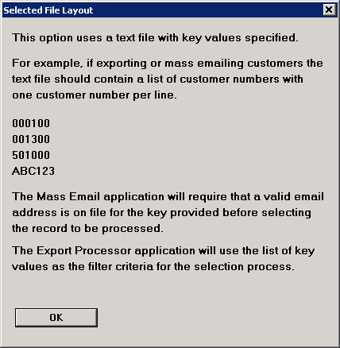
Mass Email & Export Filter by Text File

Slide 10
3PL or 3rd Party WMS Interface
Based on the interface we developed for Radio Beacon (WMS) + Existing CSV
Delimited Files (to 3PL)
Item Master
Vendor PO
Receiving
Pick Ticket
CSV Files (from 3PL)
Receiving (Warehouse Receiving)
Shipment from 3PL (Billing Selection)
Tracking Number
Physical/Cycle Count

Slide 11
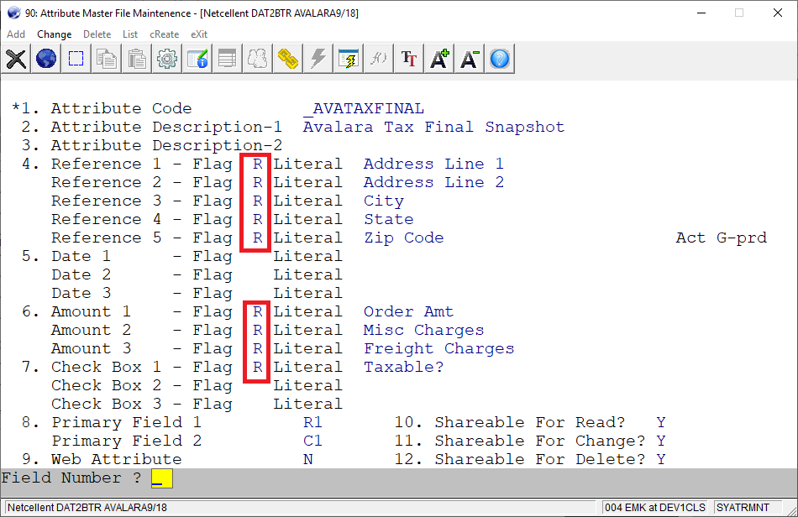
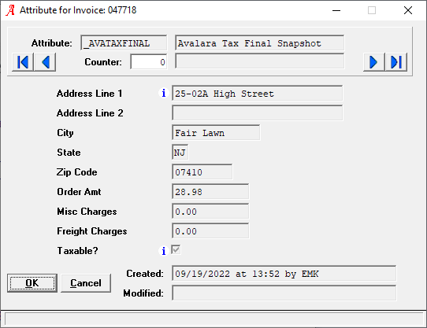
Read Only Attribute
Notes:
We added this feature for Avalara
The idea is this attribute AVATAXFINAL is created by Elliott. Elliott users should not change the value in this attribute. So it make sense to make it “Read Only”.
Is there other scenario make sense to make the attribute fields Read Only.
EDI import create a lot of attribute (but this can be iffy..if you need to manually add)
Update it with attribute CSV import, and don’t let user change it.

Slide 12
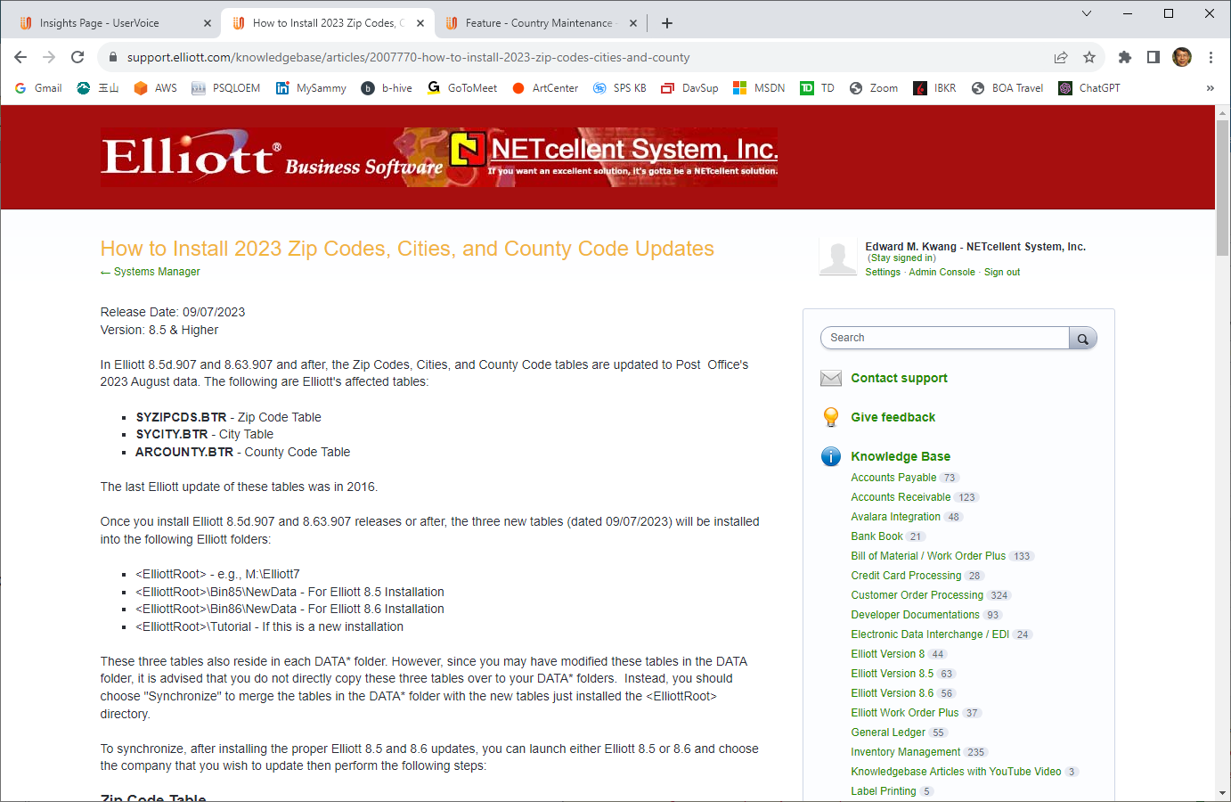
August 2023 Zip Codes Update

Slide 13
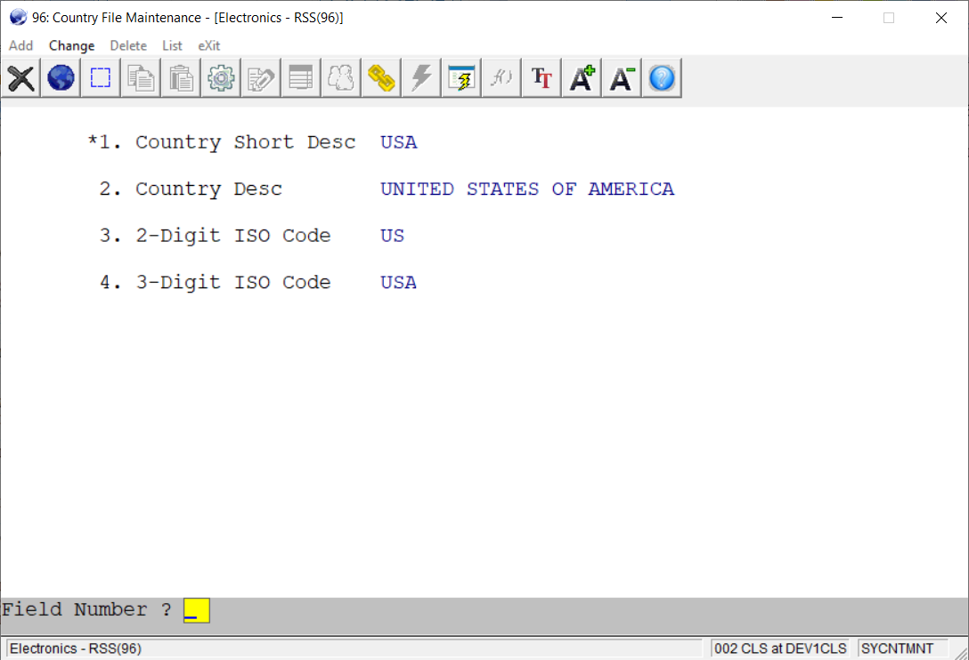
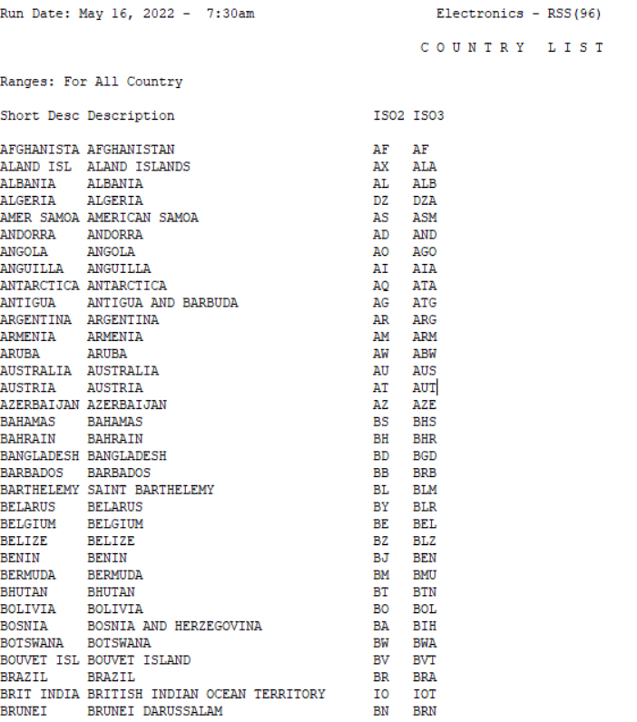
Country Code - Standardization
Notes:
Driven by Avalara integration.
Country field is a free form field in Elliott. 10 digits long
The purpose is to standardize the entry of country field.
You can optionally turn on the validation logic when you enter country field in Elliott.
Elliott Country Field Size is 10 digits, so we call that the “Short Desc”.
Then we have the 30 digits, that’s the long description.
The 2 digit ISO Code is the mostly commonly used standard.
We also keep track of the 3 digit ISO Code.
The list of country records is delivery to you with an Elliott update. You could update it, but we see no particular reason you need to do that right now.

Slide 14
Customer Add & Change CSV Import
Add New Elliott Customers
A/R -> Utility -> Customer/eContact Import
Customer/eContact Import
eContact
Import eContact
Import Customer (Legacy Solution)
Customer Import – use this one
Mass Update Customer
A/R -> Utility -> Customer/eContact Import
Mass update utility -> mass change customer
Global Setup -> Utilities -> AR Utilities -> Mass Change Customer Import

Slide 15
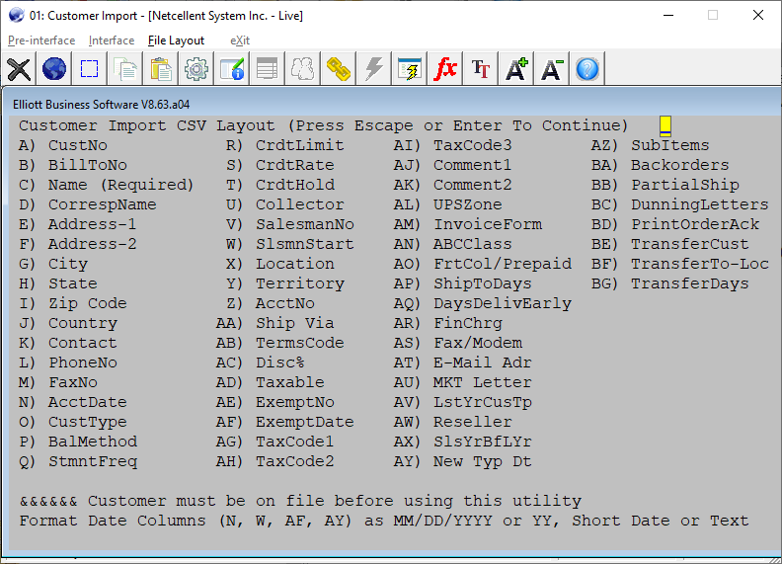
Fields for Adding Customers

Slide 16
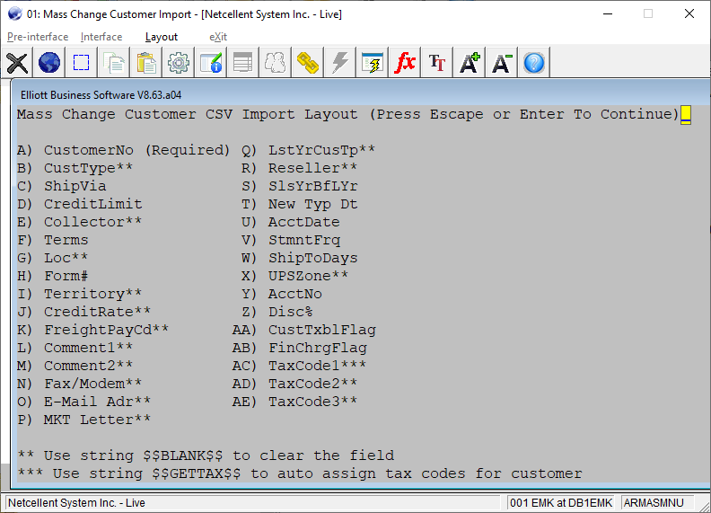
Fields for Updating Customer
Notes:
The list of fields are less than adding customer. Why is that? If you know the answer, raise you hands.
When updating a field in customer, many of them have other consequence and make it complicated.
List could be expanded. You can put your ideas on our support portal.

Slide 17
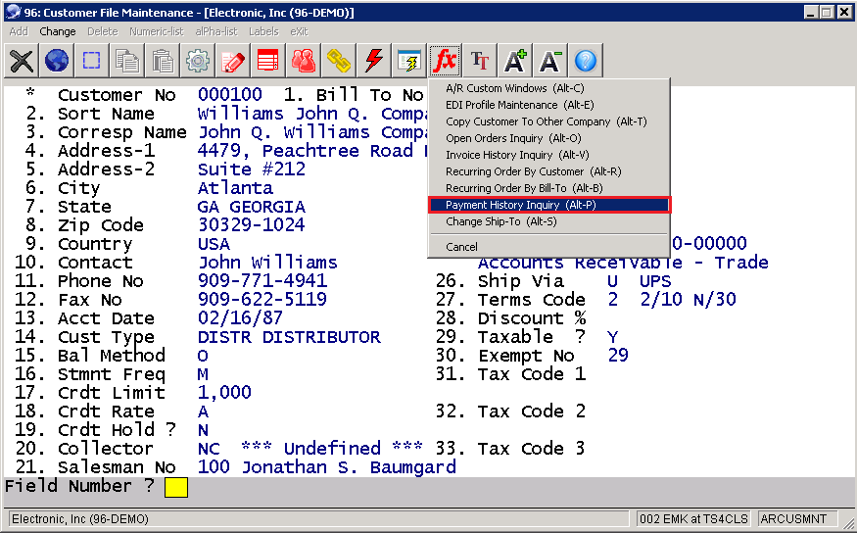
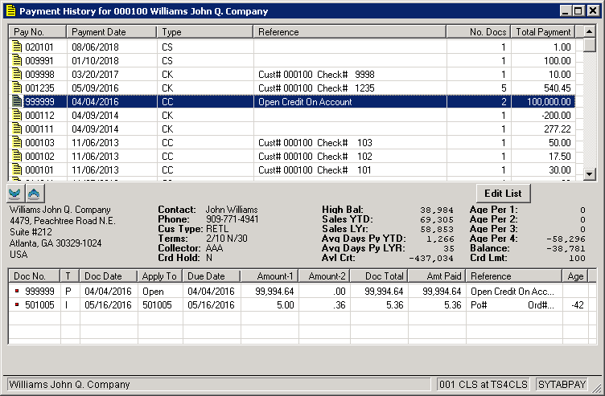
Payment History

Slide 18
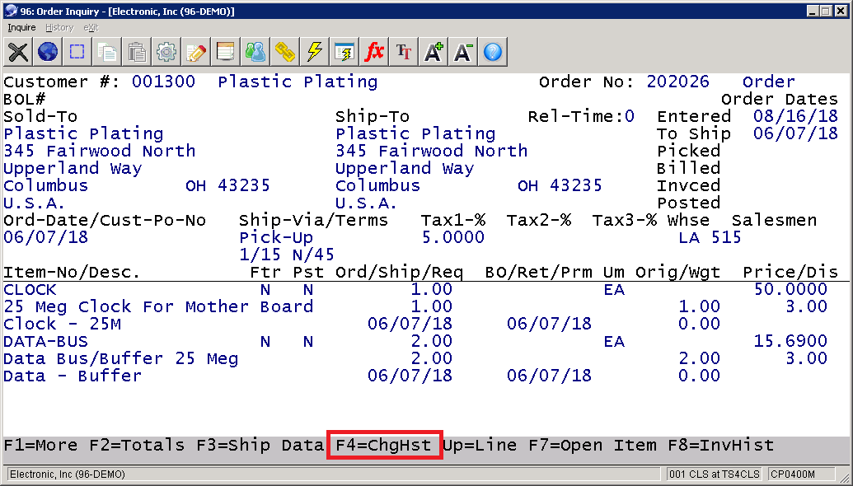
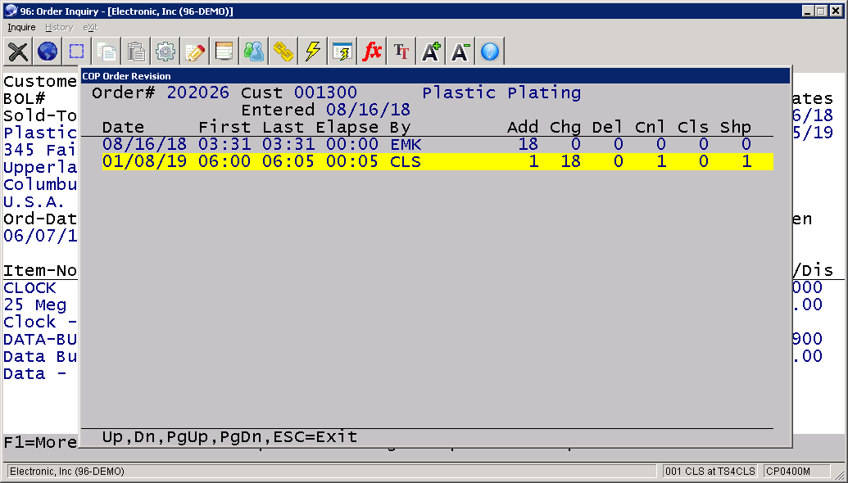
Order Inquiry with Change History

Slide 19
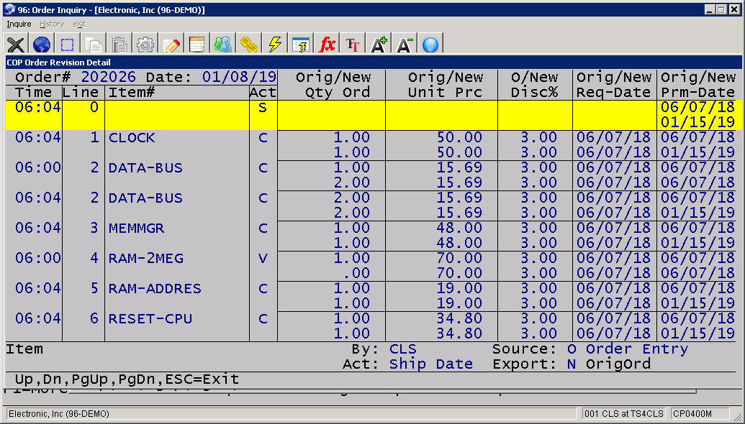
Drill down Line Item Audit Trail from Order Inquiry

Slide 20
Import Box Data for Shipment Verification
Primary Purpose – The third party WMS or logistics don’t want to produce the UCC-128 labels.
UCC-128 label is tied with EDI ASN (856)
Third party does not have all the EDI data.
Added benefits - The box data is now visible on the Elliott side.
Shipment Verification License is required

Slide 21
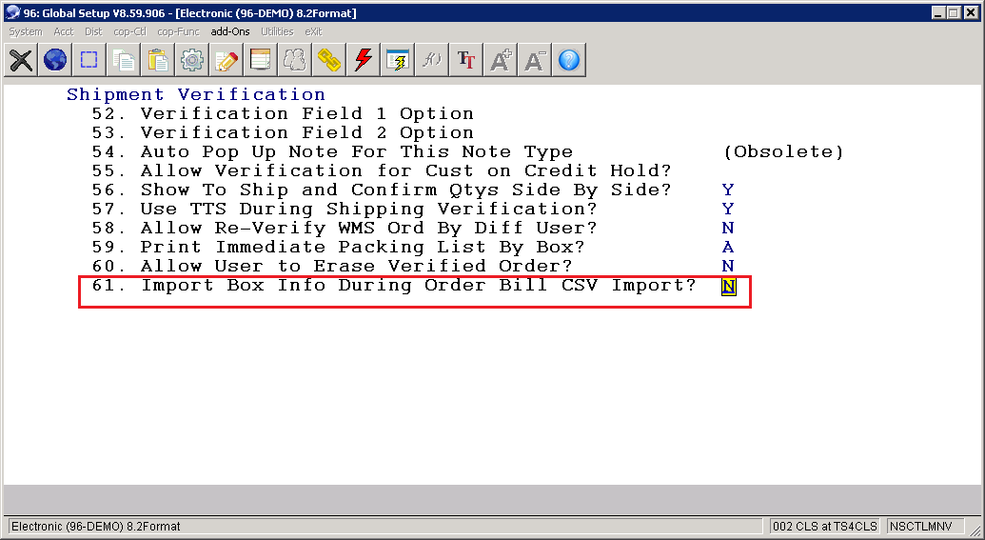
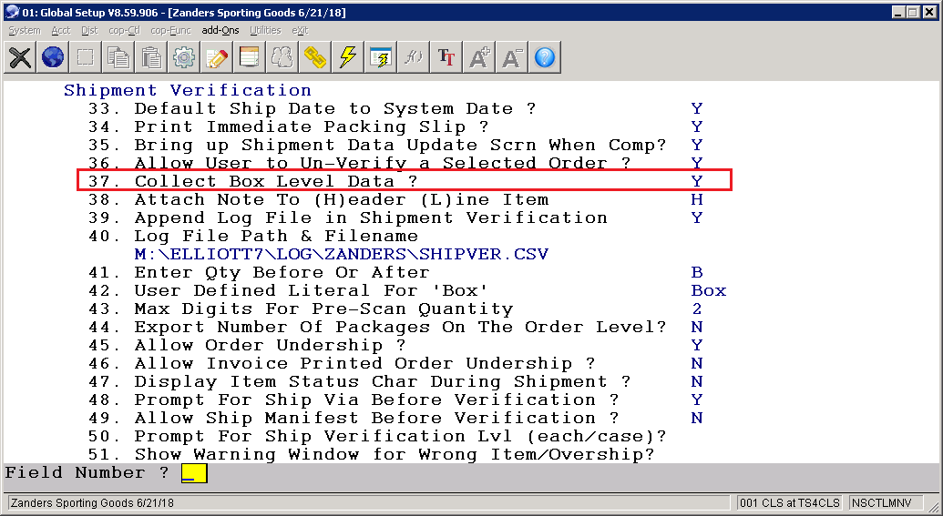
Global Setup

Slide 22
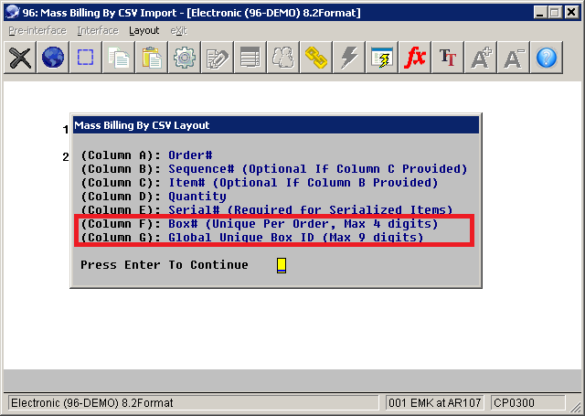
Mass Billing CSV Import Layout
Notes:
The third party WMS or Logistic will send us the data to indicate the order they have packed and ready to go. Here is the detail. We need to use that for billing selection.

Slide 23
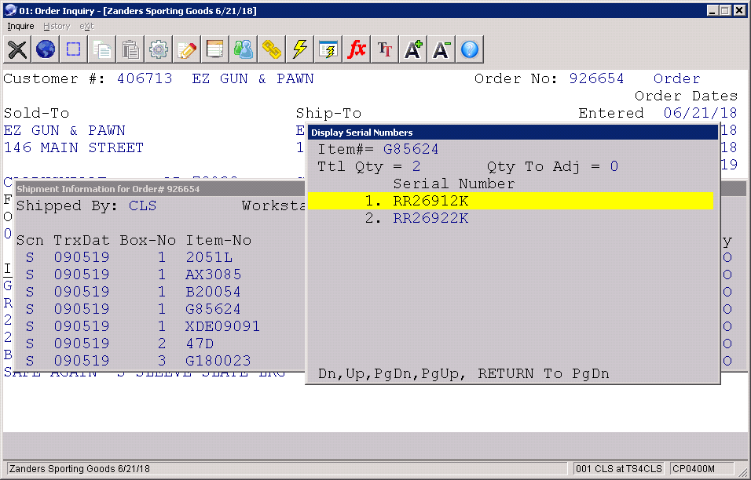
Drill down to Box Data

Slide 24
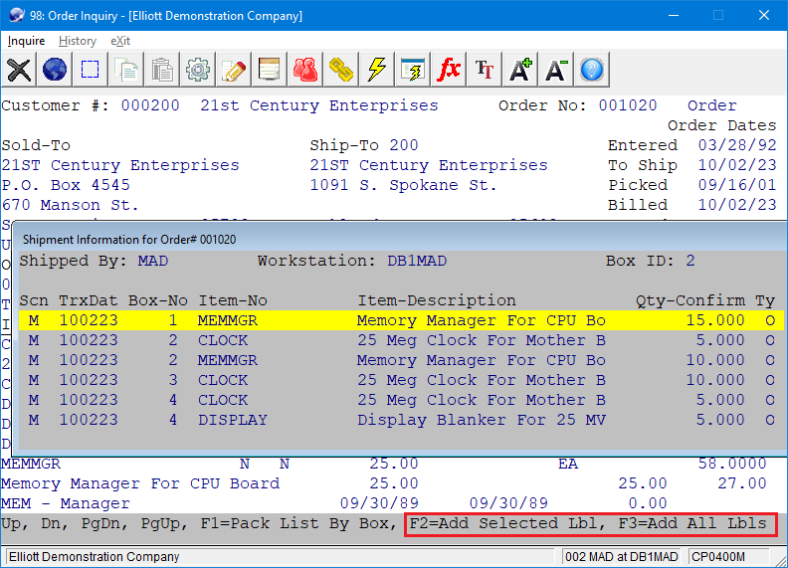
Create UCC-128 Labels

Slide 25
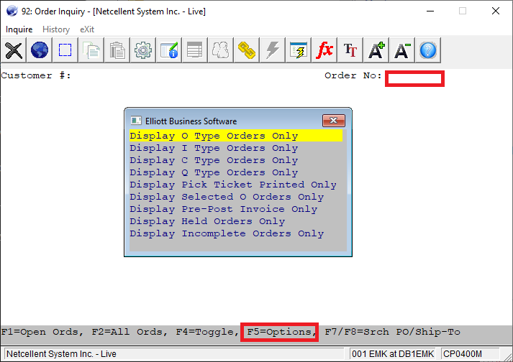
Order Inquiry F5 Filter Option
Notes:
You can either enter the customer, or skip the customer, then at Order No field, press F5, then you will see this window popup.

Slide 26
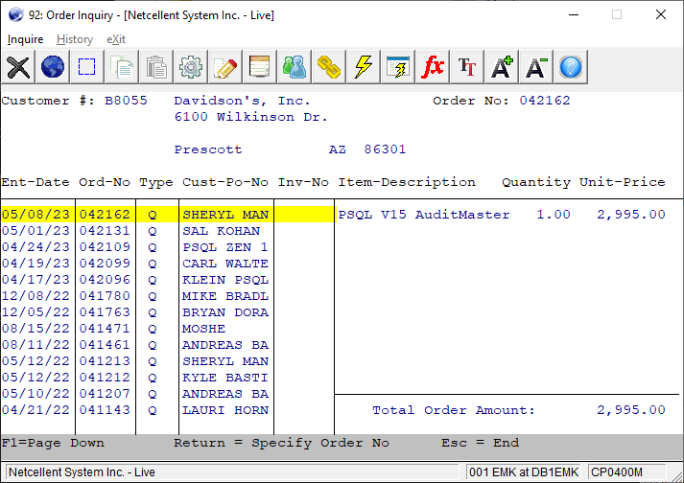
Display a List of Q Type Orders

Slide 27
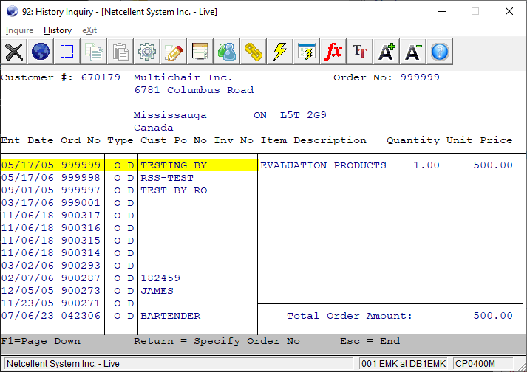
Display a List of Deleted History Order

Slide 28
Colorado Retail Delivery Fee
For a retail transaction that is delivered to the state of Colorado:
A misc. item of “Retail Delivery Fee” $0.28 as of 7/1/23 needs to be added to the invoice as a separate line item.
The alternative is the retailer can pay Colorado for this fee without adding the line item.

Slide 29
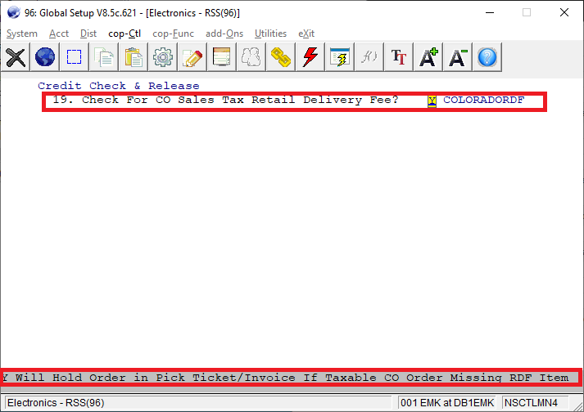
How do we help to enforce it?
Define the Colorado RDF item in Credit Check and Release. If a CO order does not have this line item, then put it on hold.
Notes:
My personal opinion is US National Sales Tax System is broken.
It used to every state collect their own tax within their own boundary.
Now each of the state can enforce special rules on the other 49 states. That make it very complicated to compliance.

Slide 30
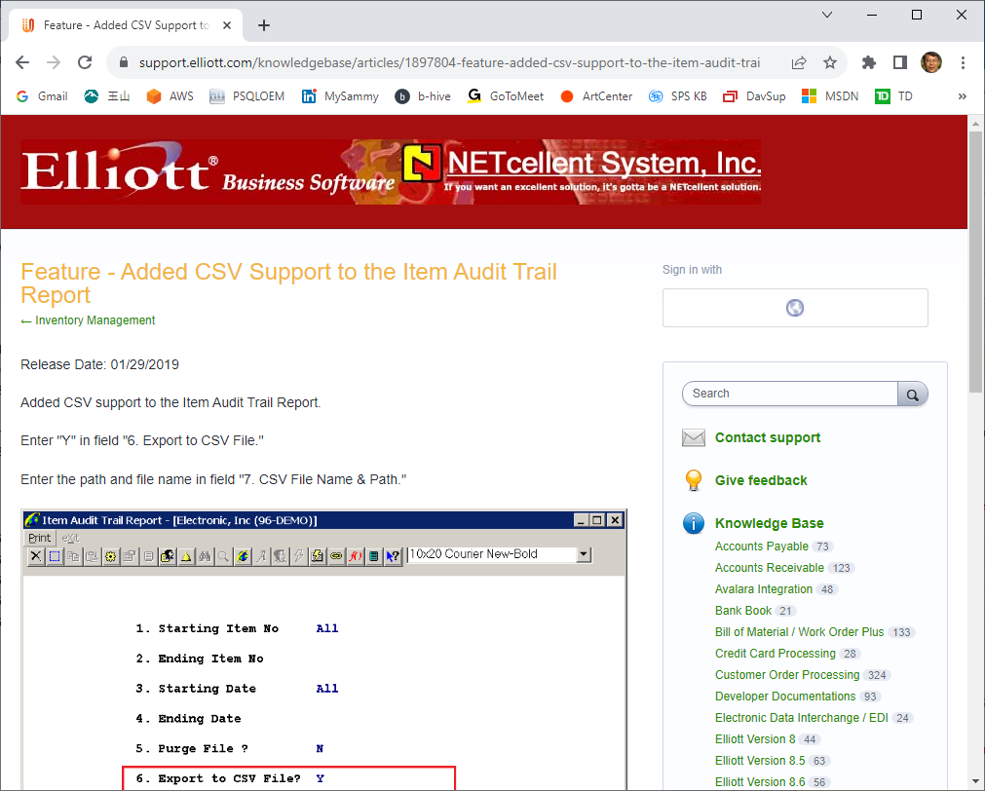
Item Audit Trail CSV Export

Slide 31
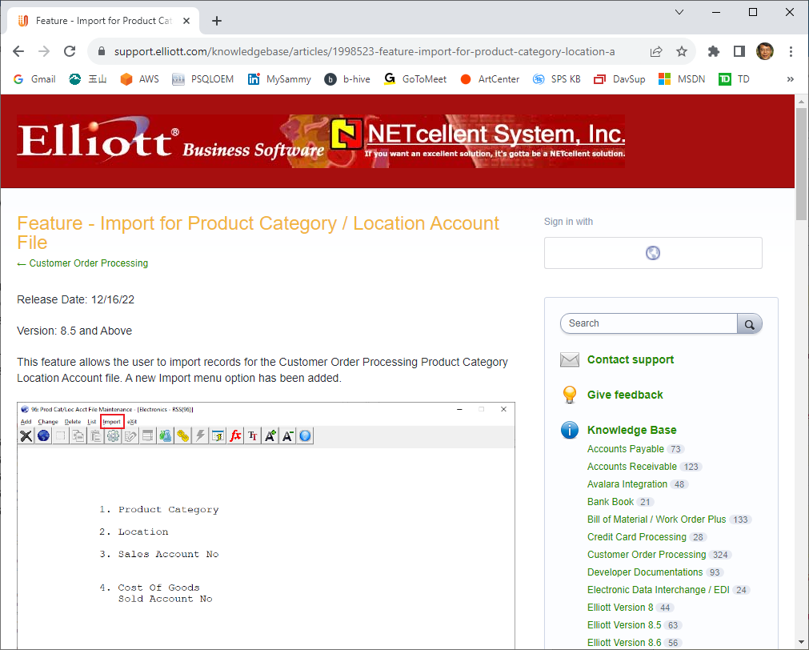
Product Category Location Account CSV Import

Slide 32
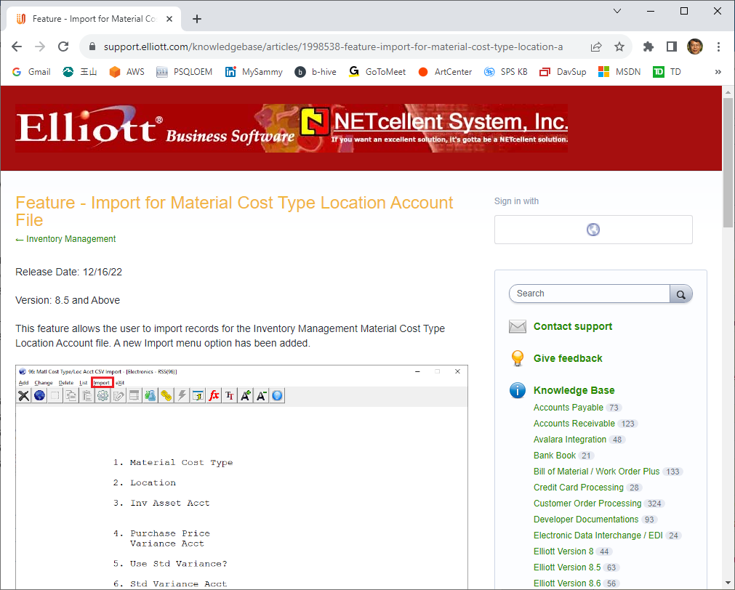
Material Cost Type Location Account CSV Import

Slide 33
Multi-Bin Physical Count in the Past
Even though you could do cycle count in the past, the implementation has flaws:
You can’t do physical count for 1 location.
Therefore, you do cycle count for 1 location.
If one item in that location is not counted, it assume it is not part of the cycle count and hence do not raise warning.

Slide 34
Multi-Bin Physical Count Enhancement
We now add support for the following:
Cycle Count by Bin Range
Physical count for one location
It continues to support:
Cycle Count by Items (old method)
Physical Count for All Locations
This change does not apply to Non-Multi-Bin Users.

