Slide 1
Plus Work Order New Features
Roger Sueng
Vice President

Slide 2
Plus Work Order CSV Import
Regular Work Order Import.
Apply to legacy, material and plus work order.
Apply standard product structure (BOM).
Plus Work Order Import with Custom Components.
The feature just applies to Plus Work Order only.

Slide 3
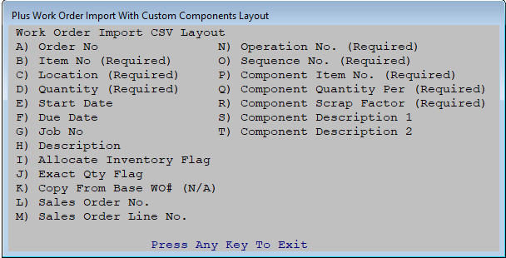
CSV File Layout

Slide 4
CSV Import File example

Slide 5
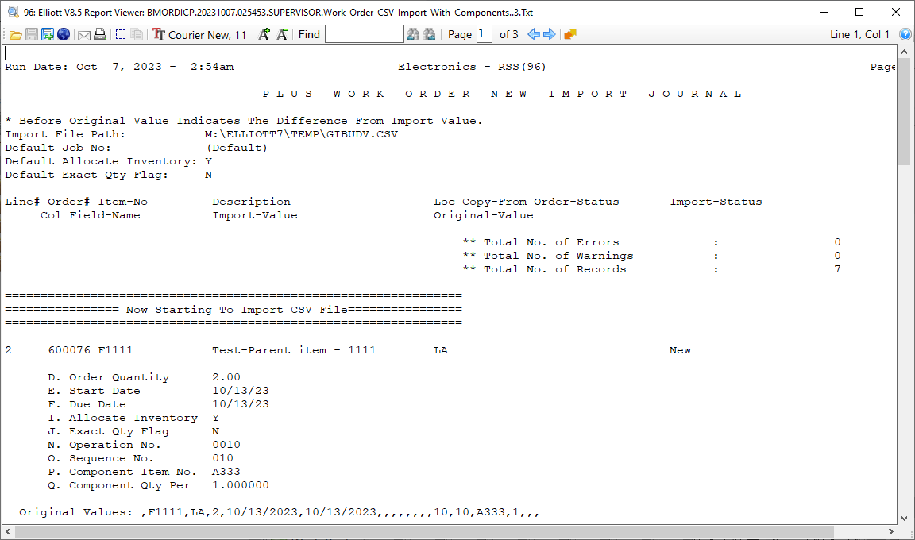

Slide 6
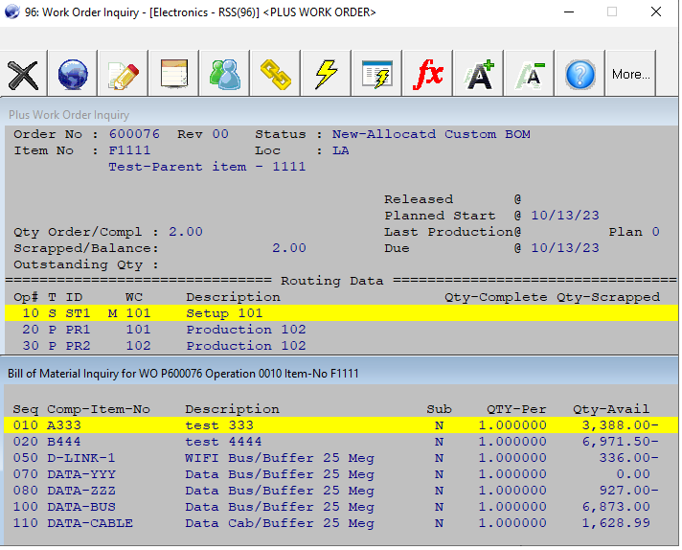
Plus Work Order Inquiry of Custom Components

Slide 7
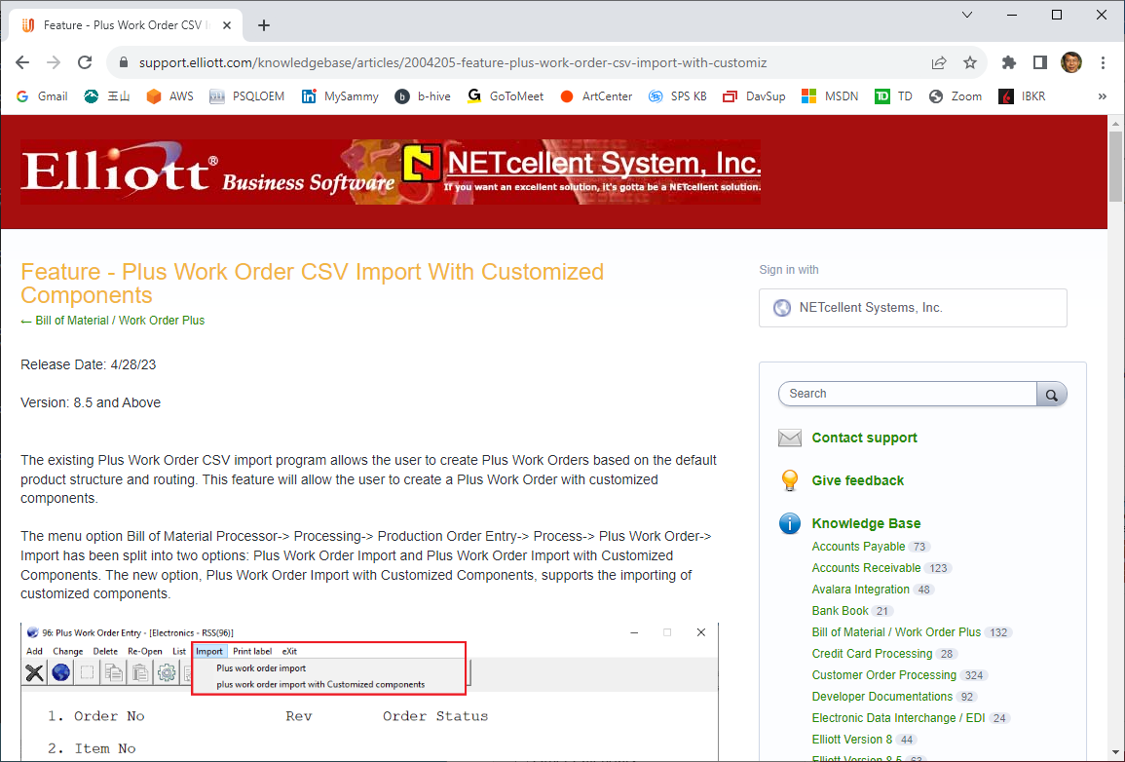
Customized Components CSV Import

Slide 8
Other Improvement Features (1)
Flatten phantom items BOM structure to create WO and allow decrease sequence number increment (e.g. 5). **
Create shortage allocation from WO+ material issue. It allows to fill in later. **
Set security to prevent from update cost on print costed bill of material. **
Allow changing operation number increment from 10 to others. **

Slide 9
Other Improvement Features (2)
You can use the component serial # as the parent serial #. In some industries, a major component’s serial number will be the finished good’s serial # as well. This feature will avoid double entry and typo errors. **
Security setting for print schedule reports.

Slide 10
Other Improvement Feature (3)
Operator Inquiry Auto Refresh setup. **
Allow to create WO by copy from a different item. It will save time to create a custom work order from a historic order.
Display hours in minutes & second in routing screen. **
Reset work order transaction data to clean up abandon records.

Slide 11
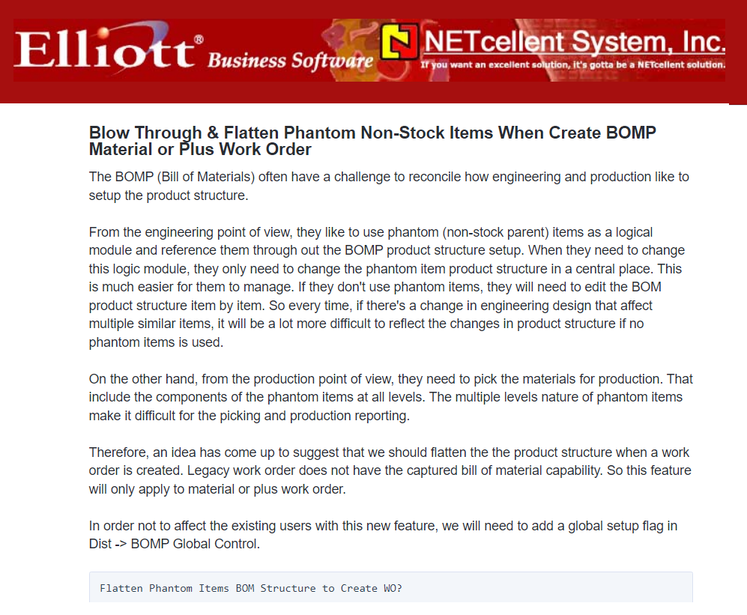
Blow Thru & Flatten Phantom Items

Slide 12
Material Shortage Tracking

Slide 13
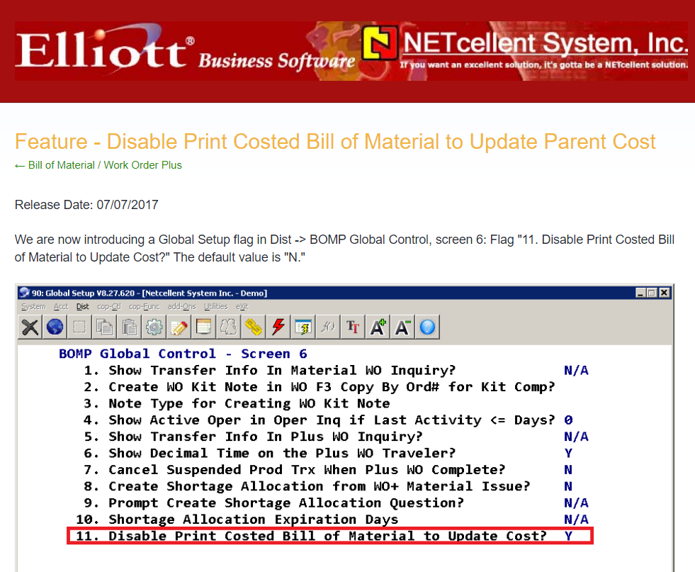
Disable Costed BOM to Update Cost

Slide 14
Plus WO Operation No. Increment

Slide 15
Component Serial No. to Parent

Slide 16
Plus WO Display Time in HH:MM:SS

Slide 17
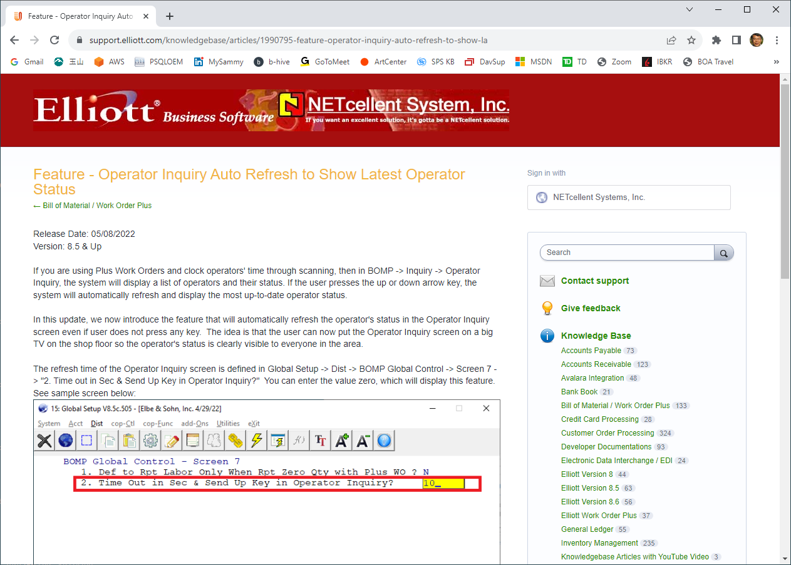
Operator Inquiry Auto Refresh

Slide 18
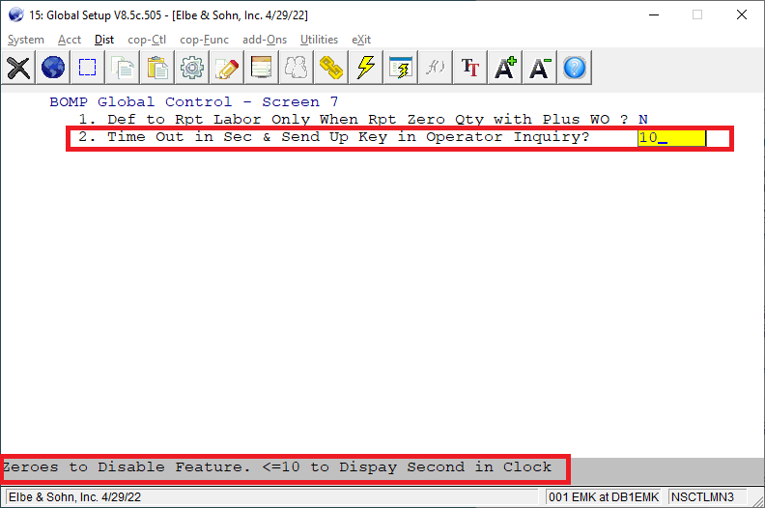
Operator Inquiry Auto Refresh Setup

Slide 19
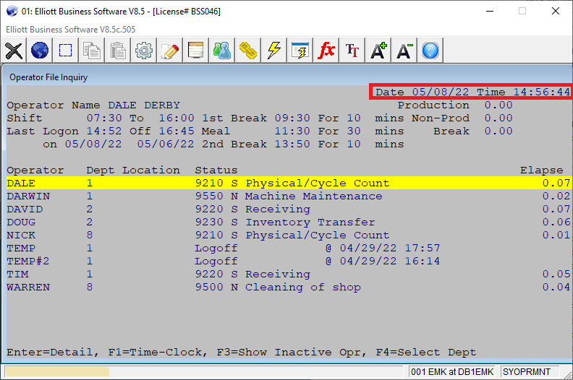
Display Operators Time Clock on a Big TV

