Slide 1
PowerSearch
Carol Santee
Vice President of R&D

Slide 2
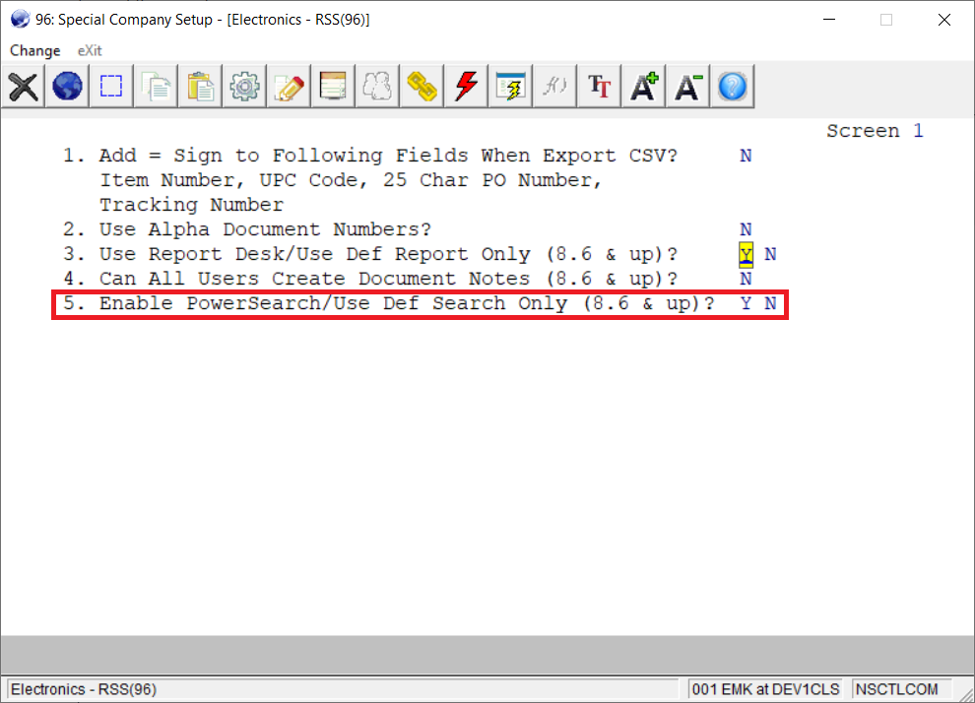
Enable PowerSearch
Company Specialized Control in Global Setup

Slide 3
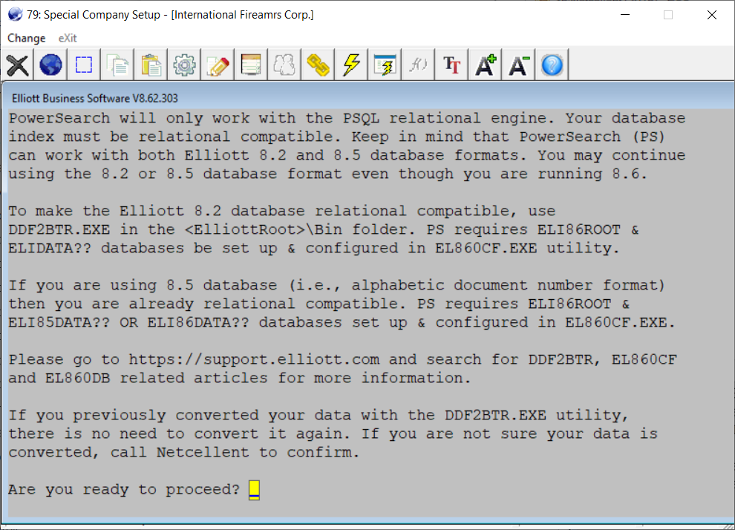
Enable PowerSearch
PSQL Relational Engine
Supports Elliott 8.2 and 8.5 (alpha document) Data Formats

Slide 4
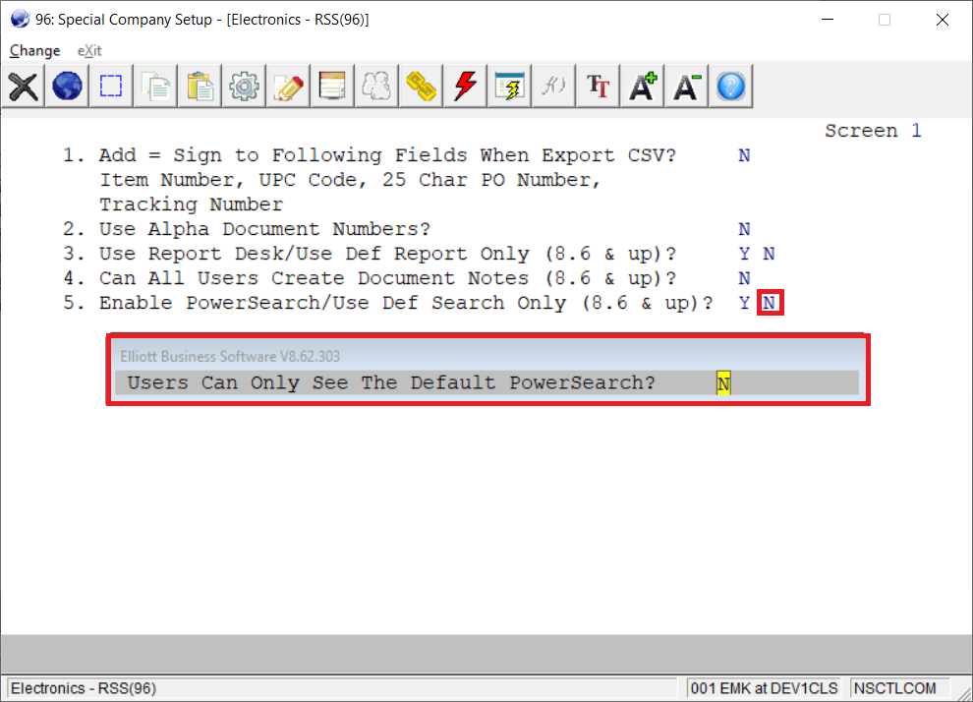
Enable PowerSearch
Y - Supervisor has access to “Show” option to control which searches are disabled
N - All searches are available to all users

Slide 5
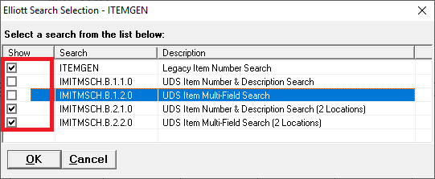
Enable PowerSearch
Supervisor can control which searches are disabled for all users.

Slide 6
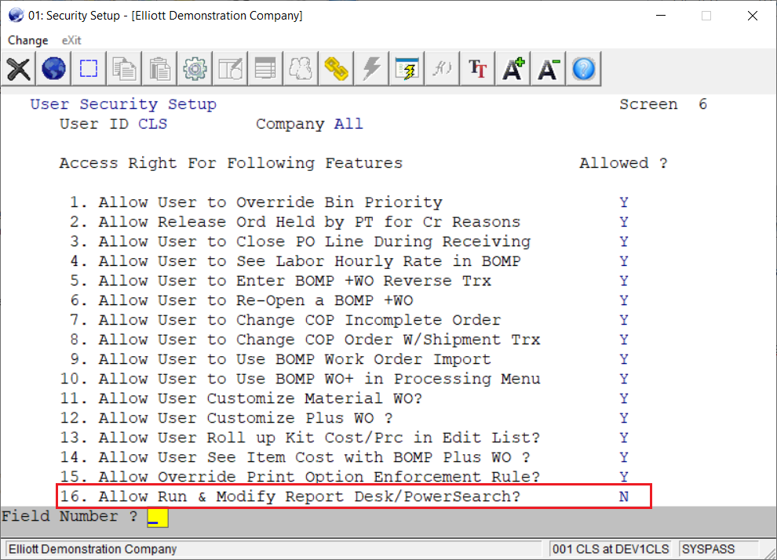
Enable PowerSearch
This option allows you to determine which users can run and modify PowerSearch searches. This can be controlled globally for all users and it separately for individual users.

Slide 7
The Right Database Name
PowerSearch needs to know your database names (DSN)
ELI86DATA?? - alpha doc numbers
ELI85DATA?? - alpha doc numbers
ELIDATA?? - 8.2 numeric doc numbers
8.2 DDFs must have entries for NSCTLFIL_?? tables

Slide 8
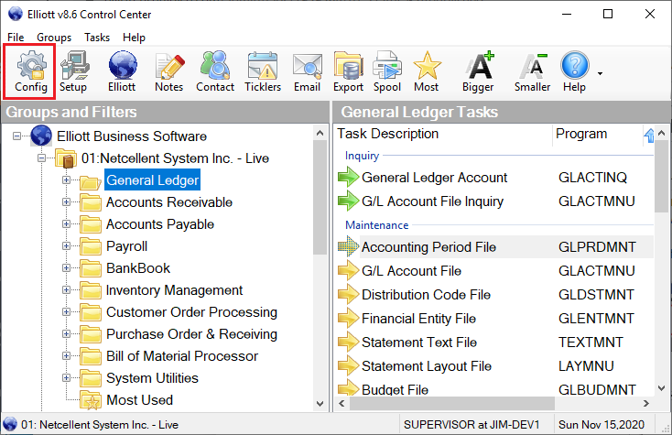
Elliott Database Configuration
Supervisor can run from the Elliott Control Center or can be run from the <ElliottRoot>\Bin86 directory using EL860CF.exe.

Slide 9
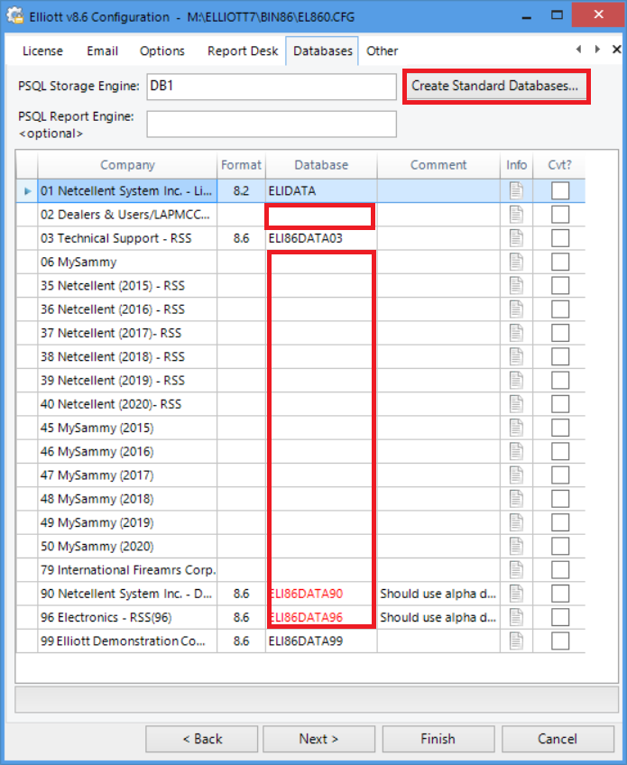
Elliott Database Configuration
Click on the “Create Standard Databases” button to create standard named databases
Run EL860DB.exe from the <ElliottRoot>\Bin86 directory
PSQL Control Center should be used to create non-standard named databases

Slide 10
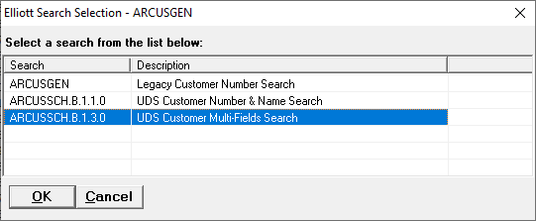
Running a PowerSearch
If an application has PowerSearch searches available, the user will be prompted to decide which search to run.
The “Legacy Customer Number Search” above is the traditional Elliott search that you are familiar with.
The “UDS Customer Multi-Field Search” is the new PowerSearch.

Slide 11
Running a PowerSearch
PowerSearch supports a standard naming convention.
ARCUSSCH.X.1.2.3
ARCUSSCH - type of search
X - either B (base) or E (enhancement)
1 - template ID
2 - search ID
3 - user revision

Slide 12
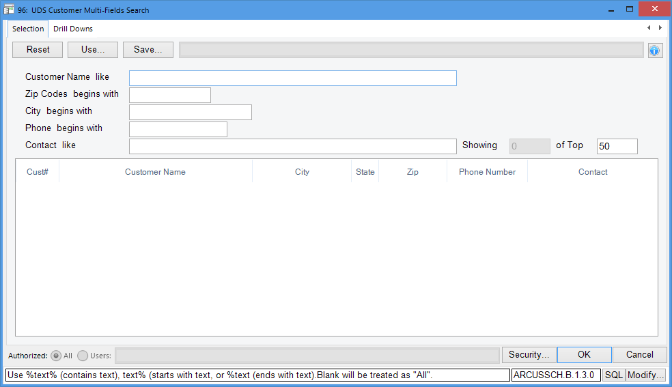
Running a PowerSearch
Clicking on ARCUSSCH.B.1.3.0 will launch the search parameter screen. You can enter the search criteria. If you don’t enter anything, clicking on the OK button will default the range to ‘All’.

Slide 13
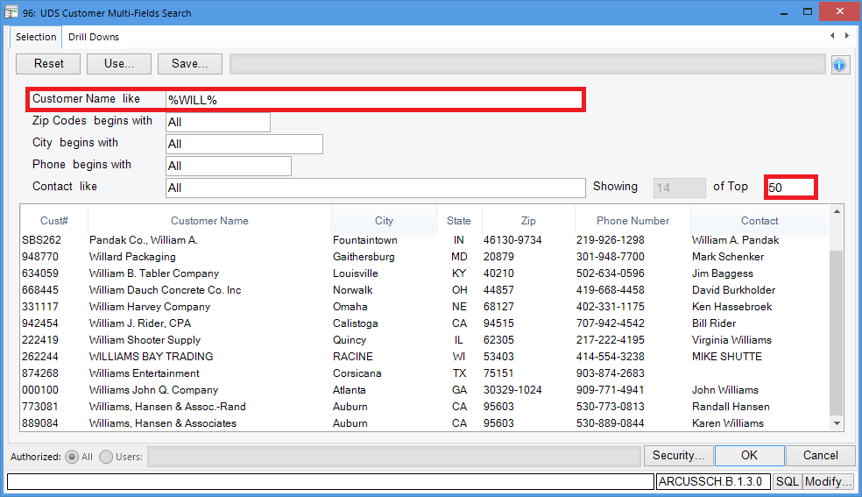
Running a PowerSearch
Fields with the “Like” condition allow you to search for fields that contain that criteria. Notice the “Top” field. This field will default to 50 on some searches. This will limit the number of records returned to the first 50 that meet the criteria entered. You can override this value to expand your search results.

Slide 14
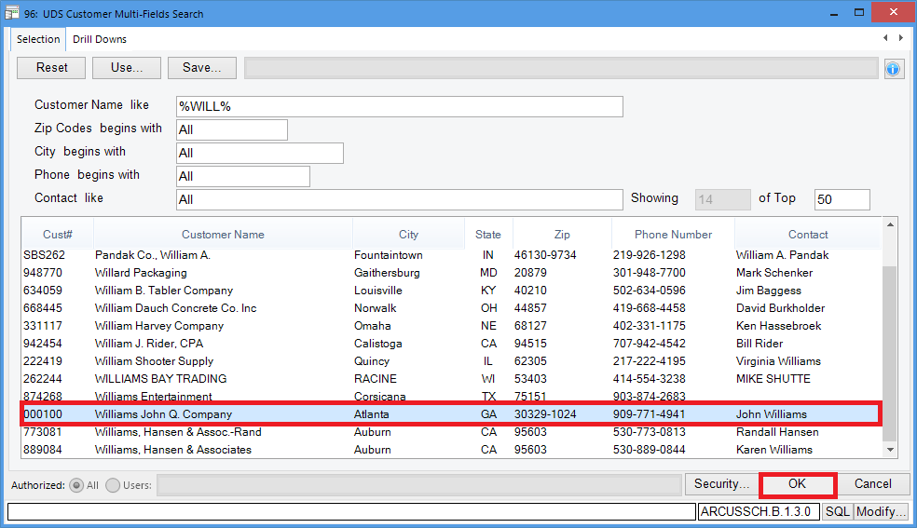
Running a PowerSearch
Select the appropriate customer, and click the OK button. This will return your selection to the application where the search was launched.

Slide 15
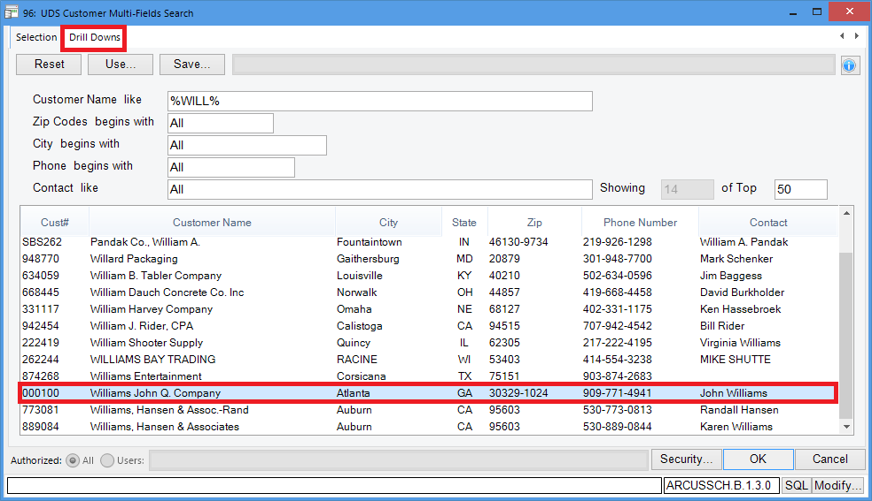
Running a PowerSearch
Some searches will have a “Drill Downs” tab available. Select a record and click on the “Drill Downs” tab.

Slide 16
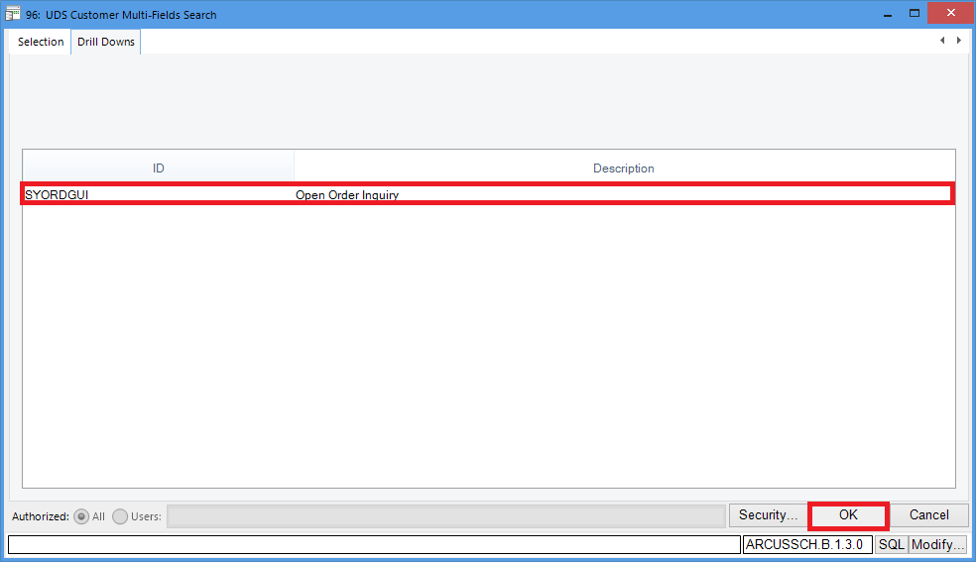
Running a PowerSearch
The “Drill Downs” tab will show you a list of the available applications you can launch. Select the application and click on the OK button.

Slide 17
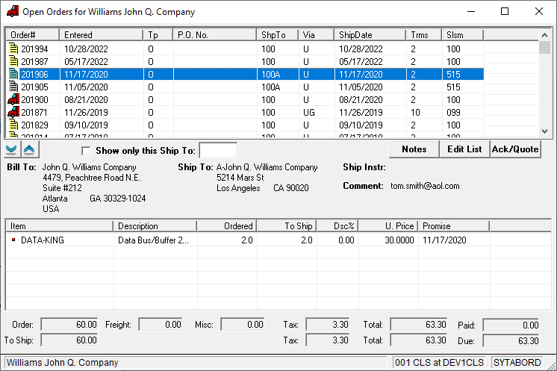
Running a PowerSearch
In this example, clicking on the OK button launched the Open Orders Inquiry for customer 000100 which was highlighted on the search result list.

Slide 18
Modifying a PowerSearch
If a user has rights to run PowerSearch per Global Setup, then when that user brings up the PowerSearch filter screen they will see the “Modify” button at the bottom right hand corner of the screen.
For example, you can go to Accounts Receivable-> Customer File Maintenance-> Change and press the F7 key to search for a customer you will see the list of searches shown above.
It shows the Legacy (original Elliott search) and UDS (User Defined Search) options that are available for the search.

Slide 19
Modifying a PowerSearch
Choose ARCUSSCH.B.1.3.0 UDS Customer Multi-Fields Search from the list. You will see this screen. Let’s say you would like to add a selection criteria based on last sale date and see only those customers whose last sale date is greater than a certain date. To accomplish this click on the “Modify” button.

Slide 20
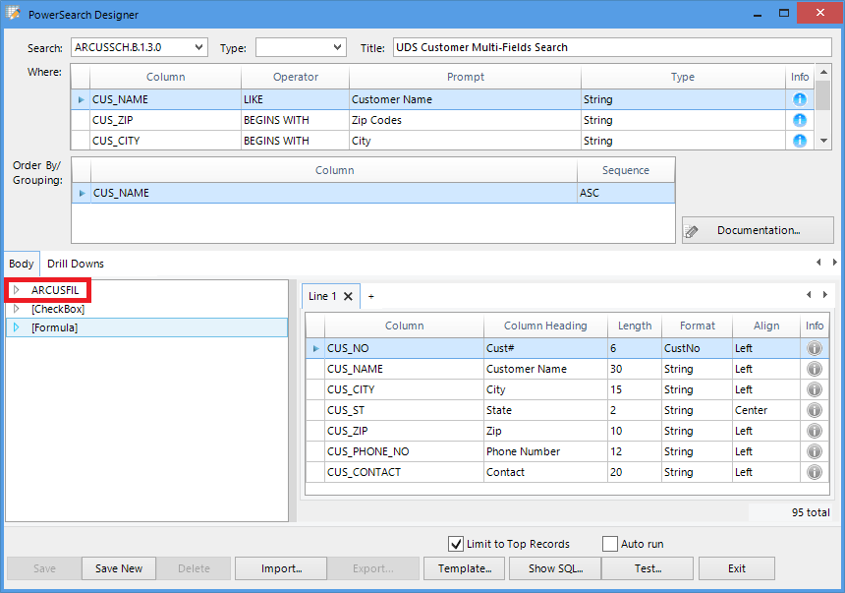
Adding a Filter
You need to add the column CUS_LAST_SALE_DT to the “Where” area at the top. The first step is to expand the ARCUSFIL table which contains the CUS_LAST_SALE_DT column.

Slide 21
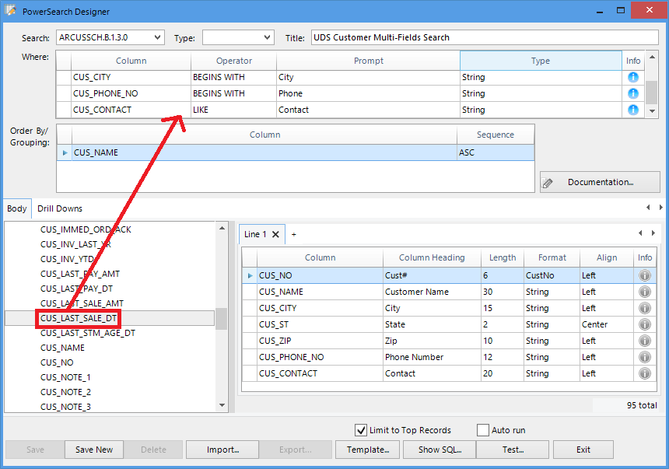
Adding a Filter
Drag the CUS_LAST_SALE_DT column from the “Body” area to the “Where” area after CUS_CONTACT.

Slide 22
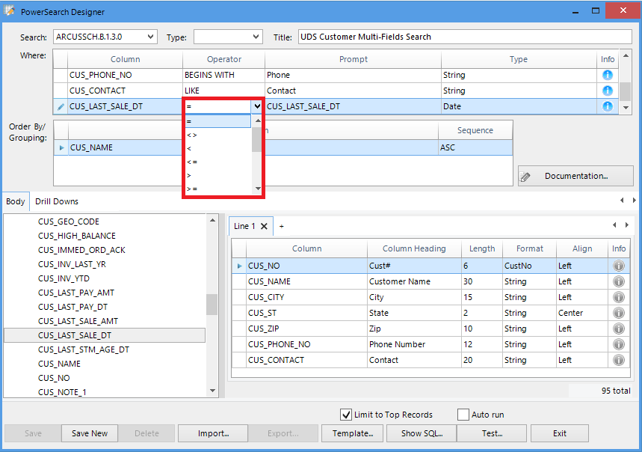
Adding a Filter
Now you can change the Operator of the CUS_LAST_SALE_DT in the “Where” are from the default of “=” (Equal) to “>=” (Greater Equal).

Slide 23
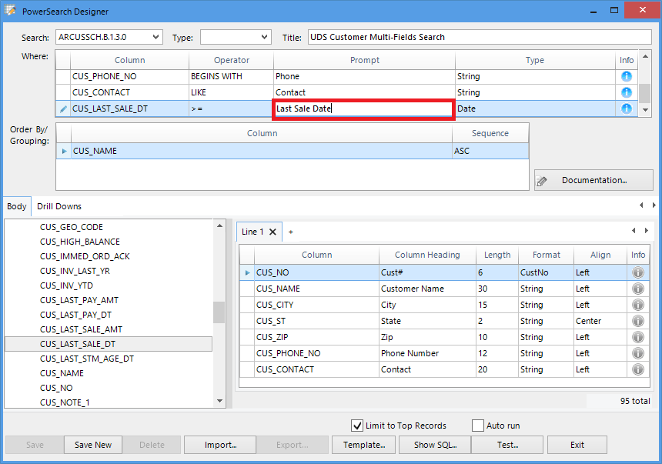
Adding a Filter
Change the prompt from “CUS_LAST_SALE_DT” to something more friendly such as “Last Sale Date”.

Slide 24
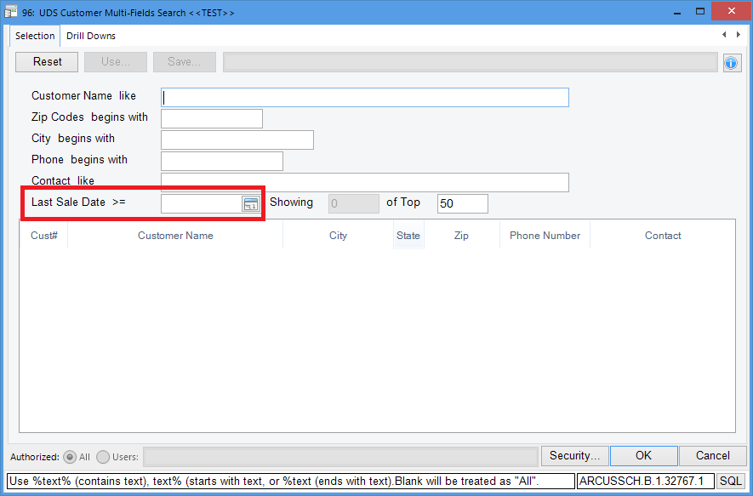
Adding a Filter
Before saving your new design, you can click on the “Test” button to test your changes. The parameter screen is shown with the new criteria “Last Sale Date >=”. Enter a value and click OK.

Slide 25
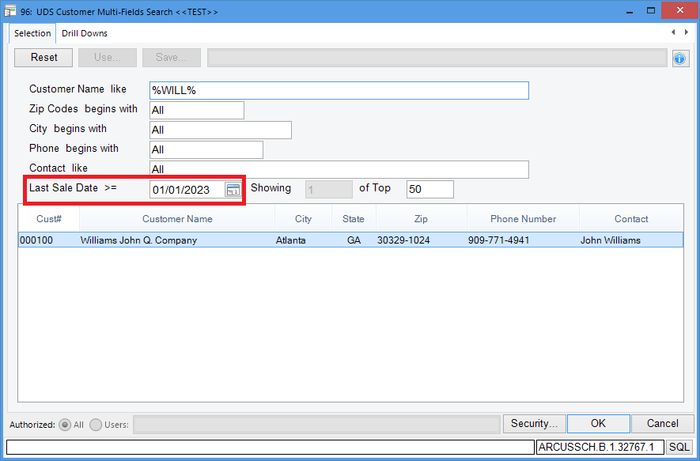
Adding a Filter
The results are shown in the list using the new criteria that was added to the search.

Slide 26
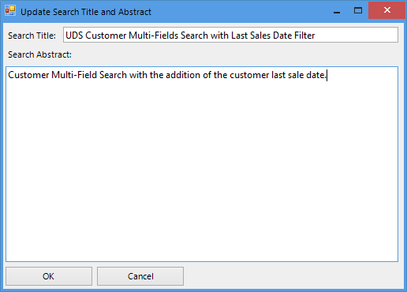
Adding a Filter
You can continue to modify the search. You can also “Exit” without saving it. If you choose “Save New” in the designer screen, the application will ask you to update the search title and provide a search abstract. A search abstract is a short multi-line description of this search.

Slide 27
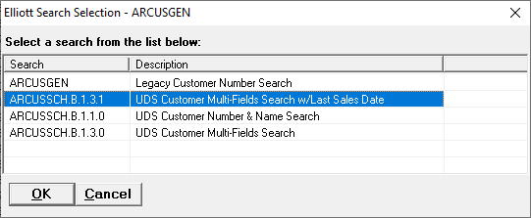
Adding a Filter
Once you exit, if you choose to “Save New”, then the new search will be listed in the search selection screen.
The search is “ARCUSSCH.B.1.3.1” with the last digit “1” meaning that this is the first revision from the original search ID “ARCUSSCH.B.1.3.0”.

Slide 28
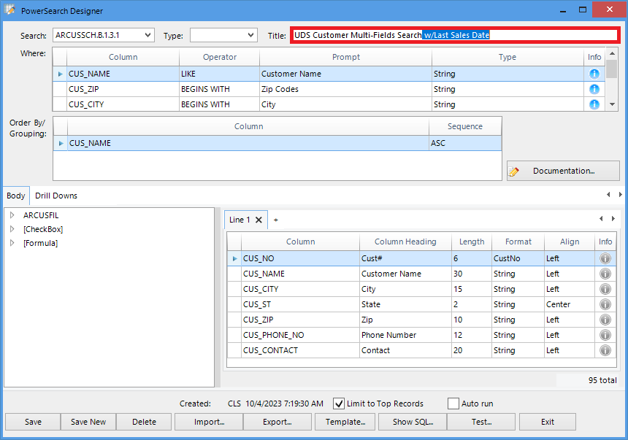
Changing a Search Title
Change the title of the search in the title area. To save the search, click on “Save” instead of “Save New”. If you choose to “Save New” then a new search “ARCUSSCH.B.1.3.2” will be created. This is normally chosen when saving an entirely new version of a search.

Slide 29
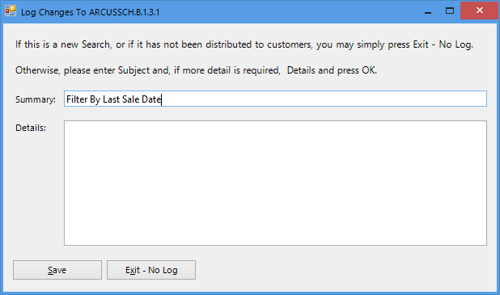
Changing the Title
You will be prompted to log this change. You can either skip it by clicking on the “Exit” button or add something to indicate the nature of the change and click on “Save”.

Slide 30
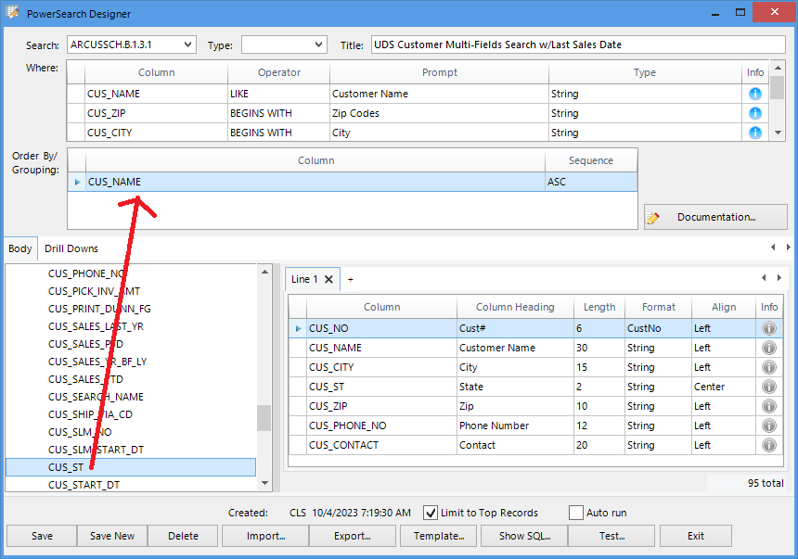
Change Order By Sequence
To add a field to the Order By/Grouping area, expand the ARCUSFIL node and drag CUS_ST to the Order By/Grouping area. Two columns are now shown in the Order By/Grouping area.
CUS_NAME ASC
CUS_ST ASC
ASC means ascending. You could also choose DESC which means descending.

Slide 31
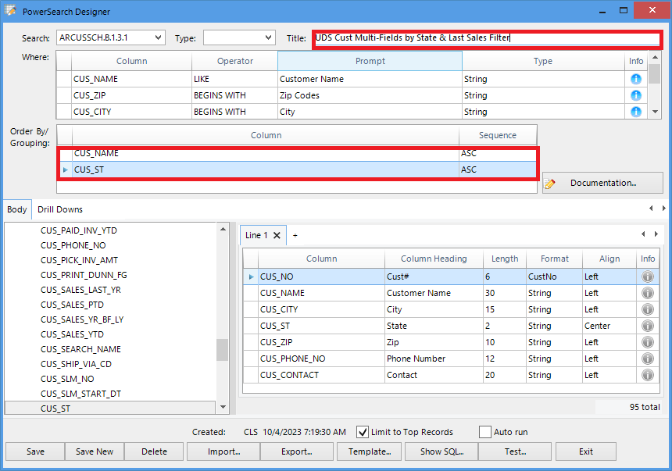
Change Order By Sequence
Change the report title to and click on “Save” to save the changes.

Slide 32

Change order By Sequence
You will be prompted to log this change. You can either skip it by clicking on the “Exit” button or put in something to indicate the nature of this change and click on “Save”.

Slide 33
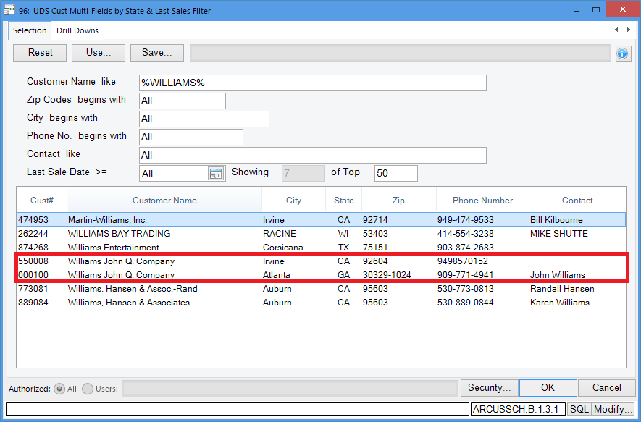
Change Order By Sequence
Run the search and see if the result is what you expect.

Slide 34
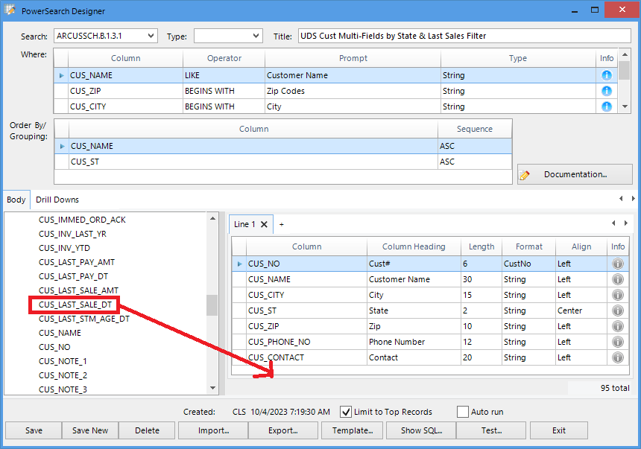
Modify the Body of the Search
You can further modify this search add the CUS_LAST_SALE_DT field to the body area of the search. You can drag CUS_LAST_SALE_DT to the Line 1 area and place it after the CUS_CONTACT column.

Slide 35
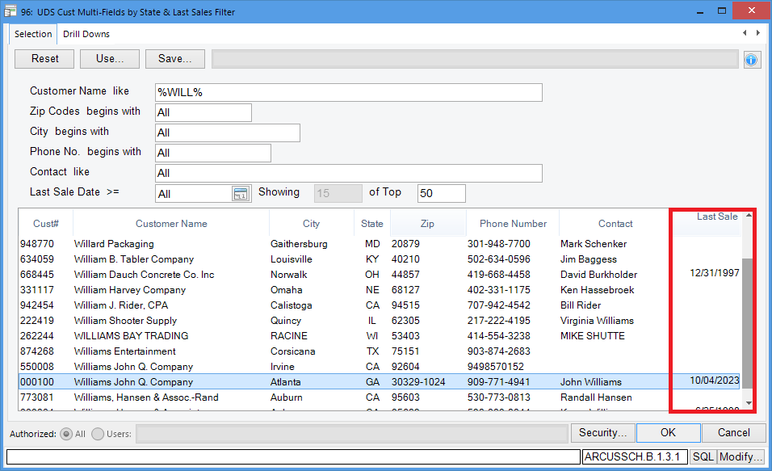
Modify the Body of the Search
Save and test the result.

Slide 36
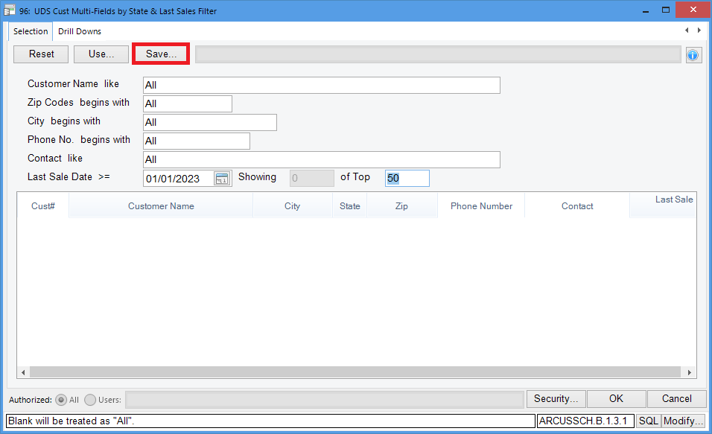
Save Default Parameters & Reuse
If you have run a search many times and you notice that you often choose the same parameters, you can save this information to use later. To save the parameters, click on the “Save” tab.

Slide 37
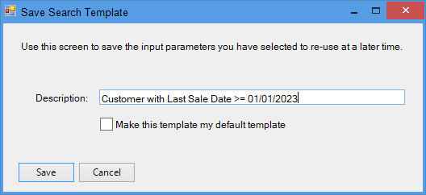
Save Default Parameters & Reuse
In the popup window, enter a description for the search. If you want this to be your default, click on the “Make this template my default template” check box.

Slide 38
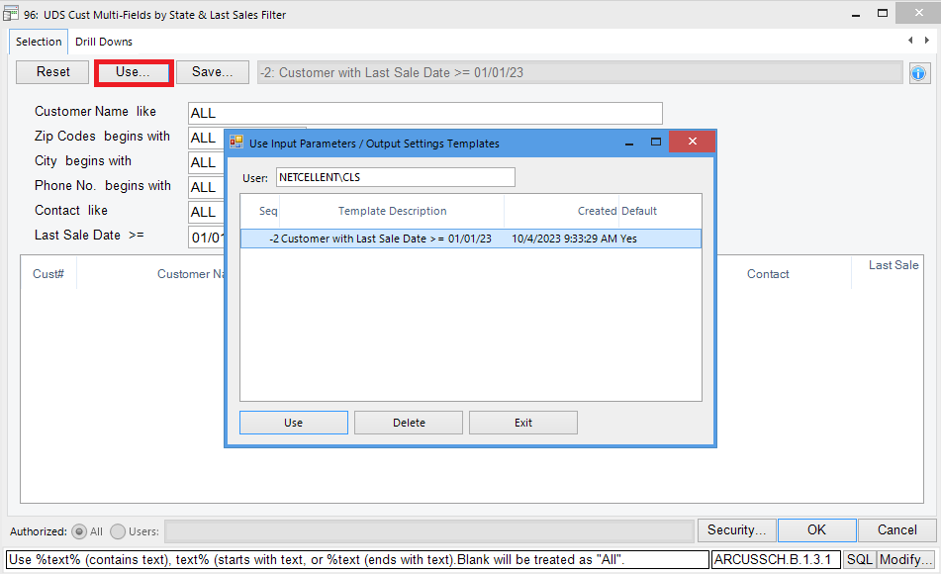
Save Default Parameters, Output Format & Reuse
The next time you run the search, click on the “Use” tab to select the parameters you want.

Slide 39
Questions and Answers

