Slide 1
Report Desk – Developer Perspective
Jim Graves
Developer

Slide 2
Why Report Desk?
Report Desk vs. Crystal Reports vs. Excel Query
Report Desk - Netcellent does the join
Crystal & Excel Query - you do the join
On the surface, it would seem that Report Desk is less powerful than Crystal Reports and Excel Query. Is it?

Slide 3
Report Desk Architecture
SQL Template
Developed by Netcellent
Use for multiple reports and/or versions of reports
Report Design
Initial report(s) developed by Netcellent
Users can create customized versions

Slide 4
Report Desk Versioning
.B - Base from Netcellent
.B.1 - Template 1 from Netcellent – all 5 reports
.B.1.1.0 - 1st report using Template 1 from Netcellent
.B.1.1.1 - 1st user-modified report using Template B.1

Slide 5
Creating a New Report
If the RD category does not exist (e.g. ARSLMUDR)
Modify COBOL program to allow Report Desk report as an option
Modify EL860S.Cfg to allow this new report to appear in the list of available reports
If the RD template does not exist
Create new SQL template
Create initial report

Slide 6
SQL Template:
Developers Only
Performance of the report is primarily determined by the way the SELECT statement is constructed.
The order of JOIN, GROUP BY, ORDER BY and WHERE statements is critical.
Netcellent wants to control this part of the process to ensure best performance.

Slide 7
SQL Template:
Developers Only
The SELECT statement can be complicated – we provide that.
Useful formulas can be complex – we provide them in the template.
End-users can view, but not modify, the template.

Slide 8
How Long Does It Take for Netcellent to Develop a Report Desk Report?
It All Depends

Slide 9
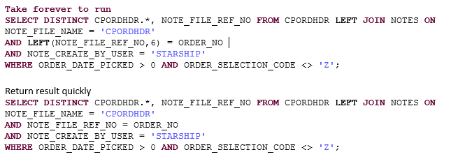
Example of SQL Statement:
Find Order’s Shipping Status

Slide 10
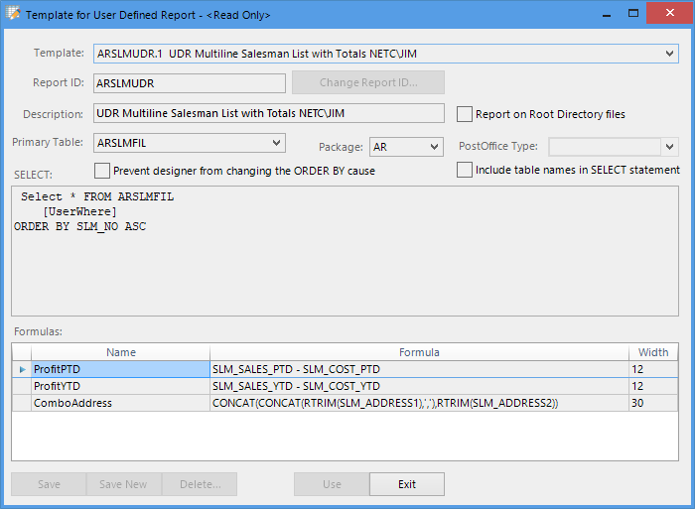
Simple SQL Template Example

Slide 11
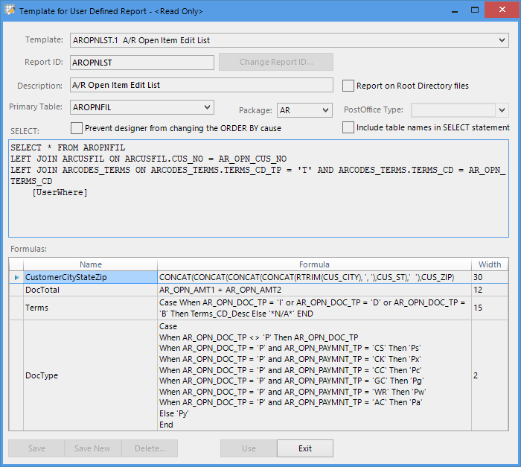
Complex SQL Template Example

Slide 12
Report Example
A/R Open Item Edit List By Apply-To
Defaults are already set.
Optionally change input parameters to set the scope of the report.
Note Calendar button, CheckBoxes, Drop-Down list.

Slide 13
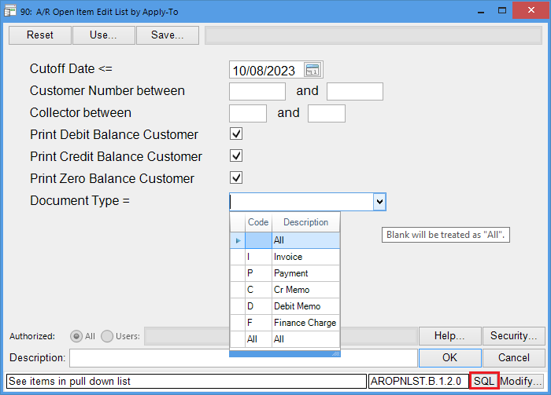

Slide 14
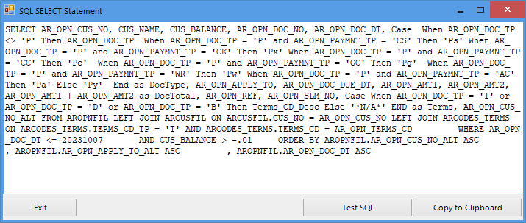
Press the SQL button to see the SQL that will be generated.

Slide 15
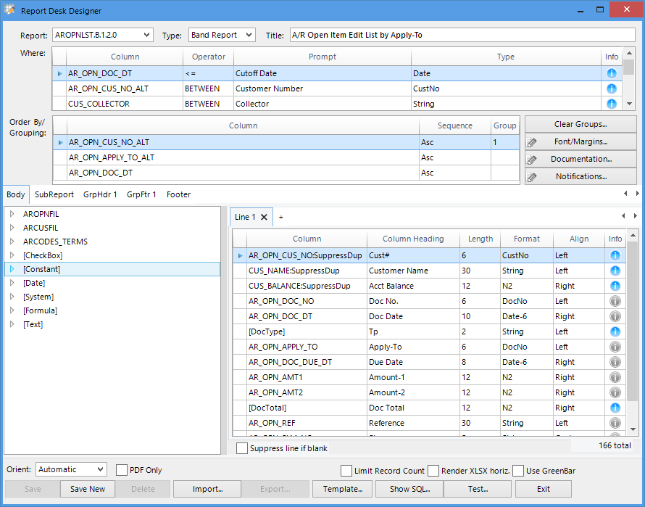
Report Desk Designer

Slide 16
Report Desk Designer Features
Drag-and-drop for report column layout
Specification of input parameters for SQL SELECT… WHERE… clause
Ability to create report groups and/or change the sort order
Multiple detail lines
Group header and group footer lines
Report totals
Learns column types and preferred titles as you use it
Many more formatting/processing options

Slide 17
Report Desk: A Superior Platform vs Legacy Reports
Faster development time
Better performance due to SQL engine
Better looking reports
Choice of format: PDF, CSV, Excel
User customizable
Save and reuse common sets of input parameters
Restrict to specific users if needed

Slide 18
Faster Development
No tedious, time-consuming report layout – the layout is drag-and-drop.
Can reuse the SQL template to develop multiple, different reports quickly.
Select different columns
Use different WHERE conditions
Sort (and subtotal) differently
Support multiple output formats with almost no additional effort.

Slide 19
Better Performance
Did you notice that running Elliott Reports on the PSQL server is much faster than on the workstation?
The Btrieve operations run on the database server – not back-and-forth with the workstation to combine related records
This means much less network traffic.
Report Desk uses the SQL engine on the server. Even if Report Desk runs on a workstation, it generally will perform as well as a legacy report on the server.

Slide 20
Better Looking Reports
Uses more readable proportional fonts
Heading area visibly different from the details.
Shading, bold fonts, larger fonts available for grouping, subtotals and totals.
Excel output has frozen title, shading, etc.

Slide 21
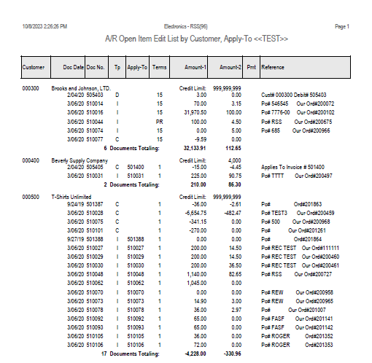
Report Desk - Sample PDF

Slide 22
Choice of Output
Industry-standard PDF by default, suitable for printing, emailing, etc.
CSV output for importing to other applications.
Excel (XLSX) output for further analysis.
Integration with PostOffice (A/R Statements only at this time).

Slide 23
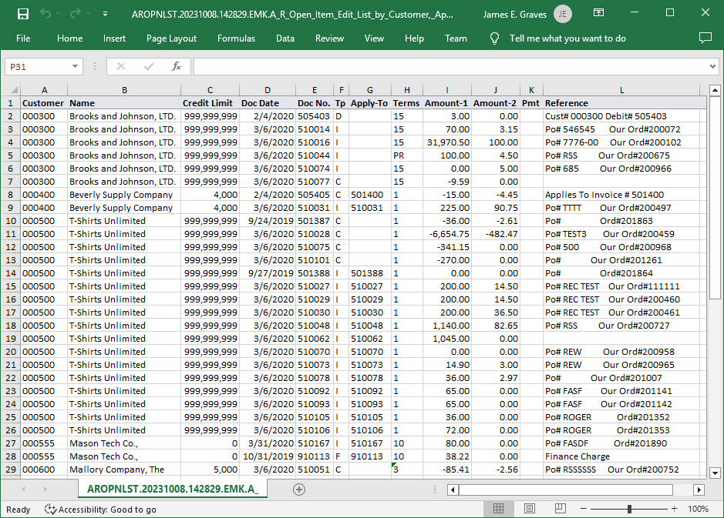
Report Desk - Sample Excel

Slide 24
User Modifiable Abilities
Add, change or delete report columns
Add additional input parameters
Change default values
Change sort order (unless restricted by the SQL template)
Change appearance options, like shading and font changes
And more….

Slide 25
Save and Reuse Input Parameters
For example, a user produces specific reports of subsets of the data on a repeating basis. He/she can fill out the first set of parameters, run the report and save them to reuse later. Then, he/she can repeat the process for another subset to reuse later.

Slide 26
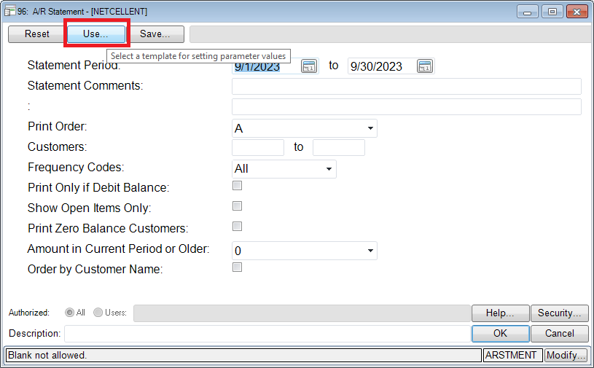
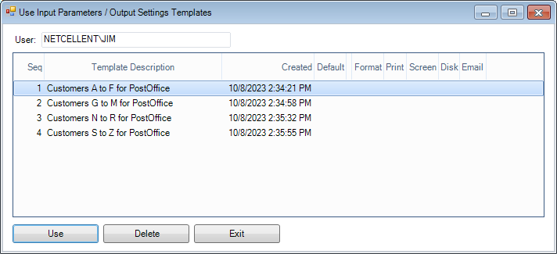
Sample Reuse Parameters

Slide 27
Restrict to Specific Users
The default security follows Elliott menu permissions to access reports.
Additionally, a user with the authority to modify a report can specify a list of users that are the only users who can run the report.

Slide 28
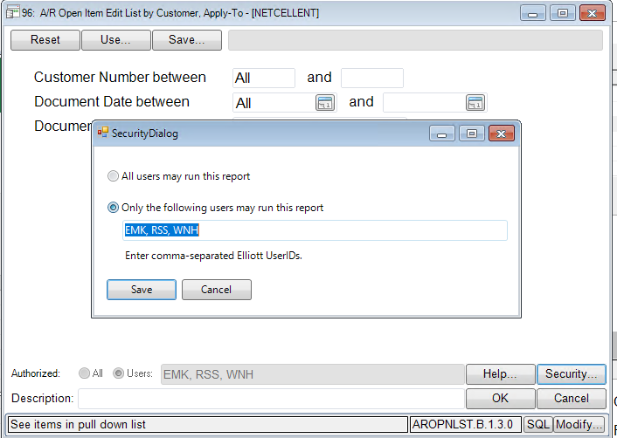
Restrict to Specific Users

Slide 29
Need a New Report?
Post a new idea on support.elliott.com.
Vote for the new report ideas that are most important to you.
Because it is easier for us to develop new reports, commonly requested reports are likely to be free of charge.

Slide 30
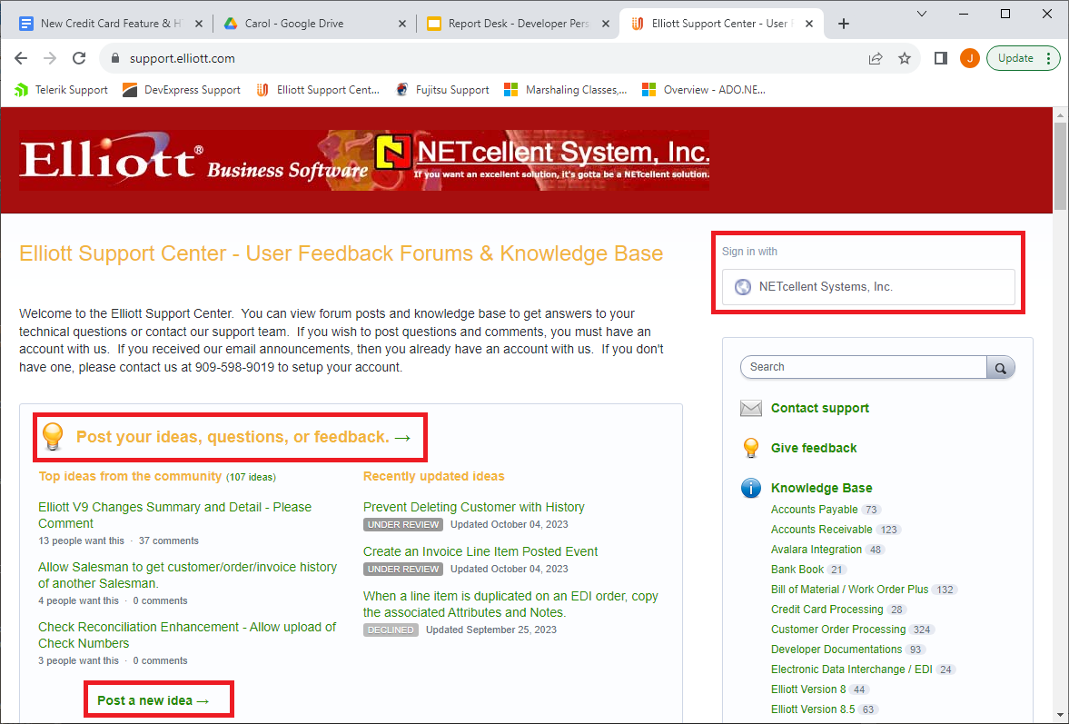
Post Idea at Support.Elliott.com

Slide 31
Posting A New Report Idea
Be as clear as possible.
Provide as much detail as possible.
Attach a sample screen or list of input parameters.
Attach a sample of the report output.
The more detailed the idea, the more likely it will be voted for and developed.

Slide 32
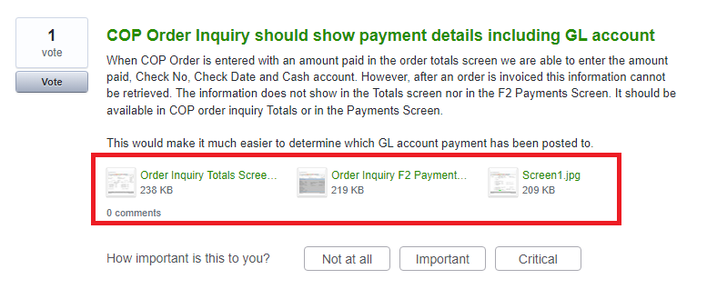
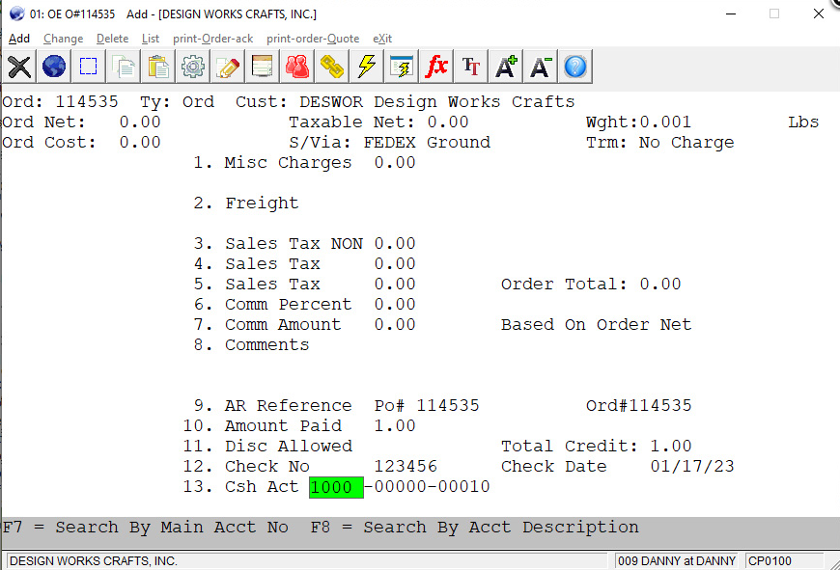
Be Clear with What You Want

Slide 33
What if Nobody Votes for Your Idea?
Maybe your requirements are more unique to you.
Ask us.
We can develop these reports faster and provide them less expensively than before.

Slide 34
Symbiotic Relationship
Your sponsorship of the development of a new report or feature could benefit others.
Others’ sponsorships could benefit you.
This can be a symbiotic relationship.
Collectively, we can all share a richer collection of useful reports and features.

Slide 35
Planned Enhancements
Ability to handle sensitive data , like Cost info, automatically
We will identify individual table/columns that need to be hidden from most users (all except users with current menu approval).
We will eliminate those columns on-the-fly from reports or other output if the user is not allowed to see them.

Slide 36
Planned Enhancements
Provide more control over SQL time-outs
Reduce the chance of run-away queries
Provide separate default time-out values for counting and processing of records
Allow designated users the ability to override the default time-outs for specific reports

Slide 37
Planned Enhancements
Throttle concurrent usage by user
Although unlikely, a single user could attempt to run many reports at the same time, possibly affecting server performance for other users.
We will make sure an individual cannot run more than a specified number, perhaps 2, of concurrent reports.

Slide 38
Potential Enhancements
Provide more reports like A/R Statements, which has additional features:
Includes database updating (e.g., calculate new balance)
Multiple fonts, graphics, line drawing, links.
Integration with PDF PostOffice

Slide 39
Elliott Report Desk
Easier
Faster
Prettier
More flexible
User customizable
And, did I mention…
FREE !

