Slide 1
Report Desk User Perspective
Carol Santee
Vice President of R&D

Slide 2
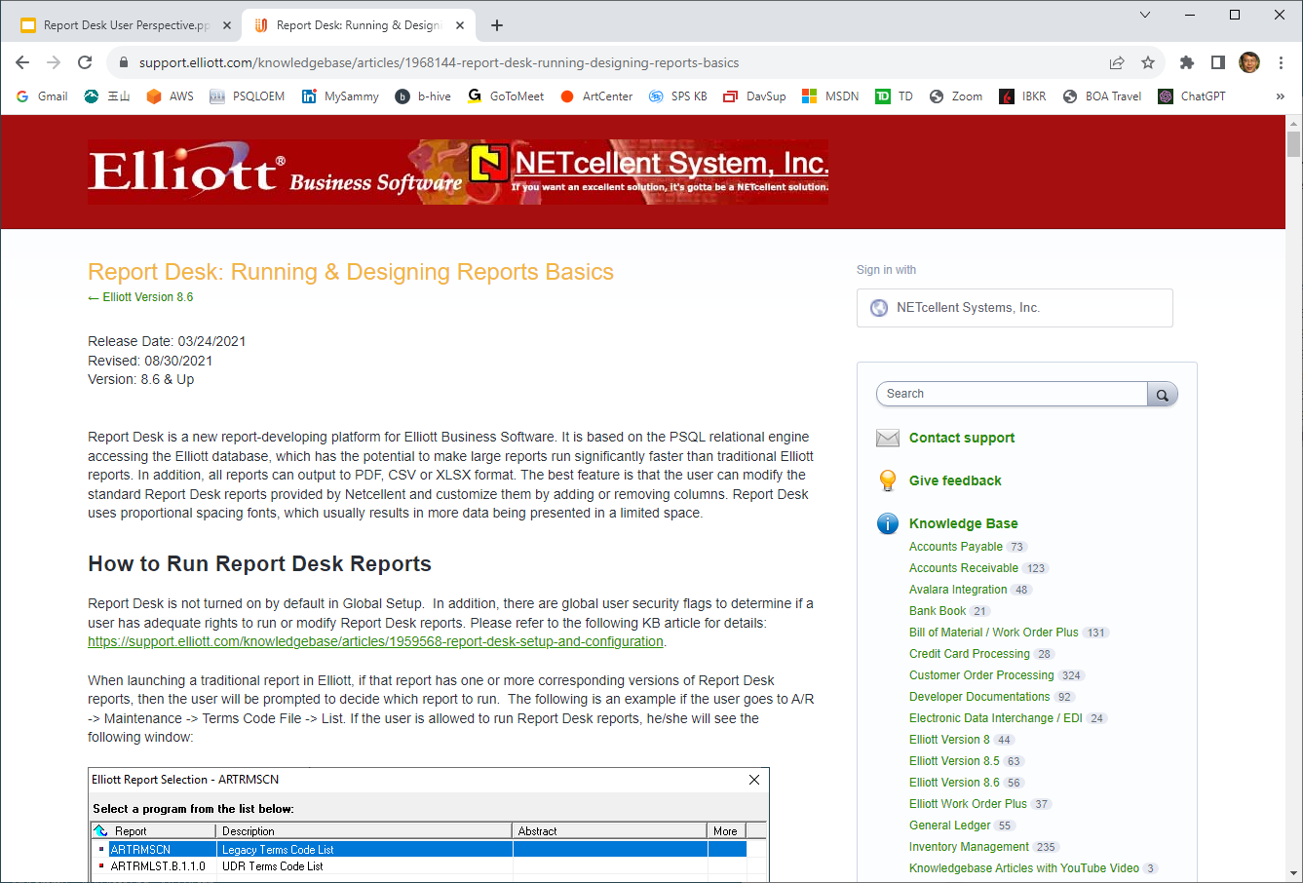
Where do I start?

Slide 3
Enable Report Desk
Company Specialized Control in Global Setup

Slide 4
Enable Report Desk
PSQL Relational Engine
Supports Elliott 8.2 and 8.5 (alpha document) Data Formats

Slide 5
Enable Report Desk
Y - Supervisor has access to “Show” option to control which reports are disabled
N - All reports are available to all users

Slide 6
Enable Report Desk
Supervisor can control which reports are disabled for all users

Slide 7
Enable Report Desk
By default no users can run report desk.
This setting controls who can run Report Desk reports.

Slide 8
Enable Report Desk
This option allows you to determine which users can modify Report Desk Reports.

Slide 9
The Right Database Name
Report Desk needs to know your database names (DSN)
ELI86DATA?? - alpha doc numbers
ELI85DATA?? - alpha doc numbers
ELIDATA?? - 8.2 numeric doc numbers
8.2 DDFs must have entries for NSCTLFIL_?? tables

Slide 10
Elliott Database Configuration
Supervisor can run from the Elliott Control Center or can be run from the <ElliottRoot>\Bin86 directory using EL860CF.exe.

Slide 11
Elliott Database Configuration
Click on the “Create Standard Databases” button to create standard named databases
Run EL860DB.exe from the <ElliottRoot>\Bin86 directory
PSQL Control Center should be used to create non-standard named databases

Slide 12
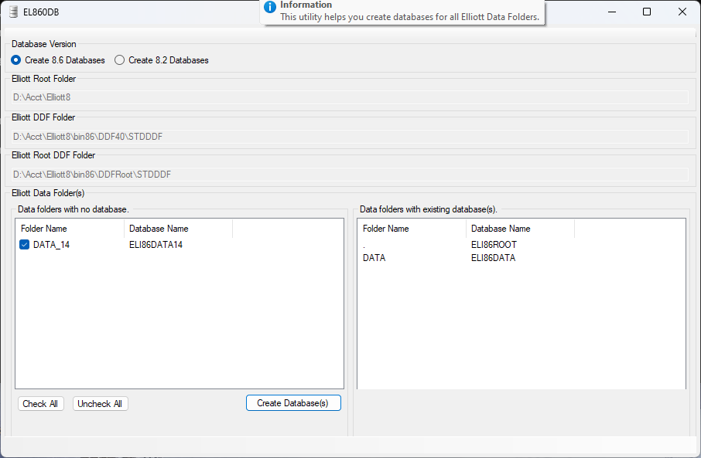
Installation - EL860DB.EXE

Slide 13
Running Report Desk Reports
If a report option has Report Desk Reports available, the user will be prompted to decide which report to run.
The “Legacy Terms Code List” above is the traditional Elliott report that you are familiar with.
The “UDR Terms Code List” is the new Report Desk report.

Slide 14
Running Report Desk Reports
Report Desk reports support a standard naming convention.
ARTRMLST.X.1.2.3
ARTRMLST - type of report
X - either B (base) or E (enhancement)
1 - template ID
2 - report ID
3 - user revision

Slide 15
Running Report Desk Reports
Clicking on ARTRMLST.B.1.1.0 will launch the report parameter screen. In this case you can enter a starting and ending terms code. If you don’t enter anything, clicking on the OK button will default the range to ‘All’.

Slide 16
Running Report Desk Reports
Once you click on OK you will be asked where you would like the output to go. The default is to screen and PDF format.

Slide 17
Running Report Desk Reports
When you click Go, the report is processed and the output is sent to your default PDF reader.

Slide 18
Modifying Report Desk Reports
If a user has rights to modify Report Desk Reports per Global Setup, then when that user brings up the Report Desk filter screen they will see the “Modify” button at the bottom right hand corner of the screen.
For example, you can go to Accounts Receivable-> Customer File Maintenance-> Numeric List. You will see the list of reports shown above.
It shows the Legacy (original Elliott report) and UDR (User Defined Report Desk Report) options that are available for the report.
If the report developer included and abstract of the report, it is shown in the abstract column. You can hover the mouse over the field to see the full description.

Slide 19
Modifying Report Desk Reports
Choose ARCUSLST.B.1.3.0 Customer credit info from the list. You will see this screen. Let’s say you would like to add a selection criteria based on sales year-to-date and see only those customers when the sales year-to-date is greater than a certain amount. To accomplish this click on the “Modify” button.

Slide 20
Adding a Filter
You need to add the column CUS_SALES_YTD to the “Where” area at the top. The first step is to expand the ARCUSFIL table which contains the CUS_SALES_YTD column.

Slide 21
Adding a Filter
Drag the CUS_SALES_YTD column from the “Body” area to the “Where” area between CUS_SLM_NO and CUS_TP.

Slide 22
Adding a Filter
Now you can change the Operator of the CUS_SALES_YTD in the “Where” are from the default of “=” (Equal) to “>=” (Greater Equal).

Slide 23
Adding a Filter
Change the prompt from “CUS_SALES_YTD” to something more friendly like “Sales YTD”.

Slide 24
Adding a Filter
Before saving your new design, you can click on the “Test” button to test your changes. The parameter screen is shown with the new criteria “Sales YTD >=”. Enter a value and click OK.

Slide 25
Adding a Filter
Choose to print to screen in PDF format. Notice that there’s a check box for “Print Parameters” which is selected by default. Click on the Go button.

Slide 26
Adding a Filter
Your default PDF viewer will display the content of the report. You will also see that the parameters that were used to print the report are printed at the end of the report.

Slide 27
Adding a Filter
You can continue to modify the report. You can also “Exit” without saving it. If you choose “Save New” in the designer screen, the application will ask you to update the report title and provide a report abstract. A report abstract is a short multi-line description of this report. This information will be displayed on the list of reports.

Slide 28
Adding a Filter
Once you exit, if you choose to “Save New”, then the new report will be listed in the report selection screen.
The new report is “ARCUSLST.B.1.3.1” with the last digit “1” meaning that this is the first revision from the original report ID “ARCUSLST.B.1.3.0”.
Since both of the report are called “Customer Credit Info” we should change the description to differentiate them. Click on “ARCUSLST.B.1.3.1” and click on the “Modify” button.

Slide 29
Changing A Report Title
Change the title of the report in the title area. To save the report, click on “Save” instead of “Save New”. If you choose to “Save New” then a new report “ARCUSLST.B.1.3.2” will be created. This is normally chosen when saving an entirely new version of a report.

Slide 30
Changing the Title
You will be prompted to log this change. You can either skip it by clicking on the “Exit” button or add something to indicate the nature of the change and click on “Save”.

Slide 31
Change Order By Sequence
To add a field to the Order By/Grouping area, expand the ARCUSFIL node and drag CUS_NAME to the Order By/Grouping area. Two columns are now shown in the Order By/Grouping area.
CUS_NAME Asc
CUS_NO Asc
Asc means ascending. You could also choose Desc which means descending.

Slide 32
Change Order By Sequence
It is possible to order by multiple comuns but in this case sorting by the CUS_NAME alone is sufficient. Right click on the CUS_NO column in the Order By/Grouping area and choose “Delete Row”. This will remove the CUS_NO column from the list.

Slide 33
Change Order By Sequence
Change the report title to “Customer Credit Info by Name & Filter By Sales YTD”. Click on “Save” to save the changes.

Slide 34
Change order By Sequence
You will be prompted to log this change. You can either skip it by clicking on the “Exit” button or put in something to indicate the nature of this change and click on “Save”.

Slide 35
Change Order By Sequence
Run the report and see if the result is what you expect.

Slide 36
Modify the Body of the Report
You can further modify this report and sort by customer type. Drag the CUS_TP column to the Order By/Grouping area. It also makes sense to add the field to the body area of the report. You can drag CUS_TP to the Line 1 area and place it before the CUS_NO column.

Slide 37
Add Grouping
Since the sorting sequence is by CUS_TP and then CUS_NAME, it would make sense to move the CUS_NAME before the CUS_NO. You can accomplish this by dragging the CUS_NAME above the CUS_NO. To add a subtotal break by CUS_TP click the “Group” for CUS_TP and choose “1” to stand for level 1 break.

Slide 38
Add Grouping
Save and test the result.

Slide 39
Report Spacing Requirements
We just added the new column “Type” to the report and the report continues to work without a problem. The report is designer for landscape letter size paper so the space is limited. How is this possible? Report Desk uses the following strategies to deal with spacing:
It tries to determine the “best fit” for each column based on the data.
It tries to use smaller fonts if there is no extra space to take away from a column.
It tries to wrap the content of certain columns to a second line if necessary to reduce column space requirements.
These adjustments happen automatically without the report designer’s intervention.

Slide 40
Report Spacing Requirements
The smallest font the system will use is 8 points by default. You can override this to use even smaller fonts. But as you add more and more columns to a report at some point you will face the dilemma of either the font being too small to read or the wrapping being too annoying to read. That is the time that you should decide to:
Ignore the PDF printing version and just use CSV or Excel
Remove less important columns
Redesign the report to use a multi-line format.

Slide 41
Add Grouping Subtotal
To add a subtotal of customer balance, sales YTD and sales last year, click on the “GrpFtr1” tab. “GrpFtr1” stands for Group Footer 1. If you have multiple groups defined, you will have multiple “GrpFtr” tabs. After clicking on the GrpFtr1 tab, you will see a plus sign in at the top of window on the right. Click on the plus sign to add columns to the Group Footer 1 area.

Slide 42
Add Grouping Subtotal
After clicking on the plus sign, you can now drag the CUS_BALANCE column from the left side to Group Footer 1 on the right side to the corresponding Balance column.

Slide 43
Add Grouping Subtotal
You will be prompted with the message “Do you want to make this column two digits wider?” because this is a subtotal area. Potentially your value may be bigger than the maximum column length reserved for the field. It is up to your discretion to answer “Yes” or “No” to this prompt.

Slide 44
Add Grand Total
Repeat this process for the report grand totals using the “Footer” tab. You can also add a “Grand Total” literal by dragging a “New Text” field from the left side to the Telephone column on the right side and change the literal to “Grand Total”.

Slide 45
Add Grand Total
Save the design and run it.

Slide 46
Text in Sub and Grand Total Areas
The same technique can be used in the subtotal area.
You can put text in any column even it is not a string format.
You can make the text bold by clicking on the “i” (information) icon to change the attribute.
If the text is longer than the space allocated for the column, it can overflow to the next column if it is unused.

Slide 47
Export Report to CSV or Excel
All reports can also be exported to CSV or Excel by choosing the format on the Report Output screen.

Slide 48
Export Report to CSV or Excel
Subtotals and Grand Totals are not exported to CSV or Excel. It is presumed that CSV and Excel exporting is for data consumption and any extra data is not that may prevent the data from being used in that manner is excluded.

Slide 49
Save Default Parameters, Output Format & Reuse
If you have run a report many times and you notice that you often choose the same parameters or you consistently use the same output format, you can save this information to use later. To save the parameters, click on the “Save” tab.

Slide 50
Save Default Parameters, Output Format & Reuse
In the popup window, enter a description for the report. If you want to save the report output options, click on the “Save Output Options with the template” check box. Run the report with your preferred Report Options.

Slide 51
Save Default Parameters, Output Format & Reuse
The next time you run the report, click on the “Use” tab to select the parameters/destination you want.

Slide 52
Questions and Answers

