Slide 1
State of The Company
Edward M. Kwang
President
Notes:
Why we pick a hotel that’s under renovation?
The main reason is for the Knotts Scary Farm

Slide 2
Logistics
WIFI - KBGuest – no password
Knott’s Scary Farm on Thursday
Dinner 5PM - 6PM
7PM – 1AM
Secret Dinner on Friday 4:30PM
TGI Friday @ 5 mins walking distance
You and your loved ones are invited
Reserve with Landy for head count
Prize for answering – raise your hand 1st.

Slide 3
Impact of Pandemic
We are all working from home now
Our servers are hosted with Amazon (AWS)
We all use Remote Desktop
IP Phones
The building we own is leased to a tenant
So how do we manage our employees?
Use MySammy for Time Measurement
Develop for our remote employees

Slide 4
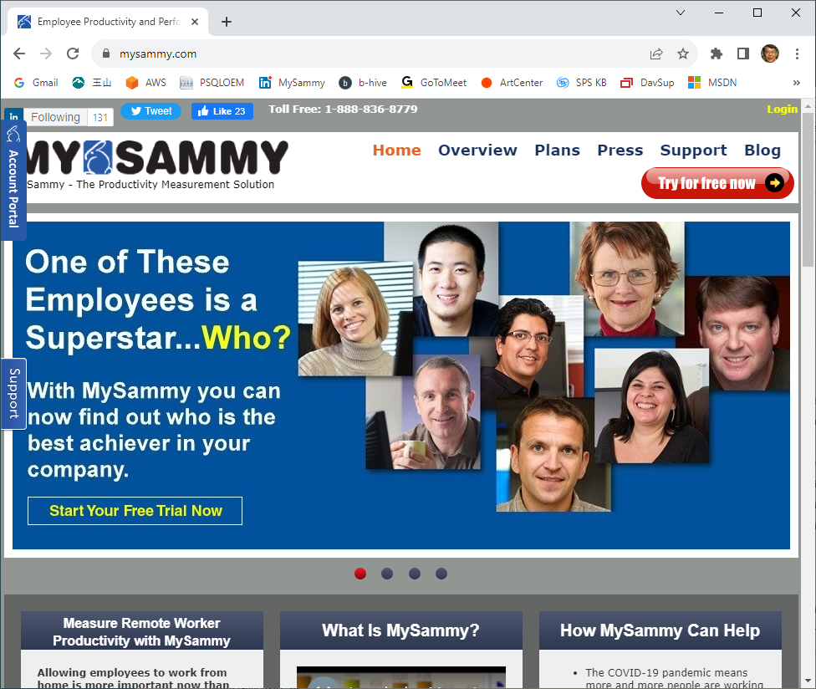
www.mysammy.com

Slide 5
Elliott 8.6
Upgrade to 8.6 carries a minimum risk.
<ElliottRoot> - Add SYRD*, SYES*.BTR
Bin85 (8.5 Programs – No Change)
Bin86 (8.6 Programs)
You can run 8.6 with 8.5 side-by-side.
We took time with this release
Elliott 2020 Conference was canceled
Add Power Search, Avalara & Others After
This is a stable release with rich features

Slide 6
The Trends We Are Moving to
Start Using Relational Database
Start more GUI Interface
Enhanced Emailing Capabilities
Partner with SPS for EDI
Ecommerce Future
Partner with Avalara for Sales Tax
Continu(ing) to Improve Support.Elliott.com

Slide 7
Trend – Relational DB
PSQL Comes with Two Engines:
Transactional Engine (Btrieve)
Relational Engine
Elliott before 8.6 is Btrieve Only
In Elliott 8.6, we start using Relational DB
Report Desk
Power Search
Avalara (National Sales Tax)

Slide 8
Trend – GUI Interface
Elliott 8.6 GUI
Report Desk
Power Search
Some Avalara UI
Elliott 8.7 – Full GUI
Will Implement Modules by Modules
Less frequently used modules first
Payroll, Bank Book, General Ledger…etc.
8.7 is the key for V9 (expand field size)

Slide 9
Trend – Email Documents
PDF PostOffice
PDF PostOffice Supports Defer Processing
Invoice Printing Can Be Deferred in 8.6
HTML Emails
Credit Card HTML Emails
Order Acknowledgement Emails
Quote Acknowledgement Emails
Shipping Acknowledgement Emails
Support 3 Email Servers

Slide 10
Trend – EDI with SPS
Our Legacy EDI Solution – ECS & Delta
Migrating our EDI customers to SPS
SPS in charge of what they do best – EDI
We in charge of what we do best – ERP
Interface through a common XML map
SPS offers a web portal – you always have a solution to process EDI manually
SPS Shopify Interface

Slide 11
Trend – Ecommerce Future
We are phasing out the e-Store.
We will continue to support Web Services
We have EDI interface thru SPS with popular Ecommerce websites like:
Shopify
Amazon
If you have your own developers
Develop your own website front end and work with our web services.

Slide 12
Trend – Sales Tax with Avalara
Old rule – physical presence in a state
Not workable due to cross state ecommerce
South Dakota vs. Wayfair (2018)
Other states may require you to collect sales taxes.
Too complicated
This give rise to vendors like Avalara
Elliott support Avalara with Elliott 8.6
What if you only deal with resellers?

Slide 13
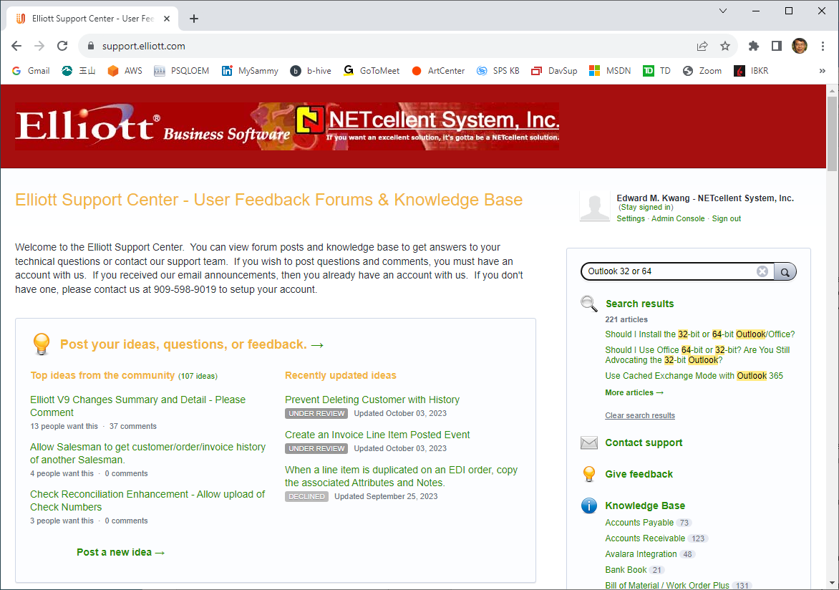
Trend – Support.Elliott.com

Slide 14
Trend – Support.Elliott.com
Https://support.Elliott.com
Started 2016
1,988 articles now
added 3 videos demo recently
Weekly announcement of new articles
Post New Ideas for R&D (requires login)
Win-Win Solution?
Fierce Internal Debate
Why give up consulting revenue?
Notes:
Taking a long time to train a knowledgeable employees
Maybe short terms lose for Netcellent, but long terms win.
We help you find the answers easily – you are happy, we win.
By transfer knowledge in our head to become KB article, we help our employees to find the answer quickly – we win.
Some of you pitch new idea to me. Sometime I will spend the time to post the new idea to our portal. But it is best if you can just post your idea.
The login is based on Elliott eContact database. If we have your email in our system, then you can login.

Slide 15
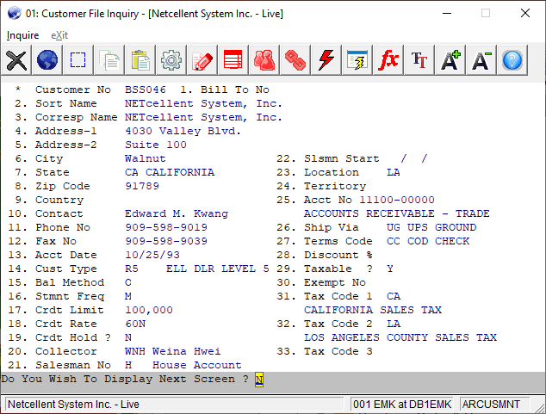
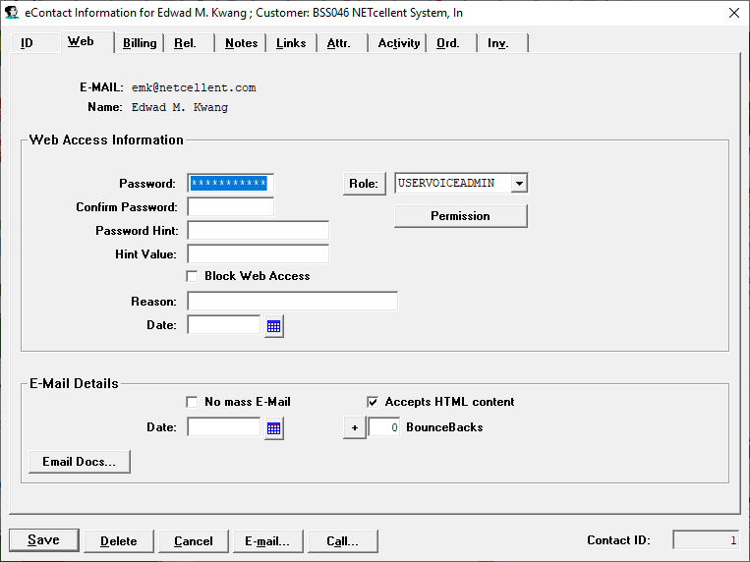
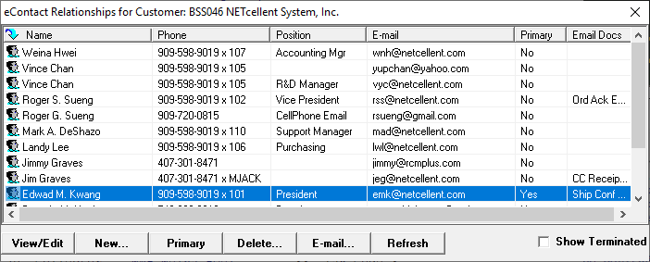
eContacts & Login Password

Slide 16
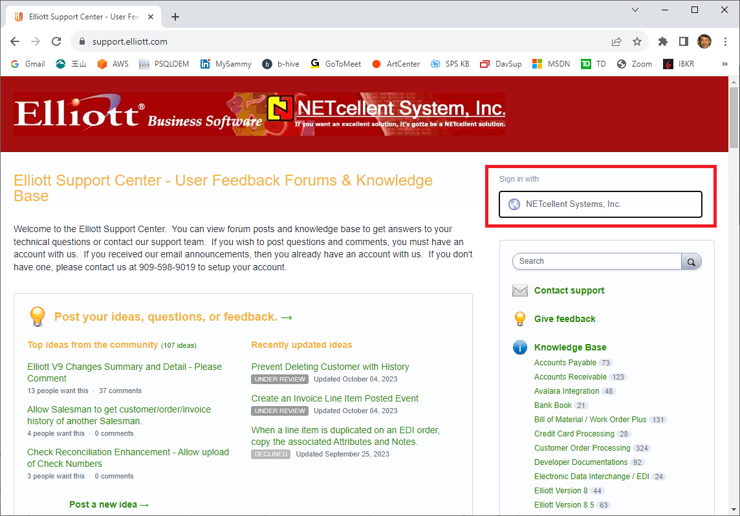
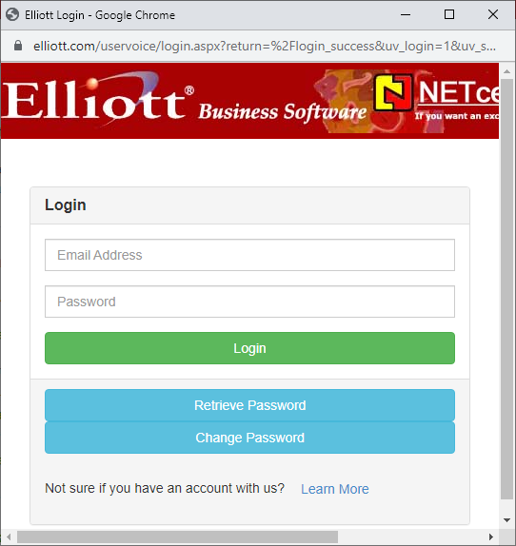
Login Support.Elliott.com

Slide 17
Agile vs Waterfall Developing
Waterfall Developing
Top down approach
Clean New Design
Risky
Agile Developing
Organic & Incremental Changes
More baggage for backward compatibility
Less Risky
Notes:
Two style of developing

Slide 18
Elliott 7.x - 8.x Releases
Database wide are compatible
You can run different versions at the side by side (with some restrictions)
Upgrading from one version to another has very little risk
If a new version has major issue, you can go back to the previous version

Slide 19
The difficulty with Elliott 9
Field size will be expanded
Require Database Conversion
You cannot run V9 and V8.x side by side
What if after database conversion, you find major issues?
How do we mitigate this risk?
Notes:
We have talked about Elliott V9 for many years. This is the reason why we have postpone the field size conversion – risky.

Slide 20
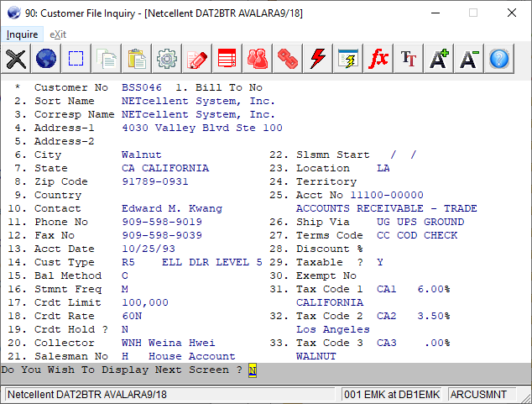
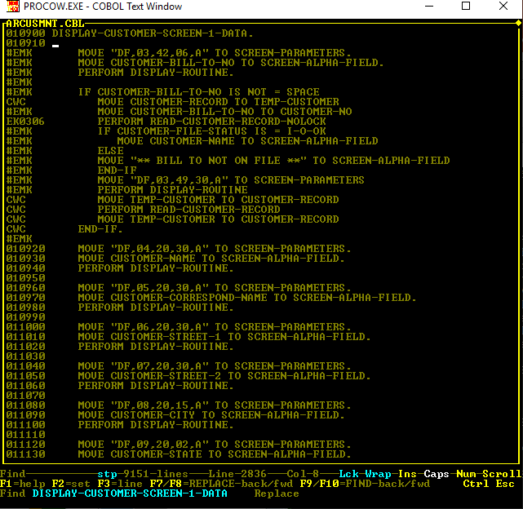
8.6 Customer Maintenance Codes

Slide 21
Working on V9 for Some Time
V9 expands Elliott field size
We did not give up. But it’s a very high wall to climb.
Need to establish multiple smaller steps to climb over this wall.
8.6 start using relational engine
Field size is less an issue for relational engine
8.7 start new user interface that’s field size agnostic.
Database is compatible with 8.x

Slide 22
Elliott 8.7 Is The Gateway to V9
8.7 & 9 have the same user interface
We can let user run 8.7 and 8.6 side by side
We can’t let user run 8.7 and 9.0 side by side
But database field sizes are different
8.7 & 9 will share the same program (Presentation Layer) that’s field size agnostic.
We will create 8.7/9 application as data
For example - each PowerSearch is just data

Slide 23
Elliott 8.6 to 8.7 Conversion
The risk is real since we are using a new presentation layer
The risk is mitigated because
8.6 and 8.7 can run side by side because database is compatible
User can choose module by module to use legacy or GUI interface.
We will only offer V9 until V8.7 is stable and widely used by Elliott User

Slide 24
V8.7 to V9 Conversion
Elliott Database Conversion
No more custom table, fields or indexes
Only one set of DDF Files
We had concluded it’s too hard to use relational engine for multiple set of DDF
No customization (use Global Setup to run certain “custom feature” on or off.
Elliott Application Database Conversion
This step can be automated
We believe the chances of having problem in this step is slim.

Slide 25
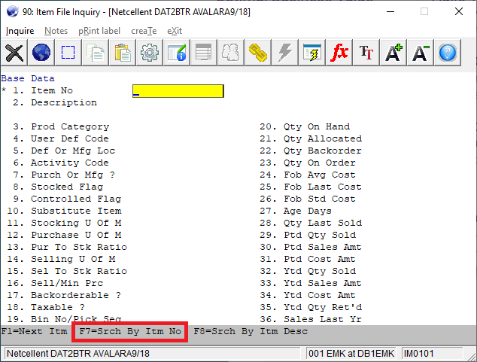
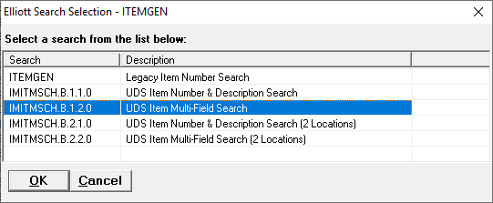
Application as Data - PowerSearch

Slide 26
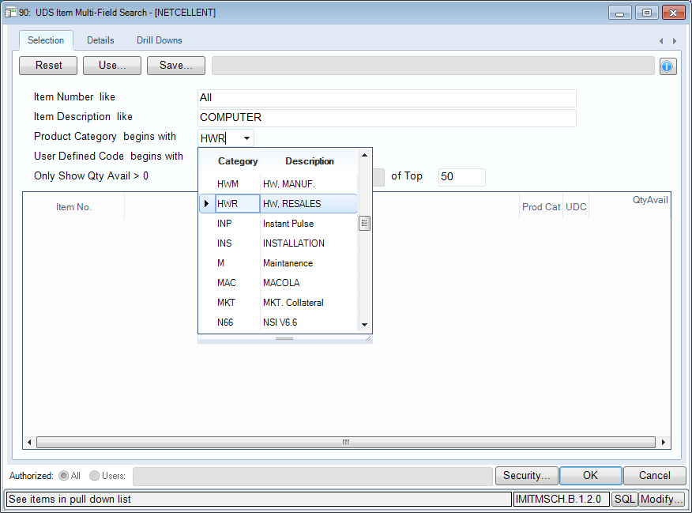
PowerSearch Example

Slide 27
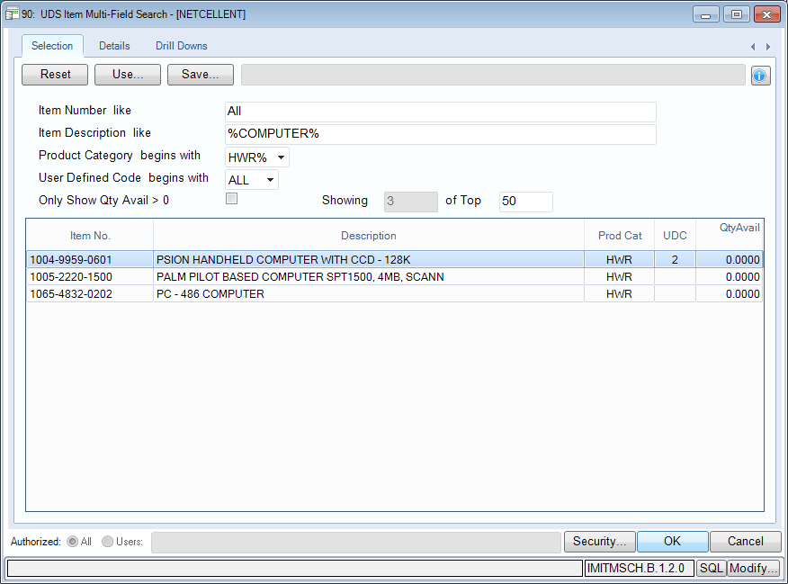
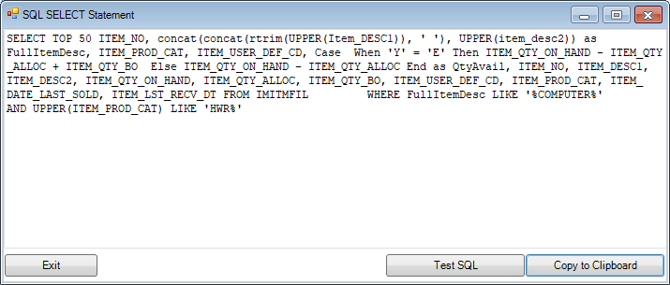
PowerSearch Example

Slide 28
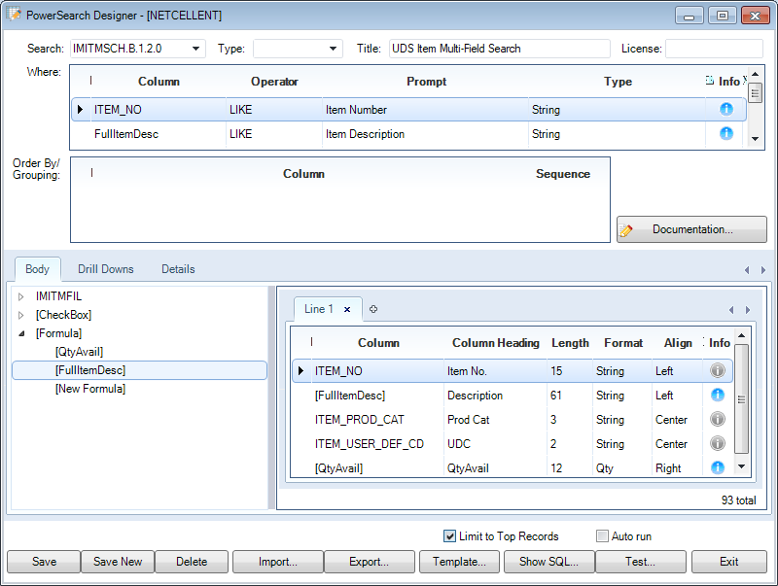
PowerSearch Example

Slide 29
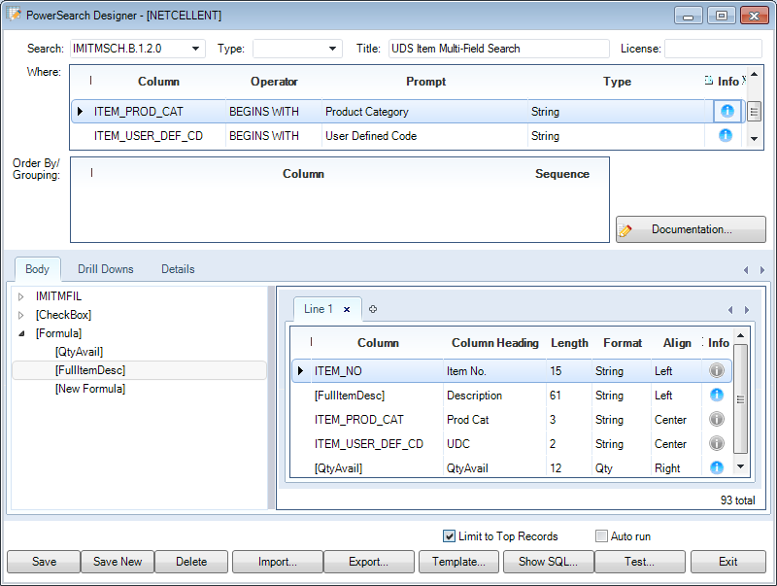
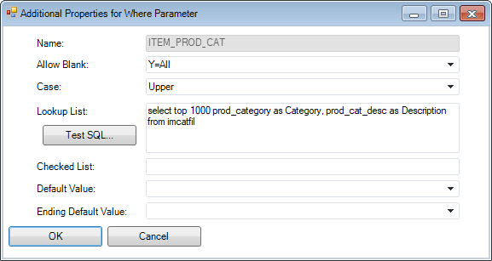
PowerSearch Example

Slide 30
Road Map
8.0 – GUI Elliott Control Center
8.2 – PDF PostOffice
8.5 – Support Alphabetic Doc Number
8.6 – Start Using Relational DB
8.7 – GUI Design (next major release)
Database compatible with 8.6
You can decide which GUI modules to use?
9.0 – Database Size Expansion
One set of DDF & one set of programs
Notes:
We can’t be fully relational if we have multiple set of DDF

Slide 31
Price Increase
It is difficult to switch ERP
One of our customer’s biggest fear:
Milking strategy
Not adding features and providing minimum support
Significantly raise maintenance fee
Elliott 8.6 will convince you on features
We reference the following to be fair:
Social Security Annual Increase
Consumer Price Index

Slide 32
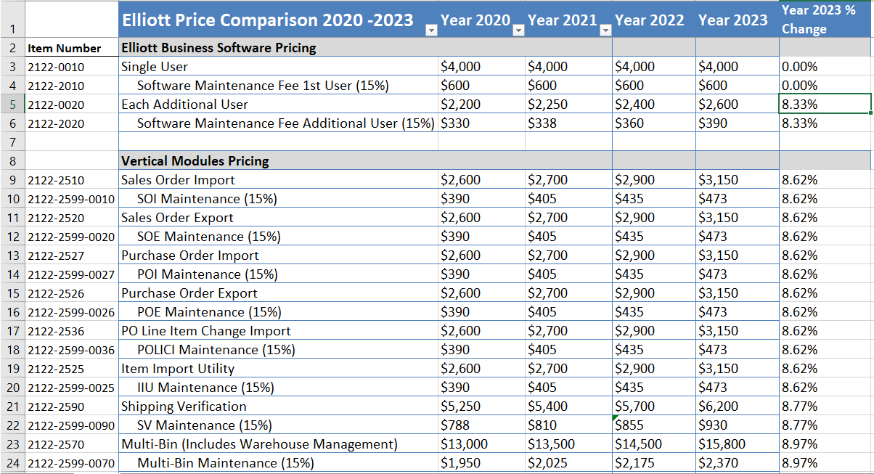
Our 2023 Target Was 8.7%
Notes:
The effective rate is actually less than 8.7%

Slide 33
Our 2024 Target Is 4%
Social Security 2024 Increase – 3.2%
Consumer Price Index (Sep) – 3.7%
Our target is 4%
Since we don’t raise the price of the 1st User
The effective rate increase is expected to be less than 4%

Slide 34
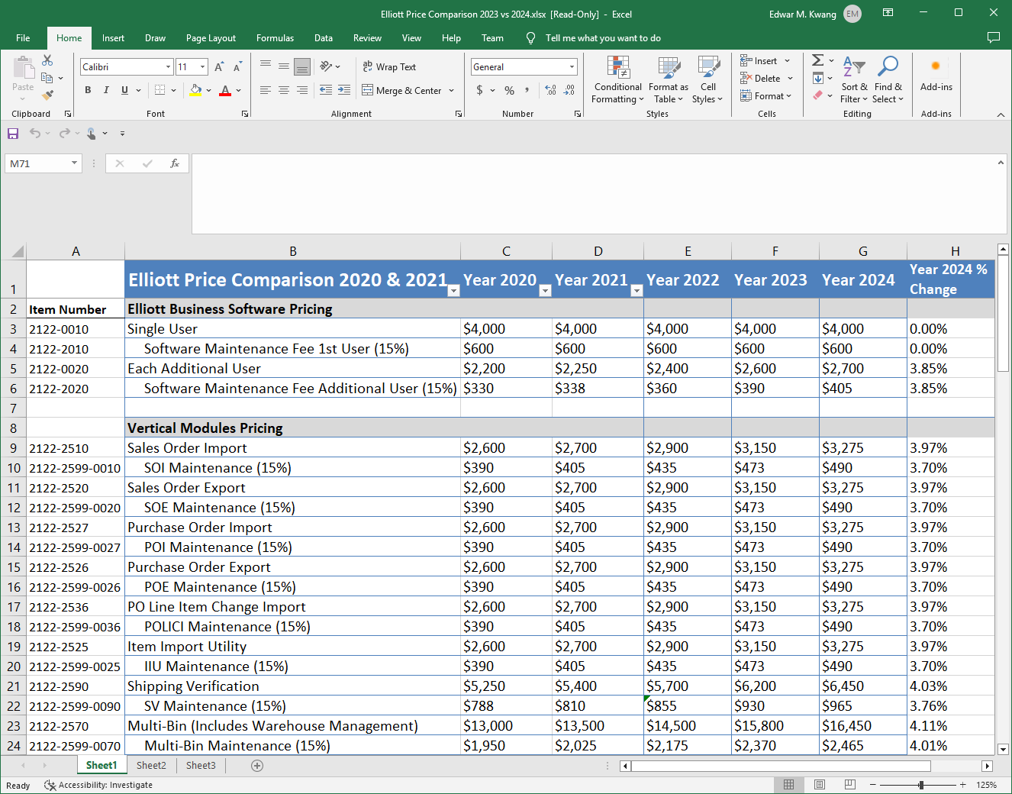
Our 2024 Target is 4%

