Slide 1
Useful Events
Edward M. Kwang
President
Notes:
The way how I am organize this presentation is, in the beginning, I will talk about Event in general. This is to benefit those users who are not familiar with Events.
For those of you who already know events very well, I promise you, in the 2nd half of this presentation, it will be relevant to you.

Slide 2
What Are Events
Events are certain activities in Elliott that users can subscribe to and get the following notifications when it happens:
Emails
Message Box
Tickler Notes (some use it as internal emails)
For example:
A customer is added
An order is deleted
A shipment is received
Notes:
Survey – how many of you do not know what “Events” is in Elliott? (Reverse question if nobody raise their hand)

Slide 3
How to Find All Supported Events
Not all events are supported
To find supported events, go to System Utilities -> System Files Setup -> Report -> Master Event List
Print all “Detail” event
Use Program ID or File Name to narrow it down.

Slide 4
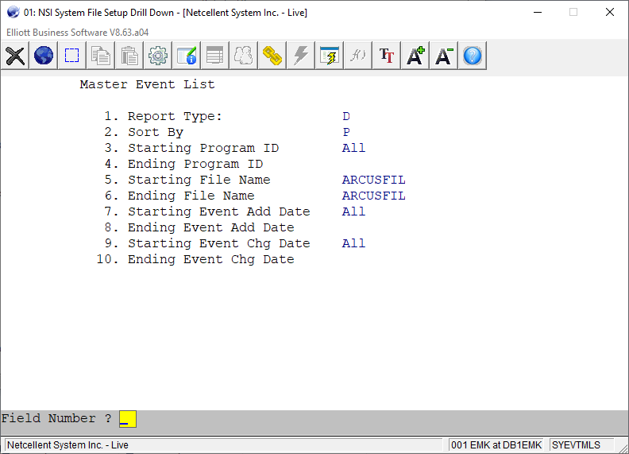
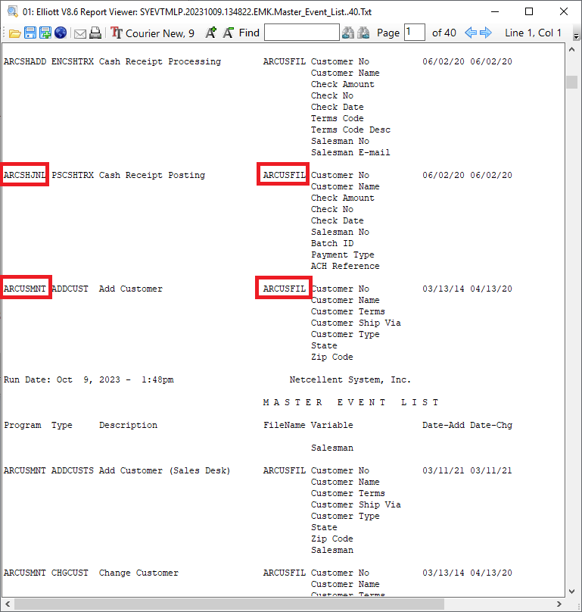
Example of Master Event List

Slide 5
Program ID & File Name
Program ID is important when
Finding out if any event is supported by a certain task – like “Cash Receipt Posting”
File Name is important when
Finding all areas that can affect certain tables like ARCUSFIL – A/R Customer File
Going to the maintenance or inquiry of that file to manage your events.
E.g. Going to Customer File maintenance or inquiry to manage events for ARCUSFIL.

Slide 6
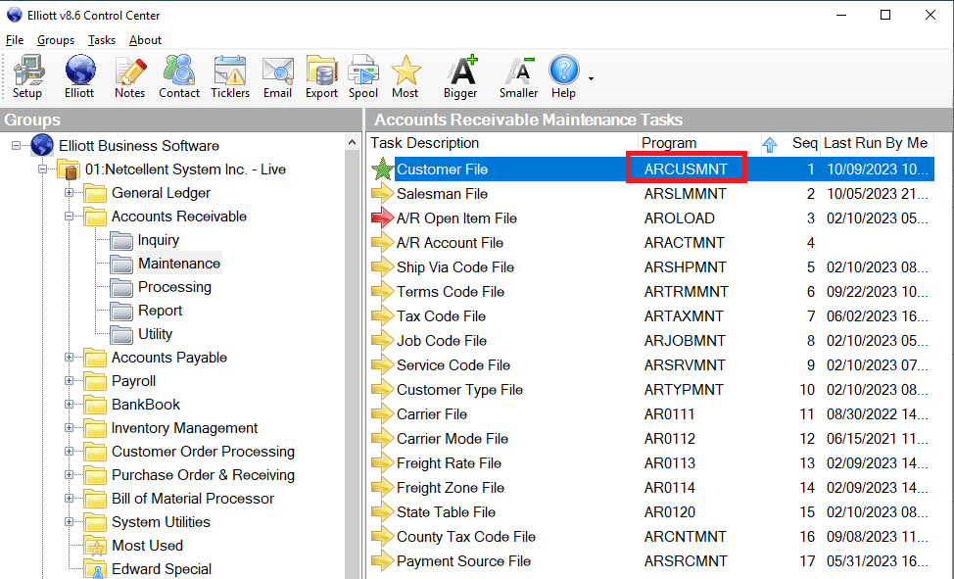
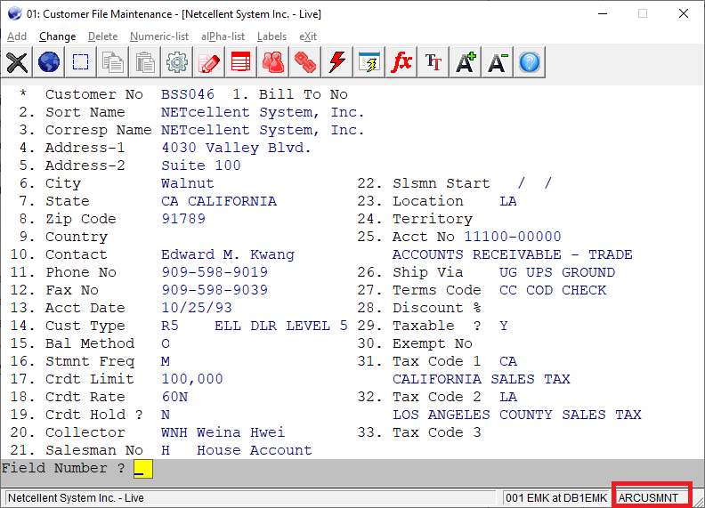
How to Find Program ID?

Slide 7
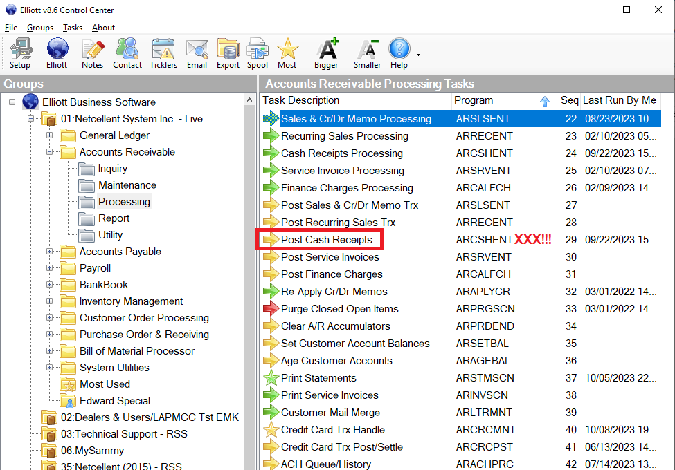
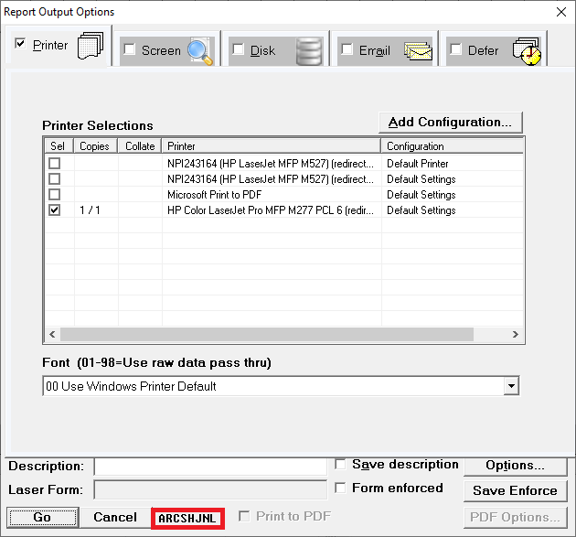
Find Printing Program’s ID

Slide 8
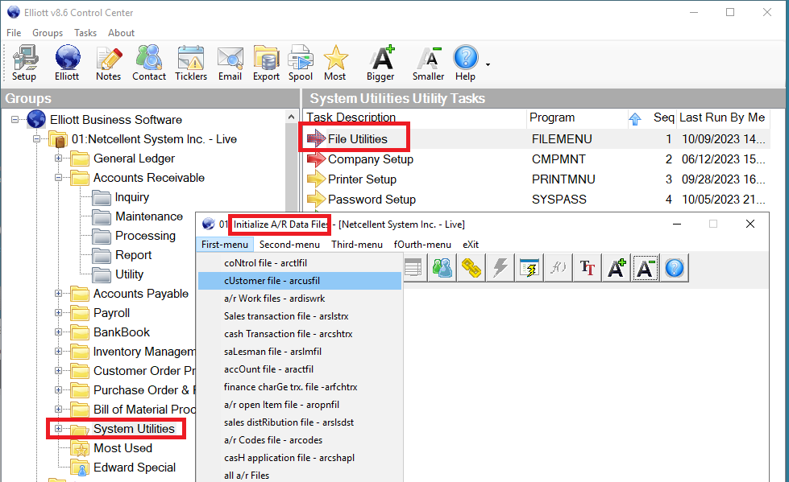
How to Find File Name?
Notes:
If you don’t have access to file initialization right, ask your Elliott supervisor to help.

Slide 9
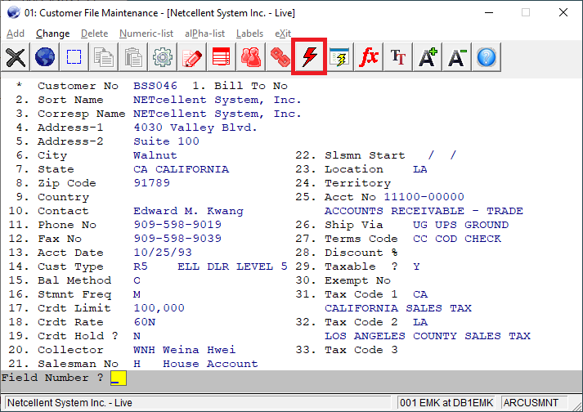
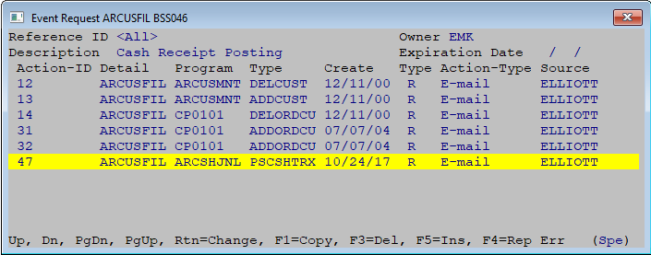
Manage Customer Events

Slide 10
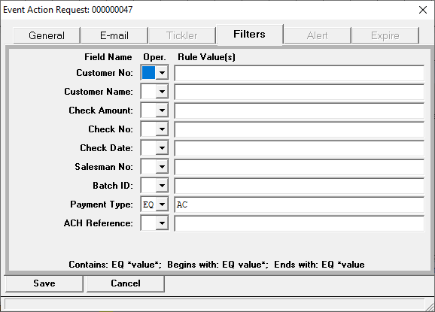
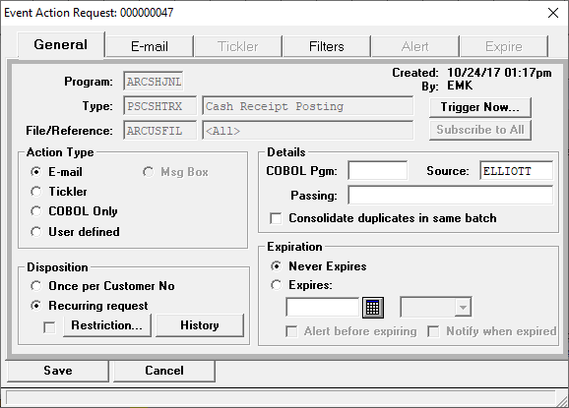
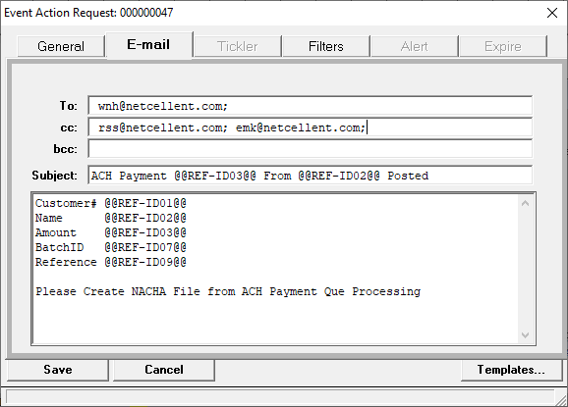
Event Detail

Slide 11
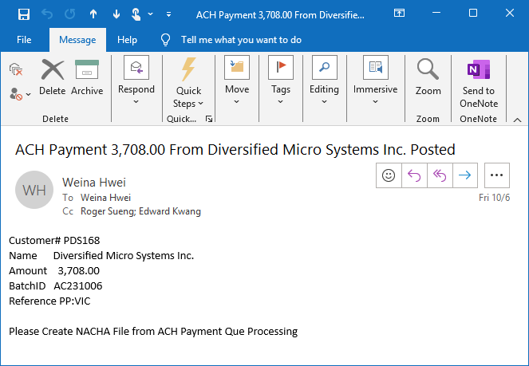
Sample Event Emails

Slide 12
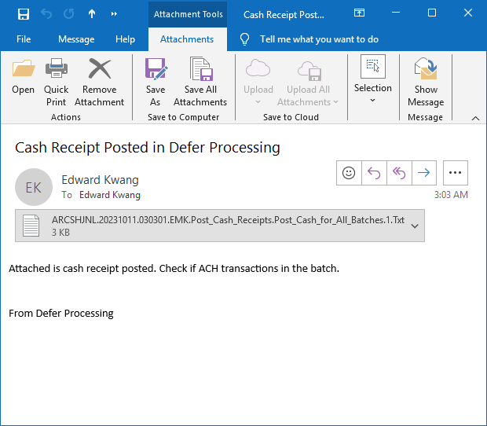
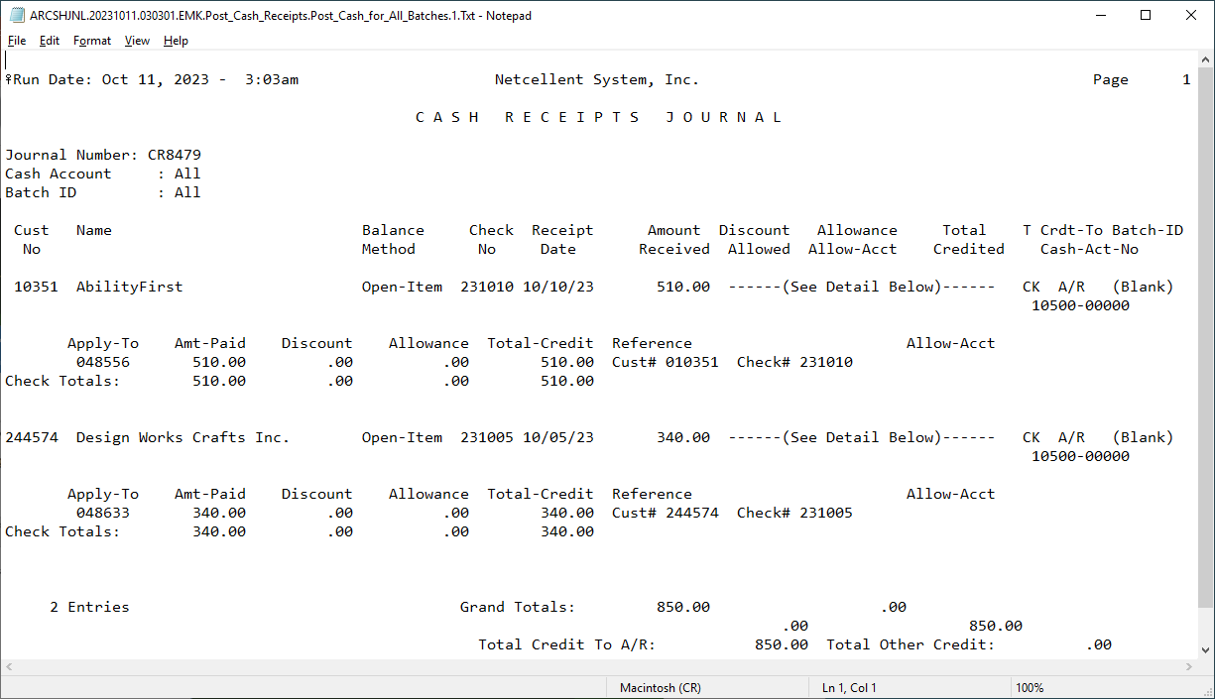
Email with Defer Processing

Slide 13
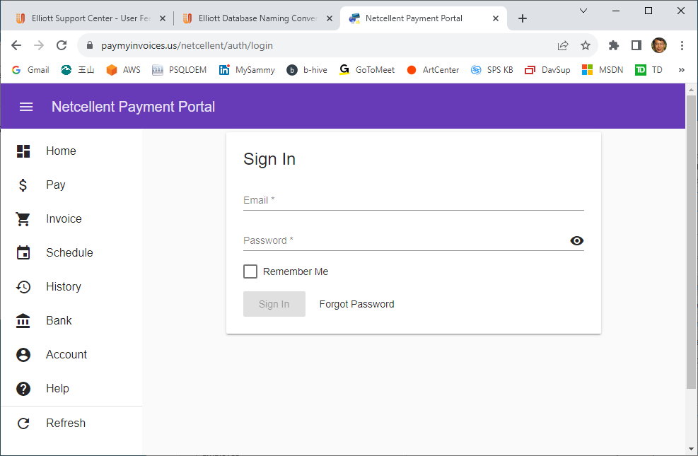
Netcellent Payment Portal
Notes:
This is a payment portal developed by Netcellent.
When you choose to pay, the payment record will be written to A/R cash as a transaction.
We use defer processing to post the cash transaction over night.
But we still need one more step. Our accounting department need to upload the ACH NACHA file to the bank portal to complete it.

Slide 14
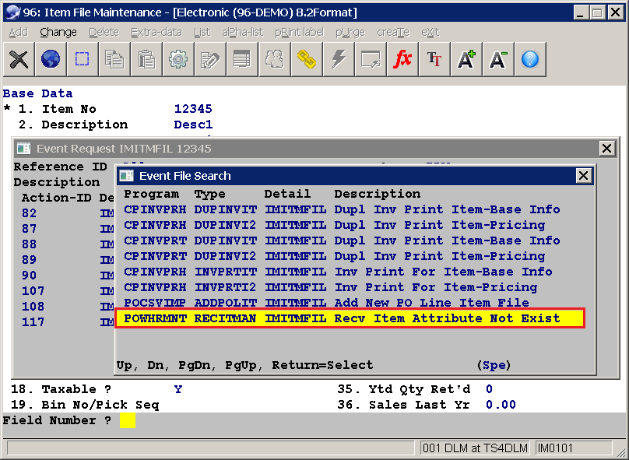
Receive Item Attribute Not Exist

Slide 15
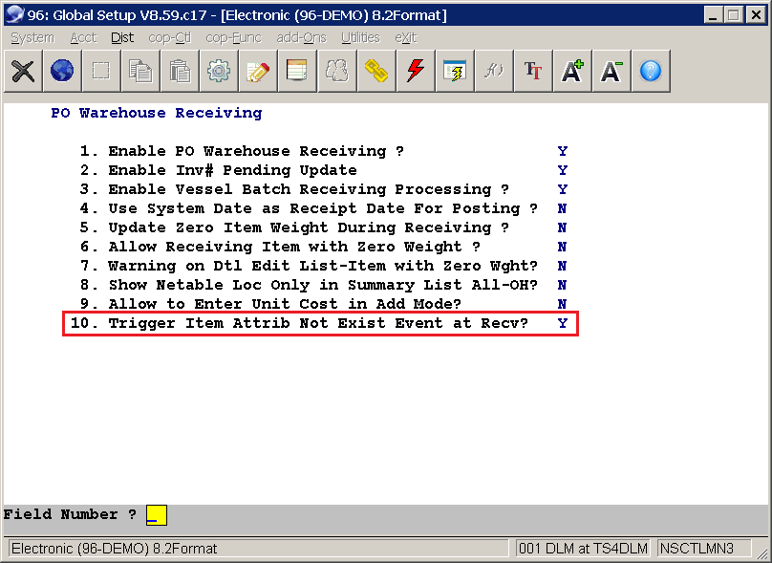
Enable Item Attrib Not Exist Event

Slide 16
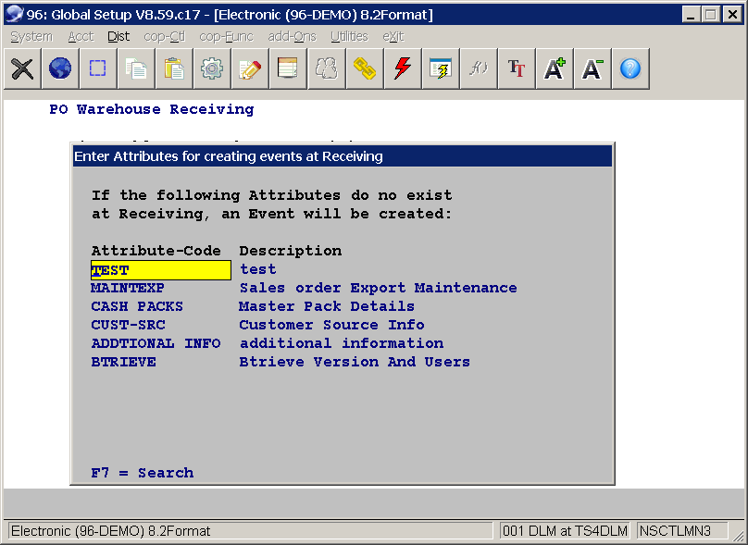
Define Required Item Attributes

Slide 17
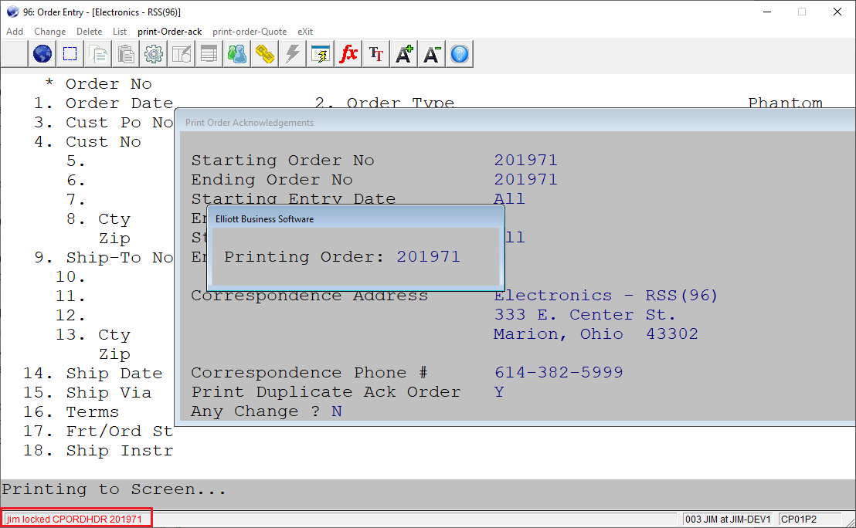
Record Locking

Slide 18
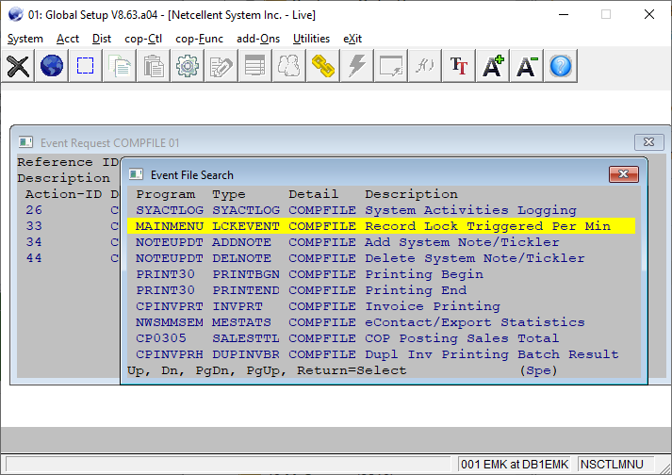
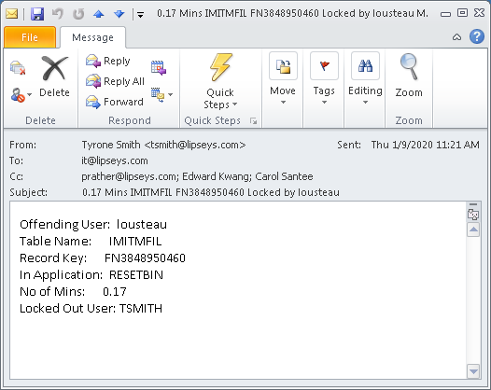
Record Locking Event to Admin
Notes:
** At End ** We know if a user is causing locking, the admin can be notified. But did you also know that you can notify the offending user too?

Slide 19
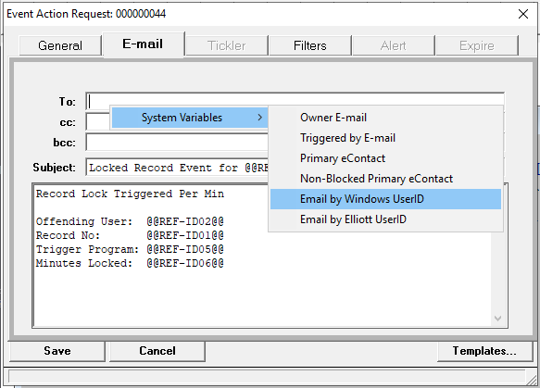
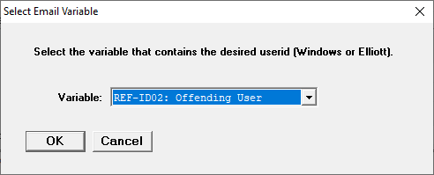
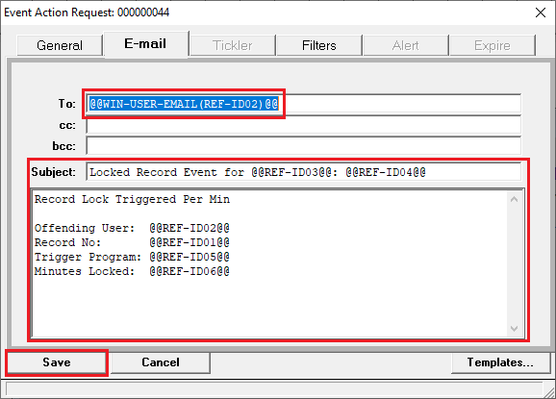
Record Locking Event to Offending User

Slide 20
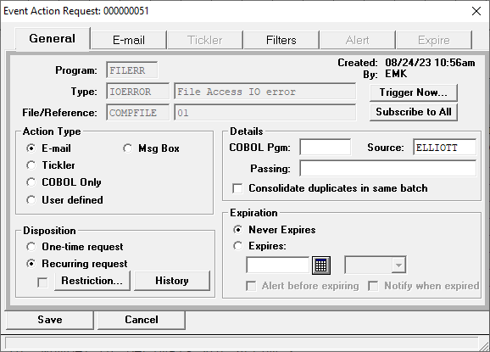
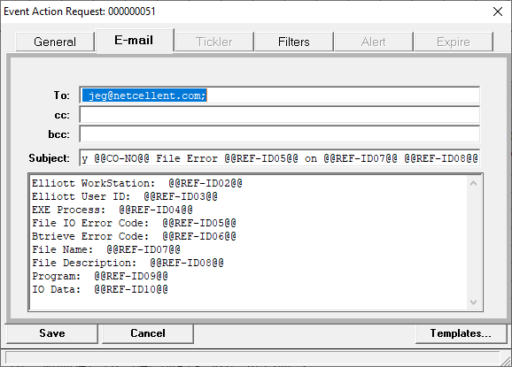
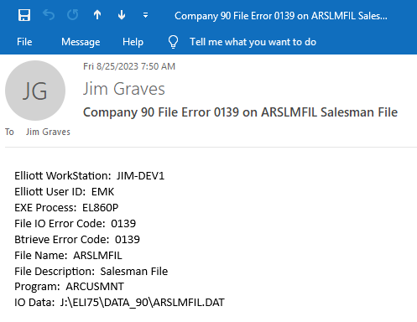
Serious File Access IO Error Event

Slide 21
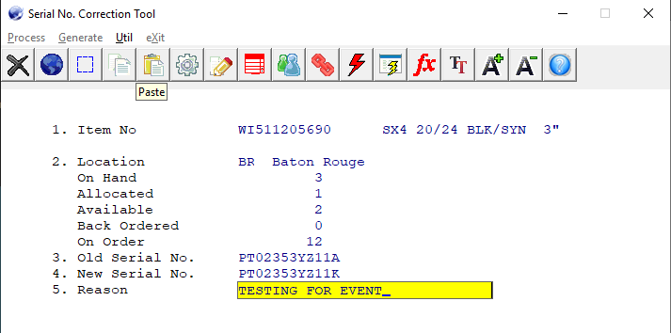
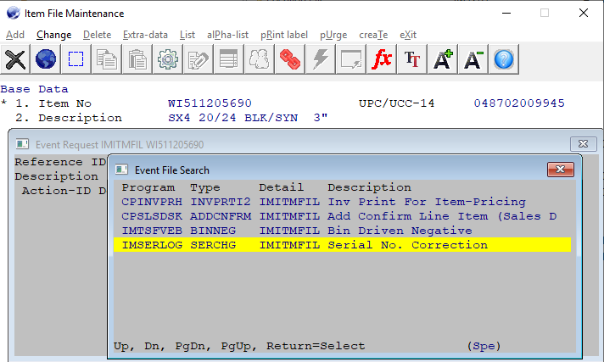
Serial No. Correction Event

Slide 22
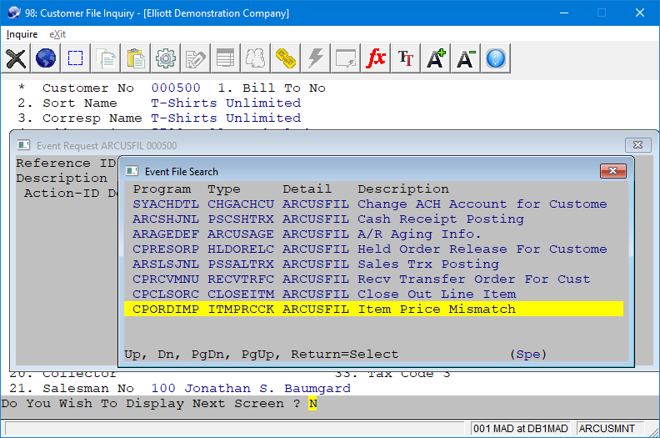
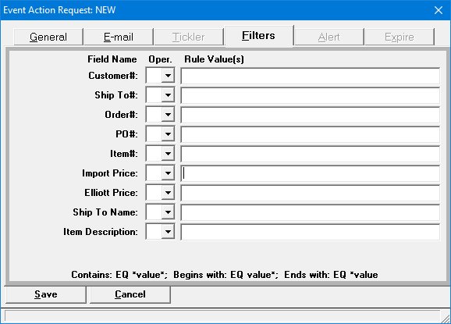
Import Price Mismatch Event

Slide 23
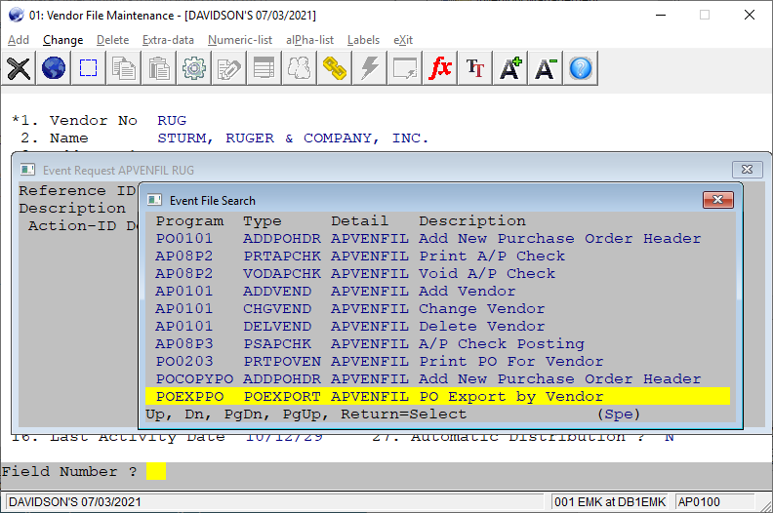
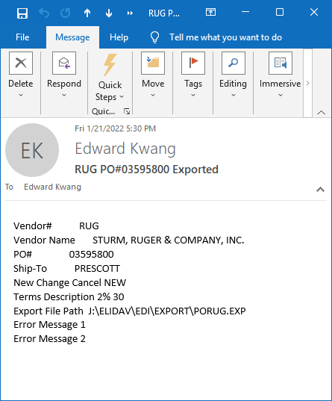
PO Export by Vendor Event

Slide 24
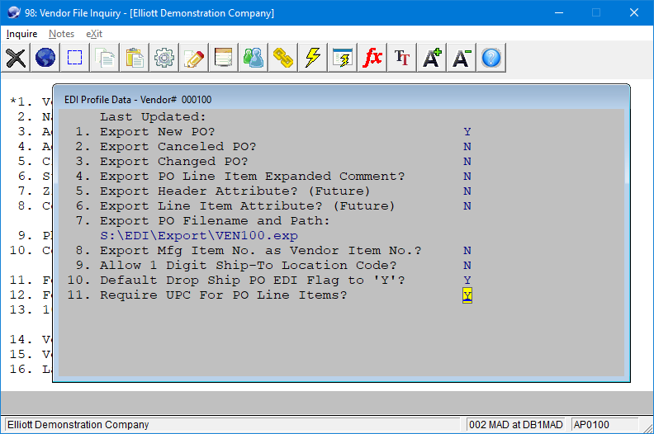
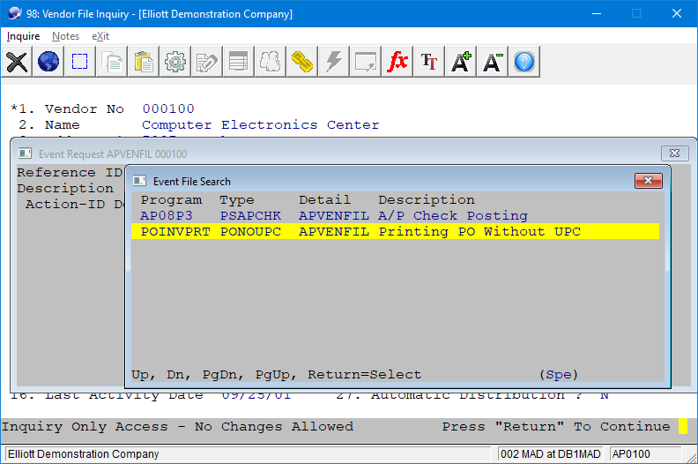
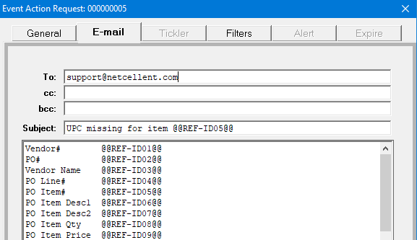
Require UPC for PO Line Item

Slide 25
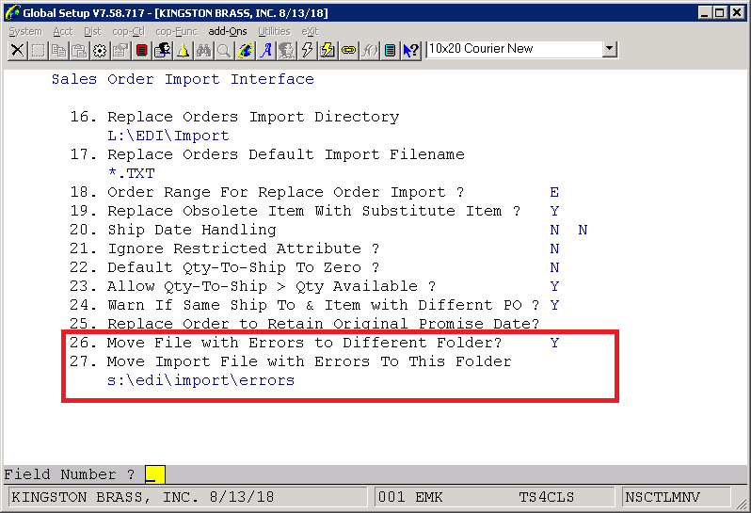
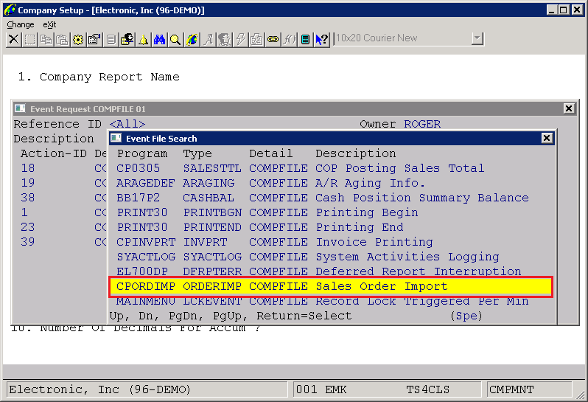
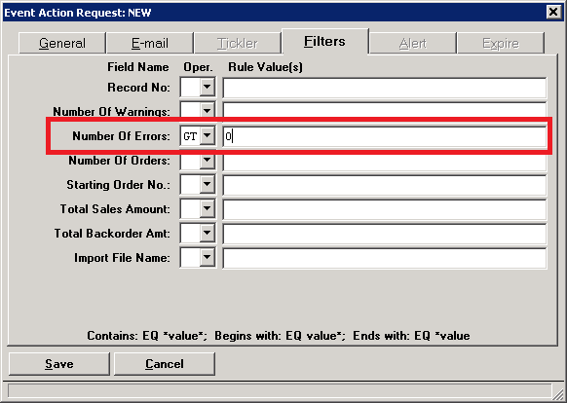
Sales Order Import Error Event
Notes:
Automate – Sales Order Import through defer processing.

